Slide 1
TOPIC: CARE TO BE TAKEN WHILE SHARING AND FORWARDING ON SOCIAL MEDIA by
NAME:KISHOR RAJABHAU YADAV CADRE:TAHSILDAR (CPTP 5)

Slide 2
What is social media?
Social media is the collective of online communication channels dedicated to community-based input,interaction,content-sharing and collaboration.for ex.
Facebook
Twitter
google+
Youtube

Slide 3
Why one needs to be careful while sharing and forwarding on social media ?

Slide 4
Forwarding Social Media Posts Equal To Endorsing It: Madras High Court
Recently the madras high court rejected the anticipatory bail of a journalist turned party leader for his allegedly derogatory facebook post on women journalists.
Key observation made by court reads as follows: “forwarding a message is equal to accepting the message and endorsing the message.”

Slide 7
Key observations
What is said is important ,but who has said it is very important in society.
When a celebrity-like person forwards messages like this,the common public will believe that this type of things are going on.

Slide 8
Words from people who are in public life should bring peace and harmony,not incite hatred and disharmony.
Talking is different from typing.Typing becomes a document,one cannot go back saying that I have not done it.

Slide 10
What types of content can land you in legal trouble?

Slide 11
You have to exercise caution on sharing or forwarding any kind of content which has
Carnal interests
Online obscenity
Defamatory content
Abuse of women
Abuse of children

Slide 12
Offence like this falls under not just IT Act but under specific provisions of the Indian Penal Code as well.
Ignorance of law is no excuse.
You cannot plead that you didn’t know the law,because you can be held accountable.

Slide 13
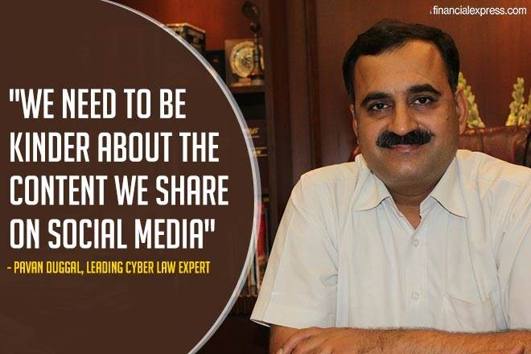

Slide 14
Points to consider before sharing on social media

Slide 15
1) Never be in a hurry to share or forward on social media.

Slide 16
2)Always take a silent count of 1 to 10 – the benefit of doing this is that it may give you a fresh perspective.

Slide 17
3)Let’s not consciously be part of the Great indian vomiting information revolution.

Slide 18
4)Any forward,retweeting or sharing on social media will now have legal consequences.Always be mindful of this.

Slide 19
5)Keep in mind that IT Act covers all your online activities in cyber sphere .Just because you are sharing or forwarding online does not make you less immune from the law or less accountable.

Slide 20
6)Exercise caution and care before you share on social media.

Slide 21
7)We need to basically do what we want others to do for us in the social circles we move in –if some content can cause harm or hurt another ,or if it can be prejudicial to their interest,avoid sharing or forwarding such content.

Slide 22
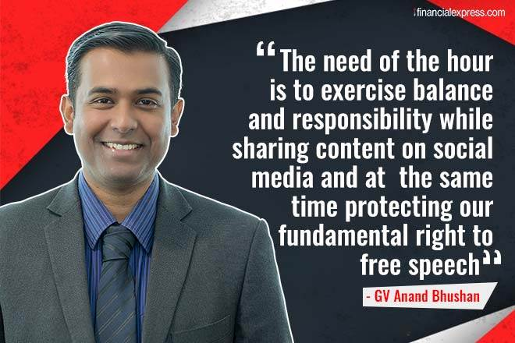

Slide 23
Thank you

