Slide 1
“What Steps To Follow If My Mobile Is Stolen Or Lost”
Presented by:
Sandip Samadhan Waghmare
(ACST)
Class – D
(CPTP-6, 2019)
YASHADA,PUNE

Slide 2
Steps to follow
Feature phone
Go to police station
Make an FIR
Submit copy of FIR to company
Get mobile ID for tracing
Submit it to police station

Slide 3
Steps to follow-Smart phone

Slide 4
Step: 1
If your phone is definitely lost, don't worry, there's still hope. Gmail to the rescue.
You can get similar results by searching "find my phone or Android device manager." You'll still need to sign in to your Gmail though.

Slide 5
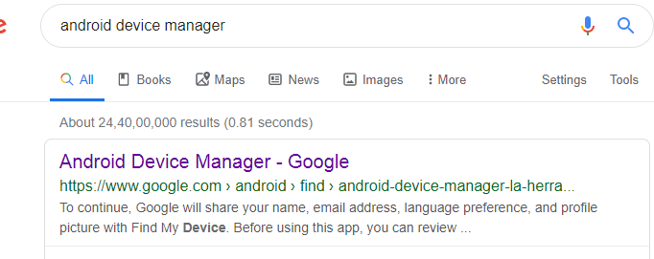
steps:2

Slide 6
Step:3

Slide 8
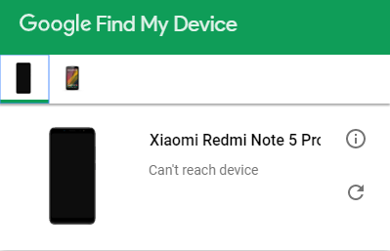
step:4
Locate Lost Android Device Click the button at the upper right corner. Android Device Manager will try to contact your Lost Android phone. Please wait patiently.

Slide 9
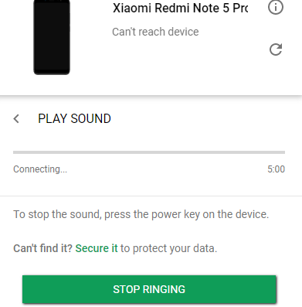
Step:5
Ring/Erase/Lock Your Lost Device Your lost Android phone is located.
As the screenshot shows, Ring: You can click the button "Ring"
and figure out whether your phone
is nearby.

Slide 10
Step:6
Lock: If the missing phone is not around you and you are worried that your phone is stolen by someone, click the "Lock" button. The current lock screen will be replaced with a password lock. You can input a recovery message, which will show on the lock screen of your lost Android and inform the guy to return it back. And it is available to enter phone number. A button to call the number will show on your lock screen.

Slide 11
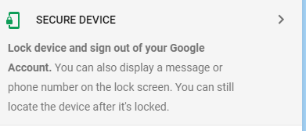

Slide 12
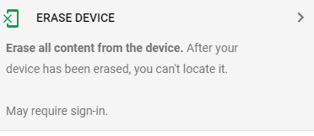
Step:7
Erase: If you think you have lost your device for good and would like to erase all data in the lost phone, click "Erase". This performs a factory reset on your device. Your apps, photos, music, and settings will be deleted.

Slide 14
Step:8
Alert the police.
You may or may not get your phone back, but you might need a police report if you have to protest fraudulent charges made with your device, and the police are definitely tracking device thefts.

