Slide 1
‘BOOK GAS REFILL ONLINE’
SOPAN TOMPE
-Batch A (DEPUTY COLLECTOR)

Slide 2
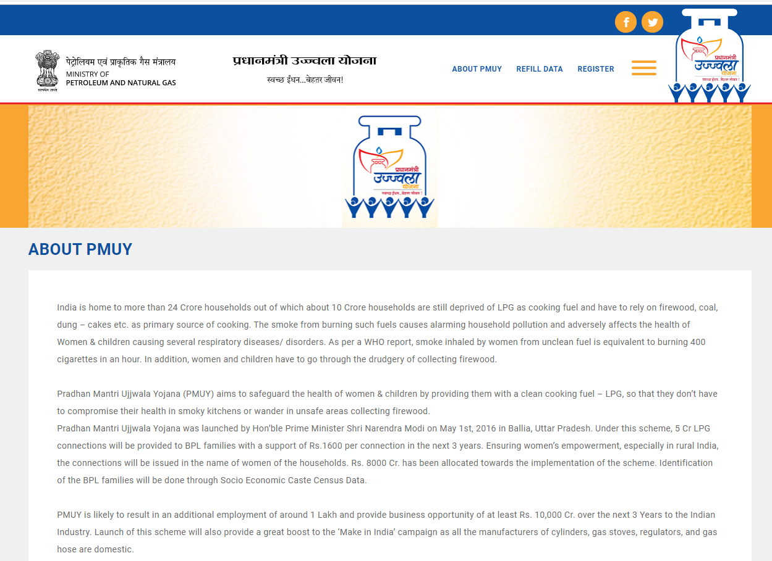
PMUY

Slide 3
SERVICE PROVIDER
HP GAS
BHARAT GAS
INDANE GAS

Slide 4
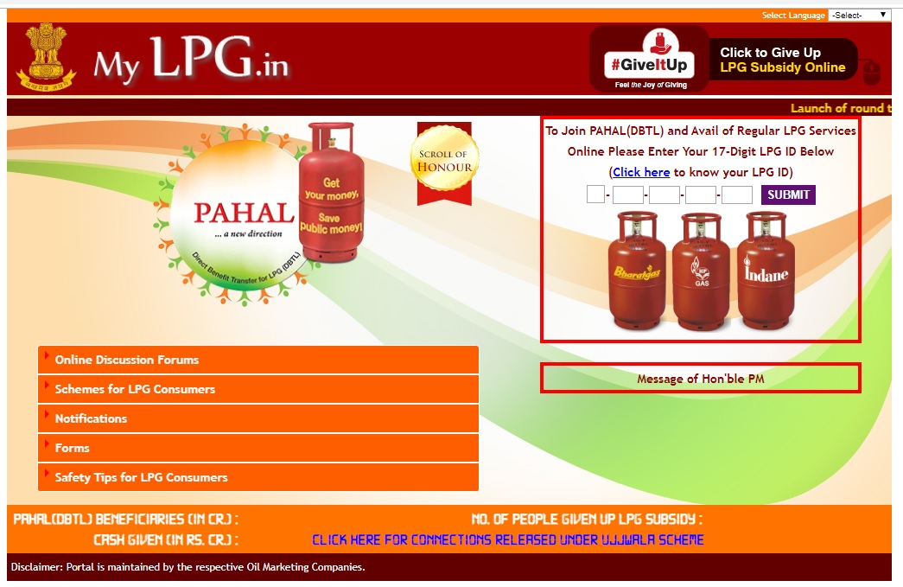
MY LPG.IN

Slide 5
DIFFERENT WAYS TO REFILL GAS
BY ONLINE WEBSITE
BY APP
BY SMS
BY IVRS/ TOLLFREE NUMBER

Slide 6
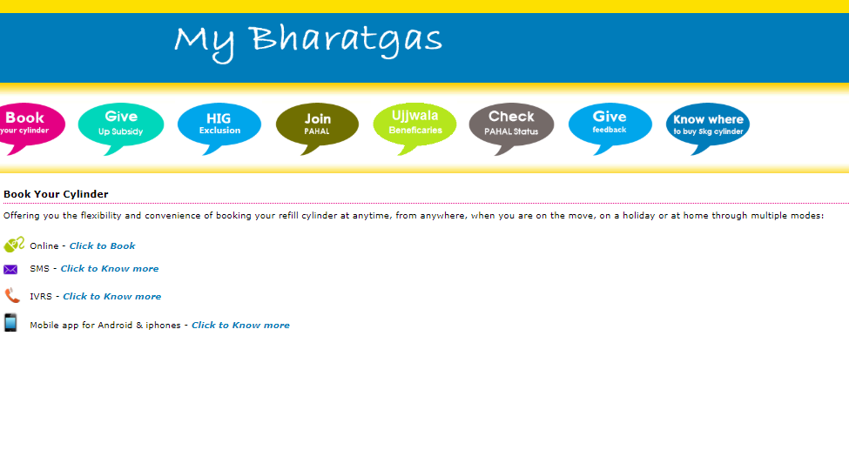
DIFFERENT WAYS TO REFILL GAS

Slide 7
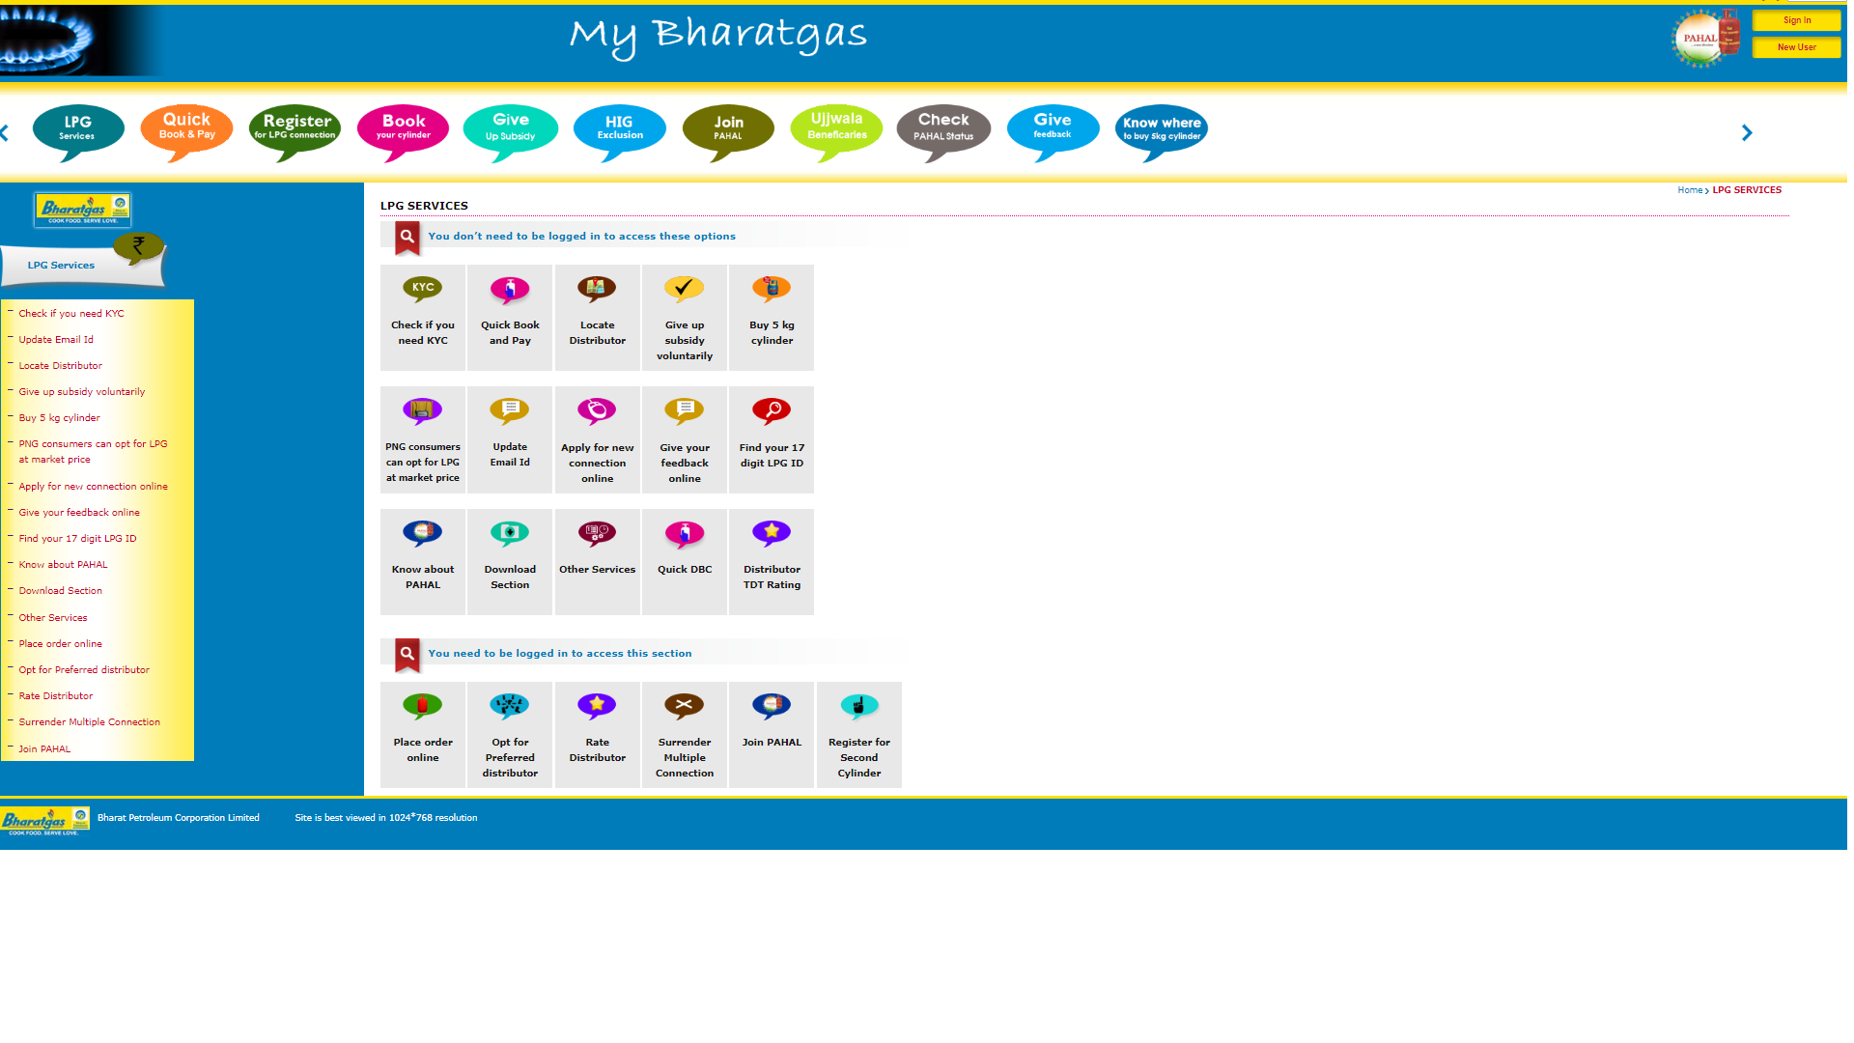
Book BHARAT GAS by using website

Slide 8
new user registration
new user
login
consumer number and regi. mobile number
login id and password
OTP

Slide 9
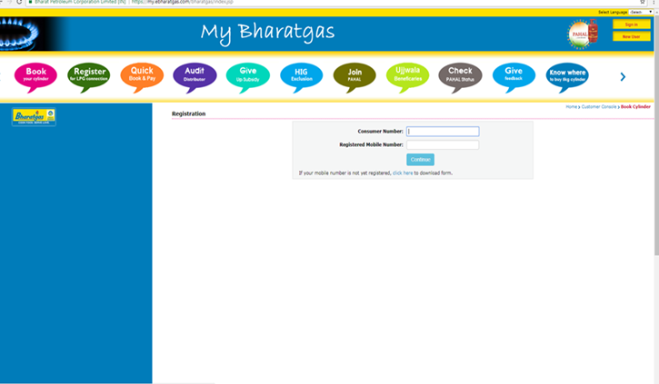
CLICK ON NEW USER fill Consumer Number And Registered Mobile Number.

Slide 10
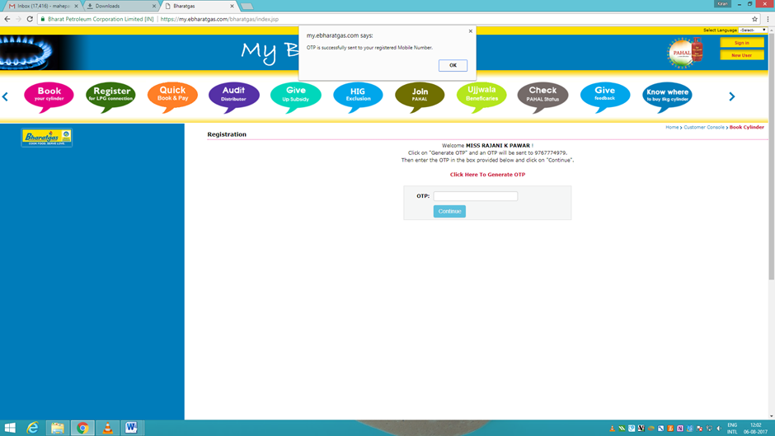
Enter OTP sent on registered mobile number.

Slide 11
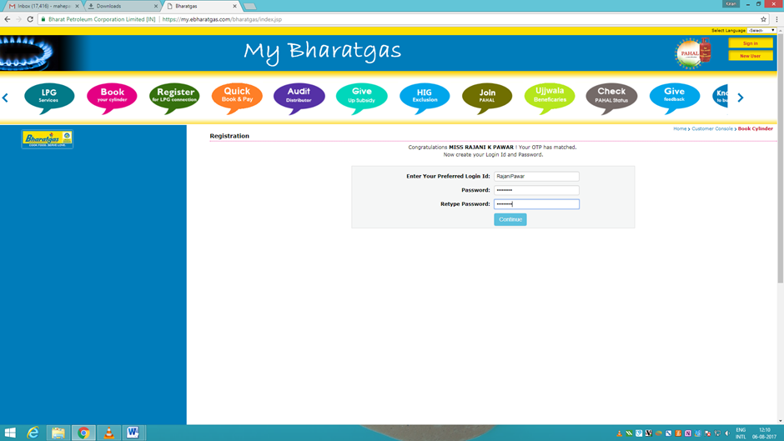
create login id and password.

Slide 12
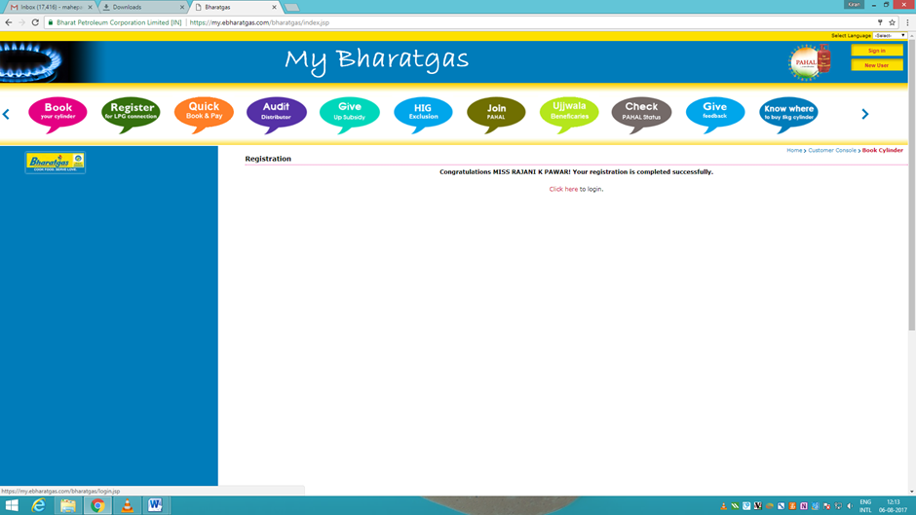
message -‘’Your registration is completed successfully’’. enter on login link.
08-11-2019

Slide 13
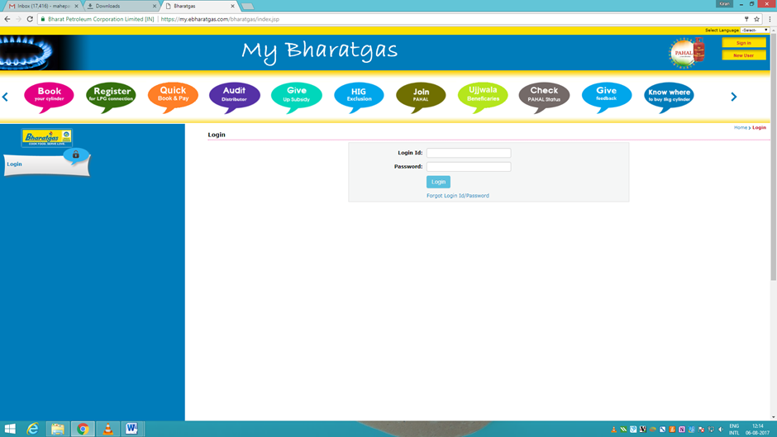
Enter login id and password.
08-11-2019

Slide 14
steps
Book Cylinder
Order completed
Book now
different modes of payment
Make Payment

Slide 15
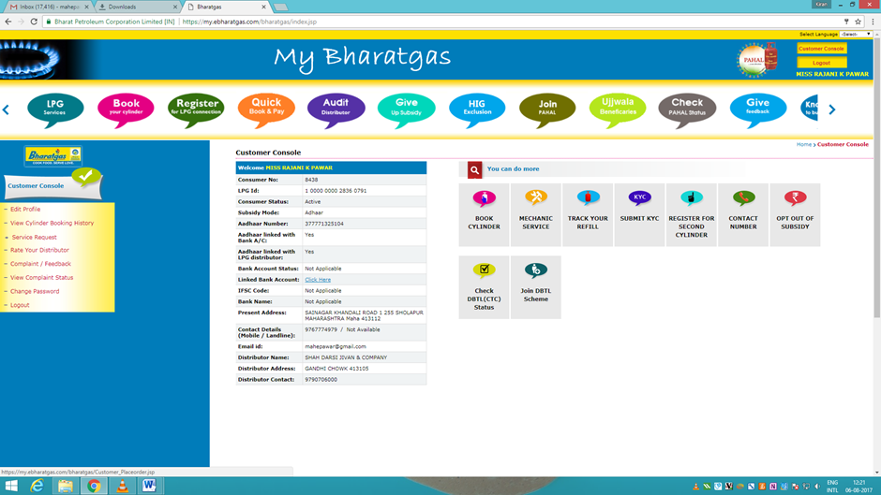
After login, Click on option ‘Book Cylinder’.

Slide 16
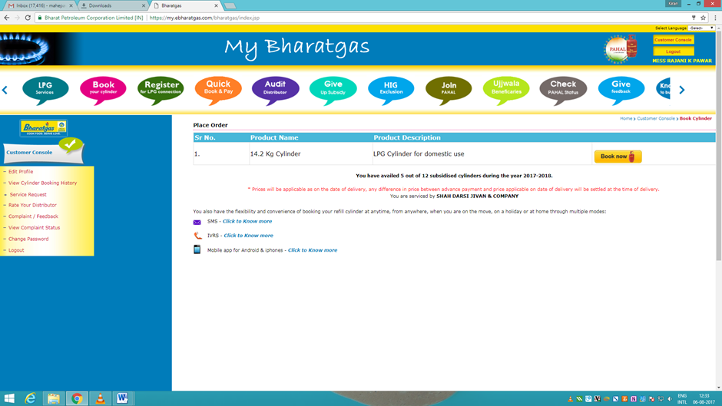
Click on ‘Book now’.

Slide 17
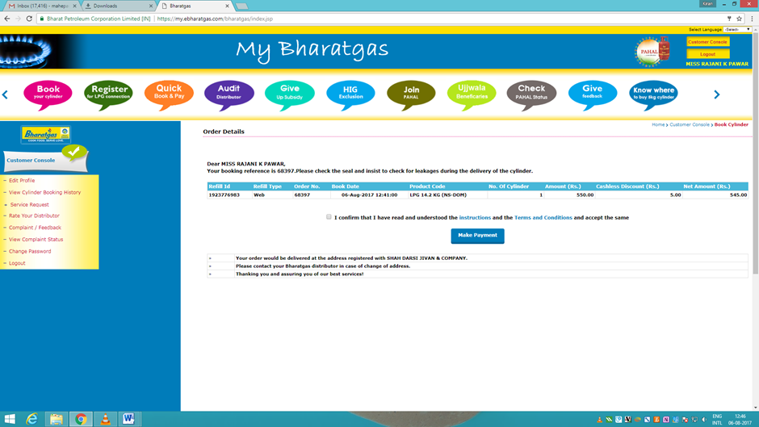
rate of cylinder, order no , refill id etc. click on ‘Make Payment’.

Slide 18
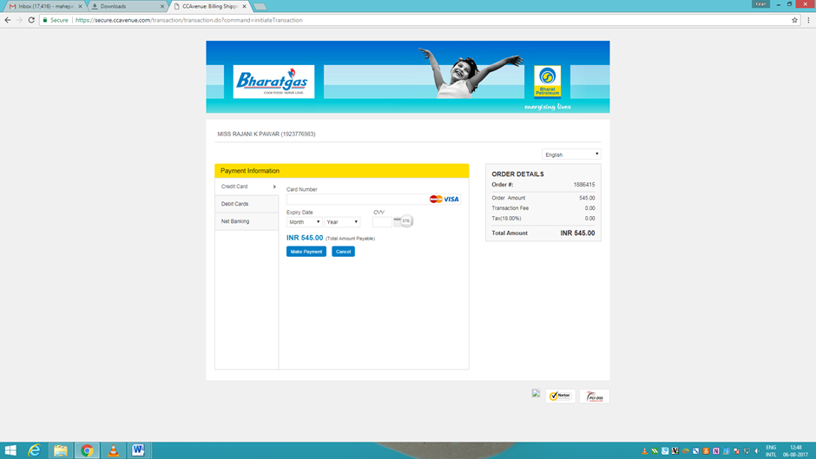
different modes of payment

Slide 19
BENEFITS
USER FRIENDLY
SAVES TIME AND MONEY
TRANSPARENT

Slide 20

THANK YOU

