Slide 1
GET MY SOIL HEALTH CARD
SURYAWANSHI VIJAYKUMAR GANGADHARRAO
( PROBATIONARY DEPUTY COLLECTOR )
CLASS A
ROLL NO.30

Slide 2
About SHC Scheme
Scheme of DAC under MoAFW.
Printed Report containing status of the soil w.r.t. 12 parameters.
Issues advisory on the types & quantities of fertilizers to be applied on farm based on the soil nutrient status.
Also advises about soil reclamation to be undertaken for optimising yields.

Slide 3
WHAT IS SOIL HEALTH CARD
N
P
K
MACRO NUTRIENTS
B
Zn
Fe
Cu
Mn
MICRO NUTRIENTS
Ph
EC
OC
PHYSICAL PARAMETERS
Sulphar
SECONDARY NUTRIENTS

Slide 4
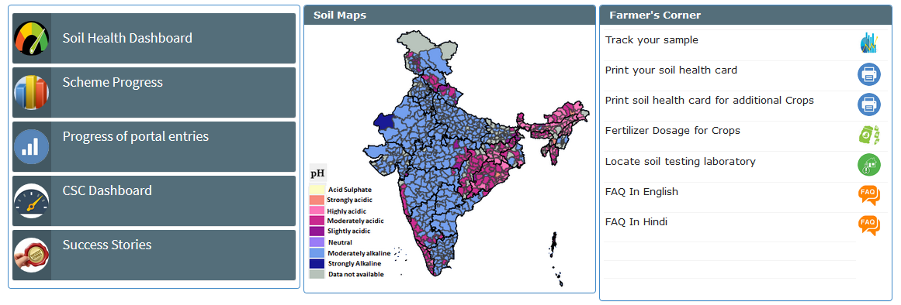
KCC Toll Free No. 1800 180 1551
https: //soilhealth.dac.gov.in/

Slide 5
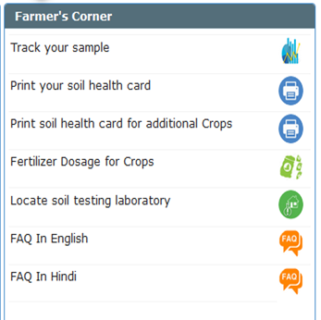
1.Locate STL

Slide 6
2.Track Your sample

Slide 7
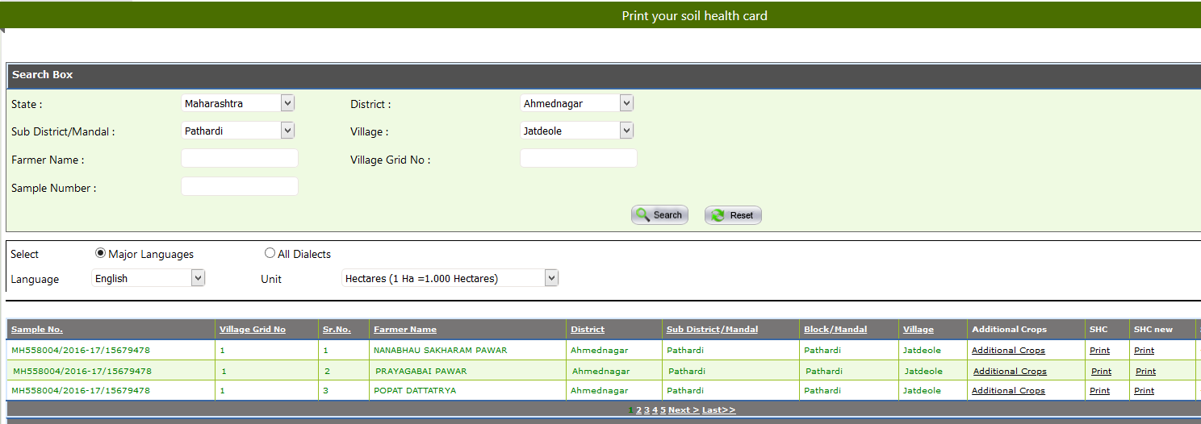
3.Print My
SHC

Slide 8
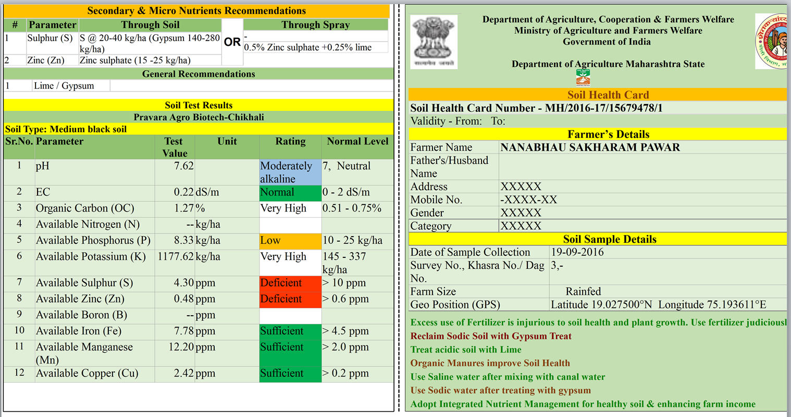

Slide 9
SURYAWANSHI VIJAYKUMAR GANGADHARRAO
( PROBATIONARY DEPUTY COLLECTOR )

