Slide 1
Create And Send Mail Merge-notice(combined Output) by
NIKHIL ARUN SONAWANE
ACST, BATCH-A
ROLL NUMBER A04

Slide 2
What is mail merge?
Mail Merge is a powerful tool for writing a personalized letter or E-mail to many people at the same time.
A common usage is for creating "personalized" letters, where a template is created and when executed, the mail merge creates a letter for each record in the database, so it appears the letter is more personal.

Slide 3
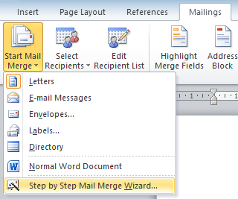
How to use mail merge:
Step 1: In a blank Microsoft word document, click on the mailings tab, and in the start mail merge group, click start mail merge.
Step 2: Click step-by-step mail merge wizard.

Slide 4
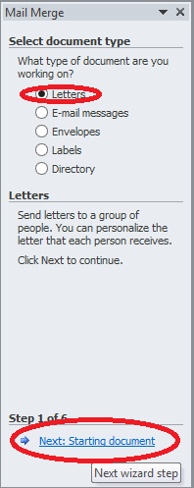
Step 3: Select document type. Here we will select Letters. Click on Next: Starting document.

Slide 5
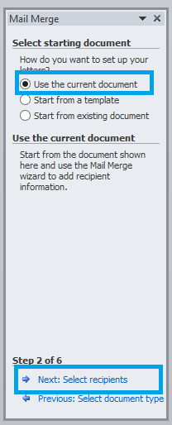
Step 4: Select Use the current document and then click Next: Select recipients.

Slide 6
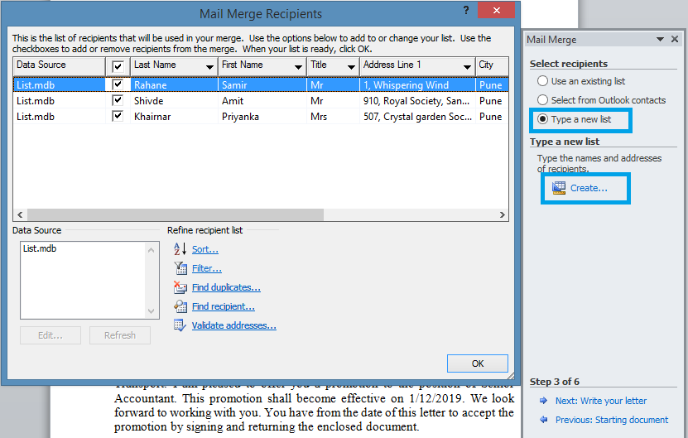
Step 5: Select recipients. In this demo we will create a new list, so select Type a new list and then click Create.
Click Next: Write your letter.

Slide 7
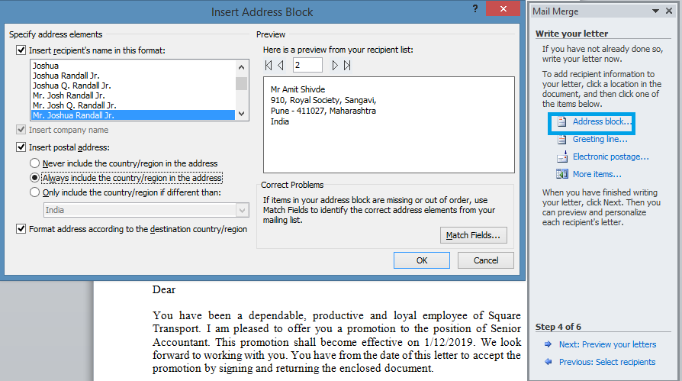
Step 6: Click Address block to add the recipients' addresses at the top of the document.
Click on Next: preview your letters

Slide 8
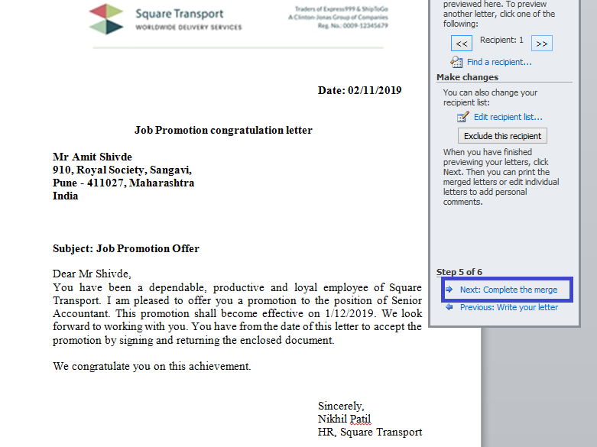
Preview of letter:
Step 7:Click on Next to complete the Merge

Slide 9
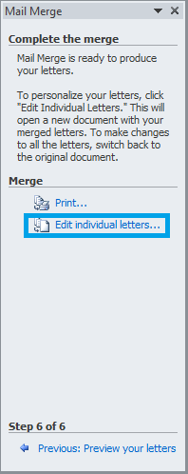
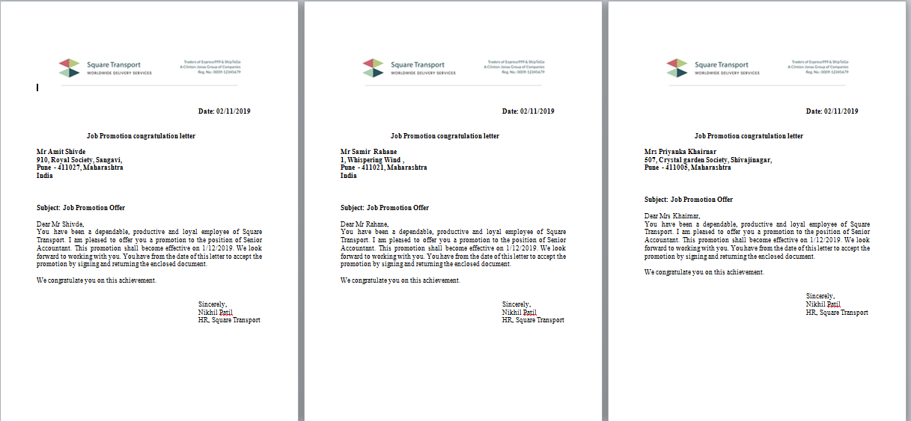
Step 8: Click Print to print letters or Edit individual letters to further personalize some or all of the letters.
Last step is to print letters and send it to respective employee address.

Slide 10


