Slide 1
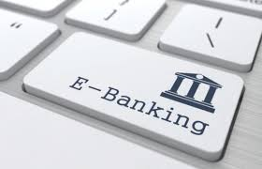
SONAWANE ANIKET GIRIDHAR (TAHSILDAR) Batch C Roll no. 3

Slide 2
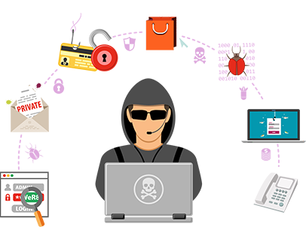
Secure my online banking transactions and take care of information safety

Slide 3
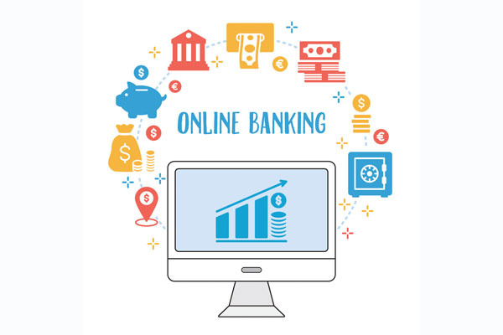
What is online banking
Banking in which costumer view their account details and transfer
Delivery of products and services through electronic medium
Ex. Cash withdrawl, online statement, small saving certificates

Slide 4
Why internet banking
Any time banking
Any where banking
Cash free banking
Online purchases, online payments
Ex. Shopping on myntra, flipkart, Electricity bill
Better customer relationship
Avoid physical appearance at branch
Save time

Slide 5
services
View account balance
Bill payments
Cash withdrawl
Loan application and transactions
Credit card and debit card
Insurance, PPF, Mutual funds,
Bank statements
chequebook

Slide 6
Security risk
Increasing no. of fraudulent websites
Fake emails
Bombarding of phishing mails, trojan horse programs
Hacking
Impersonated calls

Slide 7
Security options
Always use licenced version of software's
Check authenticity before downloading
Do not click on any links, messages
Completely logout after banking session
Use newer version of operating system
Use newer version of browser
Always enable firewall
Use antivirus
Use secured websites

Slide 8
Use incognito tab
Don't share your bank account details to anyone
Ex. CVV, debit card no.
avoid access internet banking account from public Wifi
Change password periodically
Do not share OTPs and password

Slide 9
Thank You
Sonawane Aniket Giridhar
(Tahsildar)

