Slide 1
AADHAAR CARD
APPLICATION, DOWNLOAD, VERIFICATION AND UPDATION
By
Shweta Suresh Pawar
Tahsildar (CPTP 4A)
Class A
Roll No 32

Slide 2
HOW TO APPLY FOR AADHAAR CARD?
Visit www.uidai.gov.in
Locate an Enrolment / Update center near you
Book an Appointment at UIDAI run Aadhaar Seva Kendra
Register your biometric and demographic data at the Kendra

Slide 3
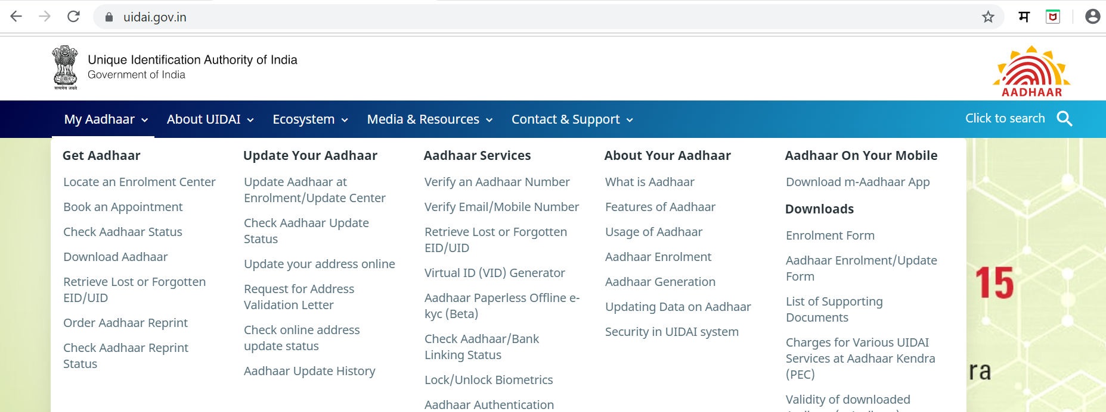
HOW TO APPLY FOR AADHAAR CARD?

Slide 4
HOW TO APPLY FOR AADHAAR CARD?
Biometrics
Demographics
Iris
Fingerprint
Photograph
Date of Birth
Name
Address
Gender
Mobile
Email

Slide 5
HOW AADHAAR GETS GENERATED?

Slide 6
How to download aadhaar?
Step 1: Keep Your Aadhaar Card or Enrolment Number Ready
If you don’t have your Aadhaar: Keep your enrolment number along with the time and date provided in the acknowledgment slip ready

Slide 7
How to download aadhaar?
Step 2: Visit UIDAI Website
Visit https://uidai.gov.in
‘Aadhaar Online Services’
Download Aadhaar
Fill required details

Slide 8
Fill Required Details
How to download aadhaar?

Slide 9
How to download aadhaar?
Step 3: Request for TOTP/OTP
Enter a TOTP If NOT click on ‘Request OTP’
Step 4: Enter OTP
Enter the OTP received within a few seconds in the field provided

Slide 10
How to download aadhaar?
Step 5: Enter Password
Password
First four letters of name (In block letters)
Birth Year
For instance, if your name is THOMAS and your birth year is 1989, your password will be THOM1989

Slide 11
VERIFICATION OF AADHAAR
1. Visit UIDAI's website: www.uidai.gov.in
2. On the website, under the head 'Aadhaar Services', click on 'Verify Aadhaar Number’
3. You will be redirected to a new page

Slide 12
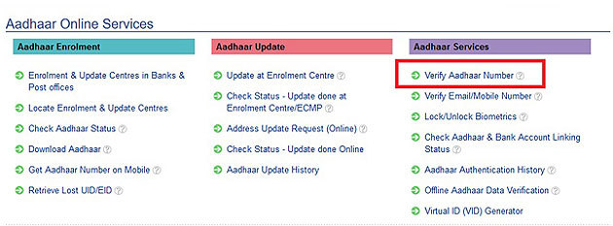
VERIFICATION OF AADHAAR

Slide 13
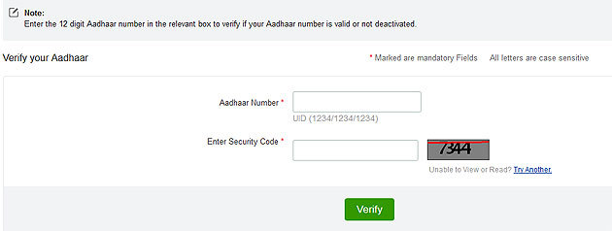
VERIFICATION OF AADHAAR
On that page, you will be required to enter your 12-digit Aadhaar number and the captcha code

Slide 14
UpdaTIng aadhaar
Three ways to update or correct your details:
1. Update online 2. Request update by post {Not in practice currently} 3. Visit a nearby enrolment centre

Slide 15
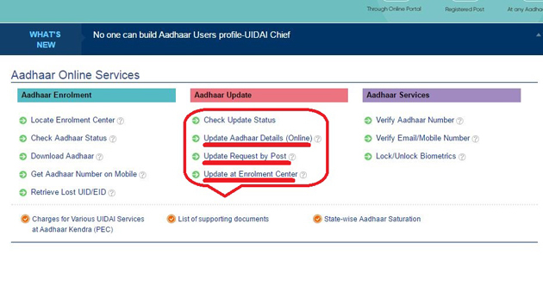
UpdaTIng aadhaar

Slide 16
UpdaTIng aadhaar
Updating Online:
Registering Mobile Number is mandatory
ONLY DEMOGRAPHIC DETAILS can be updated online (Name, Address, DoB, Gender, Mobile & Email)

Slide 17
UpdaTIng aadhaar
Updating Online:
Scan and upload supporting self-attested Proof
Aadhaar card Update Request Number can be used to track the status of request

Slide 18
UpdaTIng aadhaar
Visiting nearby enrolment centre for update:
Both demographics & biometrics (Finger Prints, Iris & Photograph) can be updated
Carry original documents

Slide 19
THANK YOU

