Slide 1
Name of OT:
Vishwas Pundlikrao Shirsath
Cadre : Deputy Collector
Topic: Use Login ID & Passwords on Public Computers Using Safety tips

Slide 2

Introduction
Whether you’re surfing the web on a Public computers, you’re at risk.
While these computers are free to use and are often equipped with some form of protection, just like any other machine that accesses the Internet, they do have their share of vulnerabilities.
Since users of public computers can’t necessarily download the latest antivirus protections, it’s important to know what measures can be taken to protect personal information from prying eyes.

Slide 3
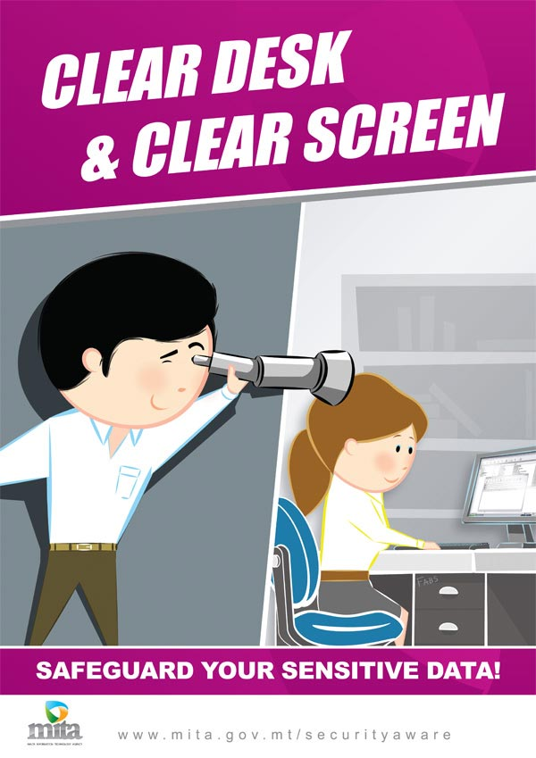
Safety Tips when Using a Public Computer
1. Don't leave the computer unattended with sensitive information on the screen.

Slide 4
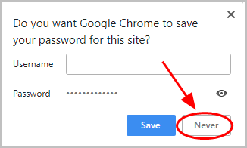
2. Don't save your login information.
Always log out of websites by clicking "log out" on the site.
It's not enough to simply close the browser window or type in another address.
Many programs (especially social networking websites, web-based email, and instant messaging systems) include automatic login features that will save your user name and password.
Disable this option so no one can log in as you after you have finished using the computer.

Slide 5
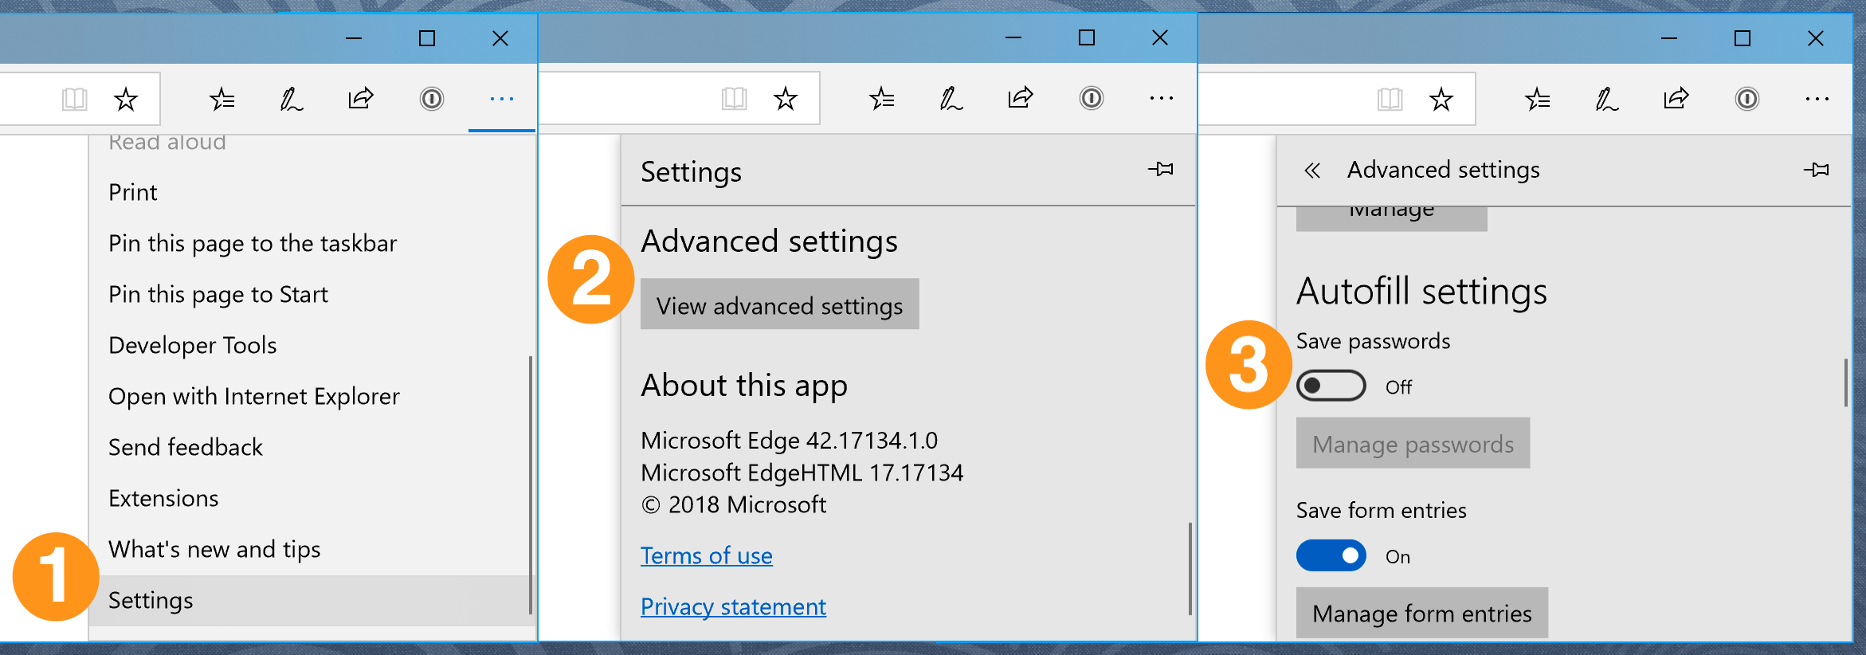
3.Disable the feature that stores passwords.
Before you start surfing the web, turn off the Internet Explorer feature that ‘remembers’ your passwords.
Click the "Content" tab, and then click "Settings", next to "Autofill setting".

Slide 6
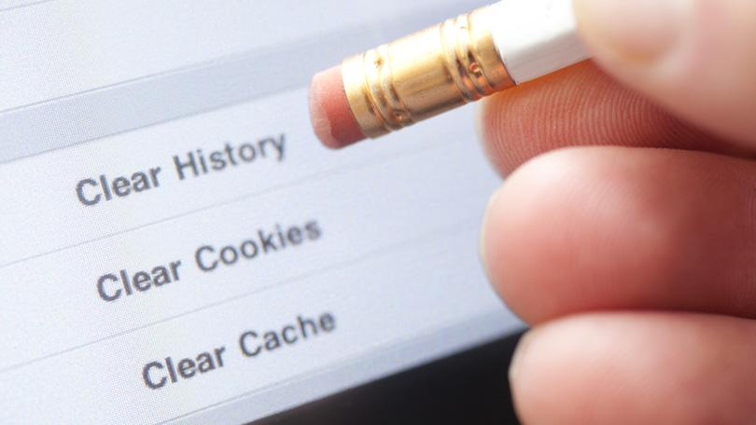
4. Erase your tracks.
In the top-right corner of the browser window, click the Chrome menu.
Select 'history'.
Click the button 'clear browsing data'. A dialog box will appear.
From the drop-down menu, select how much history you want to delete.it will include in 'browsing history.'
Click the button 'clear browsing data.'

Slide 7
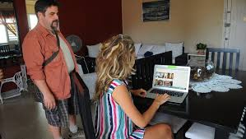
Watch out for over-the-shoulder snoops.
When you use a public computer, be on the look out for thieves who look over your shoulder or stand particularly close to you in order to take note of your sensitive information (such as passwords) as you enter them on the computer.

Slide 8
6. Don't enter sensitive information into a public computer.
The above measures provide some protection against casual hackers who use a public computer after you have.
But keep in mind that a really industrious thief might have installed sophisticated software on the public computer that records every keystroke and then emails that information back to him.
Then, it doesn't matter if you haven't saved your information or if you've erased your tracks. They still have access to this information.
If you really want to be safe, avoid entering any sensitive information into any public computer, especially your credit card number or any other personal or financial details.

Slide 9


