Slide 1

    Track status
    of
  a Court Case
By
Sayali Anant Shirke
Assistant Commissioner of State tax
Batch- CPTP 5 (2017)

Slide 2

INTRODUCTION
The ECourts Project was conceptualized on the basis of the “National Policy and Action Plan for Implementation of Information and Communication Technology (ICT) in the Indian Judiciary – 2005” submitted by e committee, Supreme Court of India with a vision
To transform the Indian Judiciary by ICT enablement of Courts.

Slide 3
Aim of ecourt services
To provide efficient & time-bound citizen centric services delivery
To automate the processes to provide transparency in accessibility of information to its stakeholders.
To enhance judicial productivity, both qualitatively & quantitatively, to make the justice delivery system affordable, accessible, cost effective, predictable, reliable and transparent.

Slide 4
STEPS TO BE FOLLOWED
1. Website- www.ecourts.gov.in
2. Search by CNR Number
3. On clicking the search button, the current status and entire history of the status will be shown
4.If you don’t know CNR Number then click on case status and search by other options like Case registration number, Party name, Advocate name etc.

Slide 5
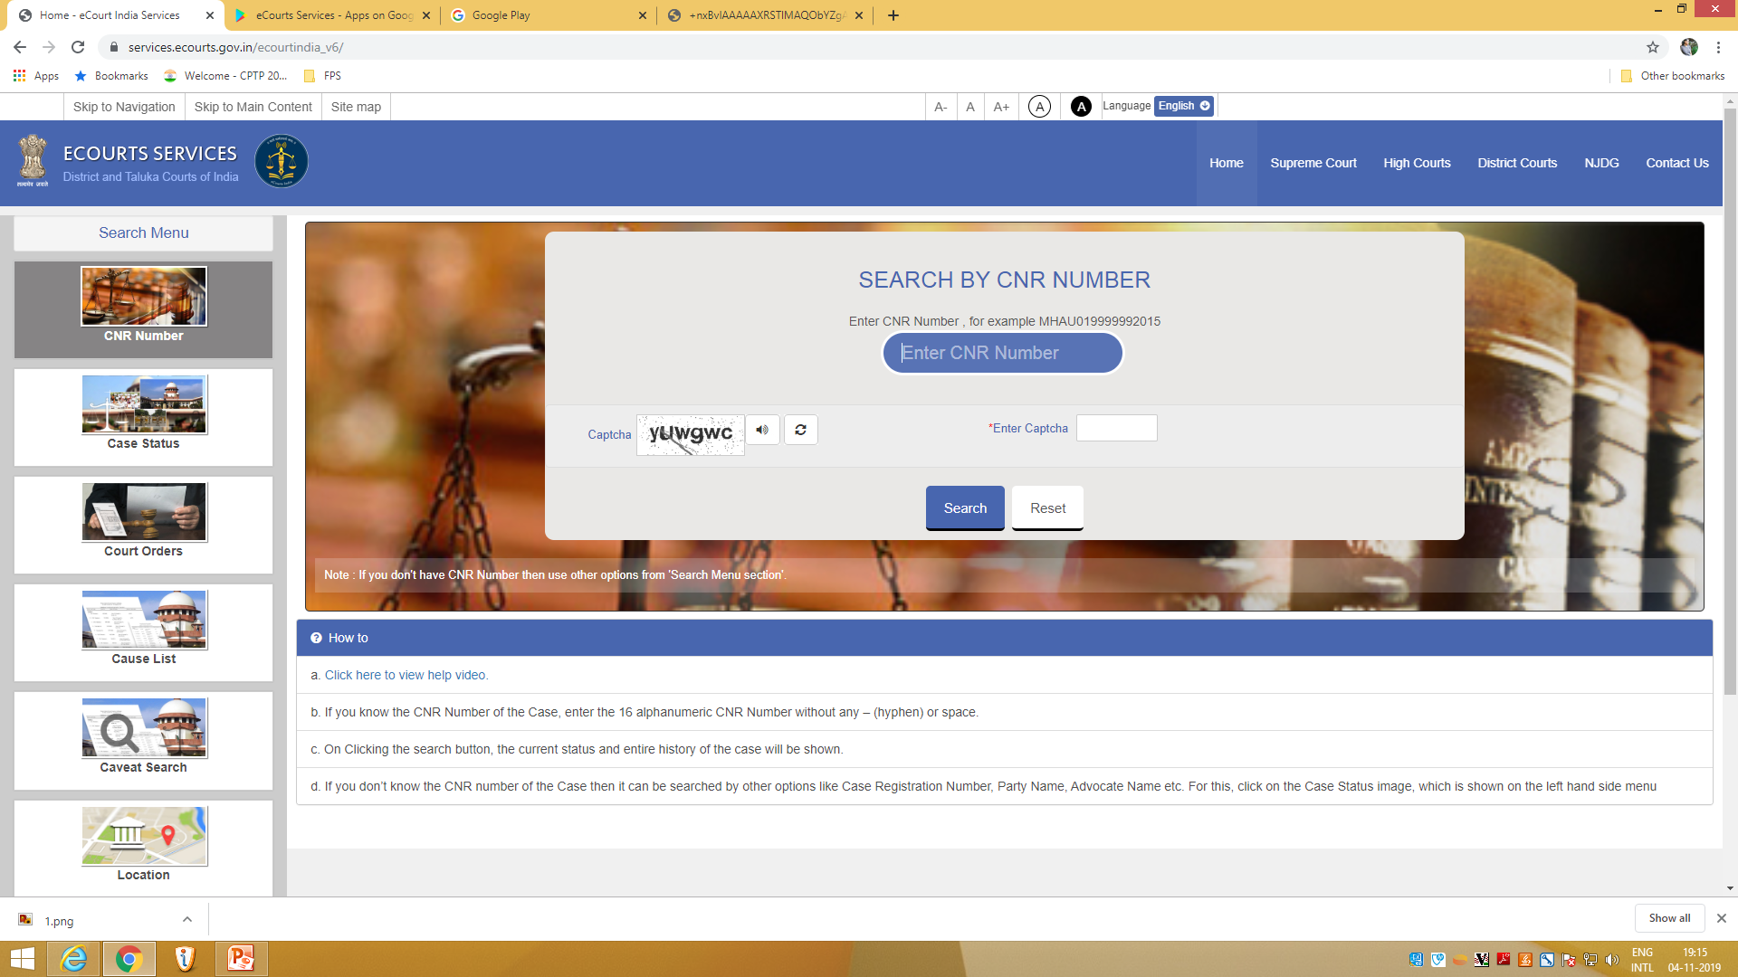
Search by CNR NUMBER

Slide 6
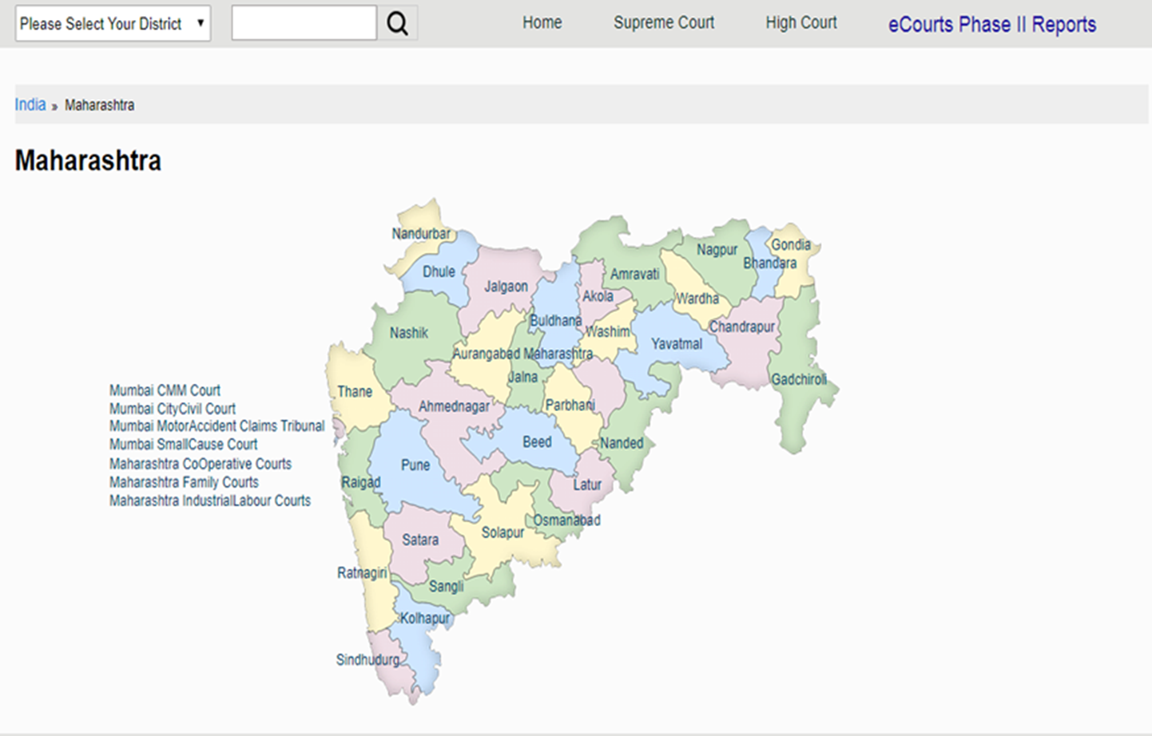
TRACKING CASES IN DISTRICT COURTS

Slide 7
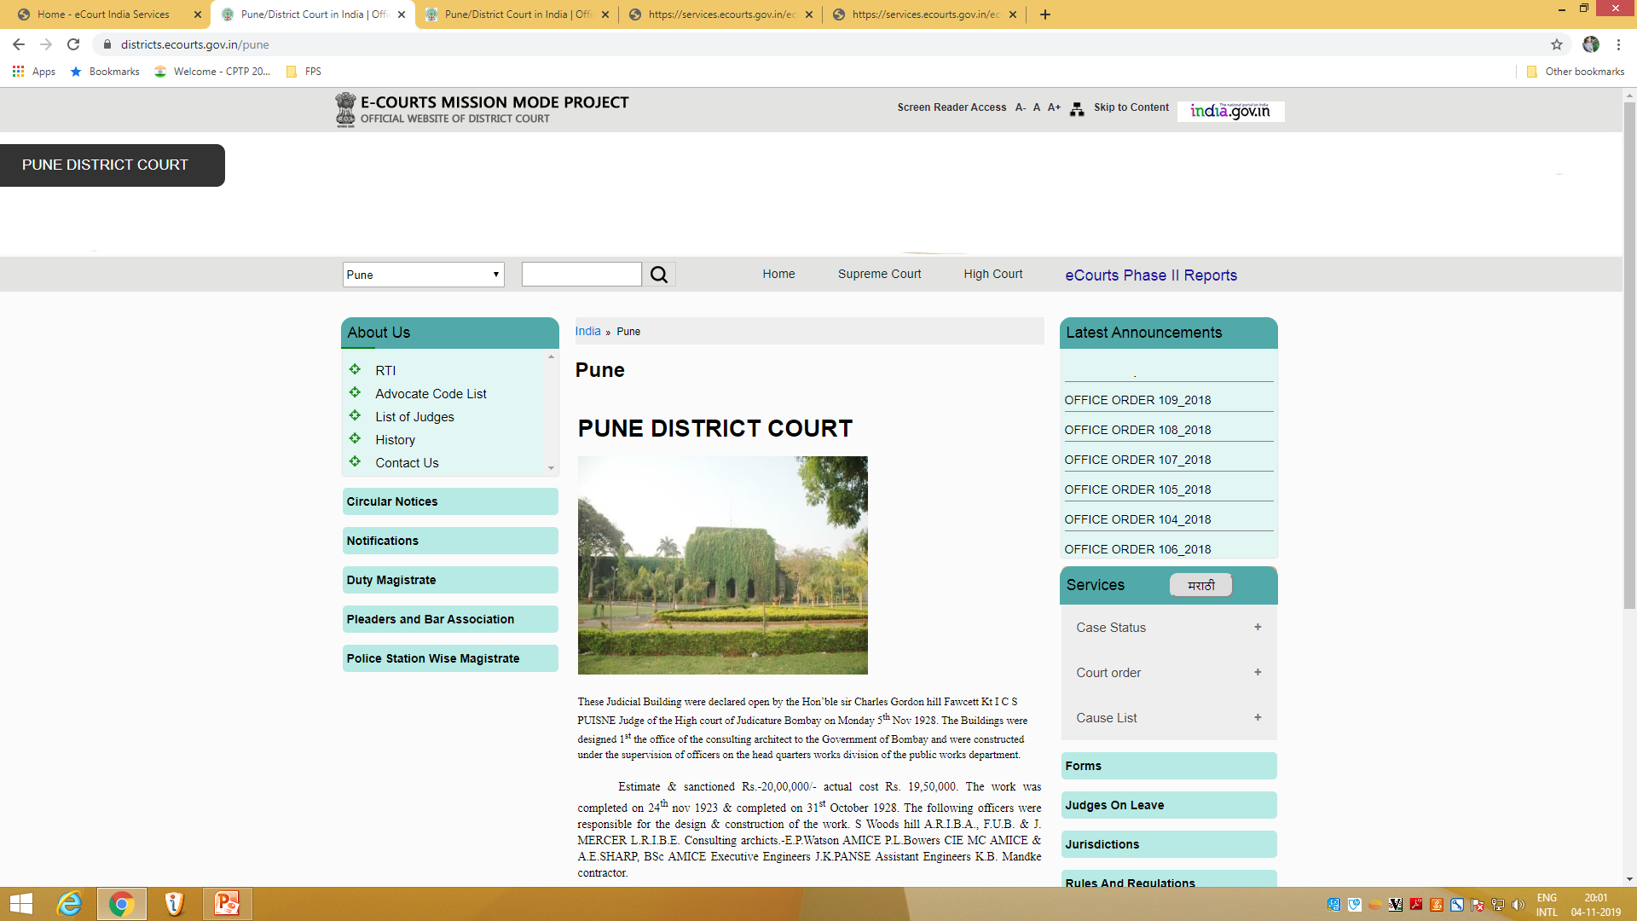
CASES AT PUNE DISTRICT COURT

Slide 8
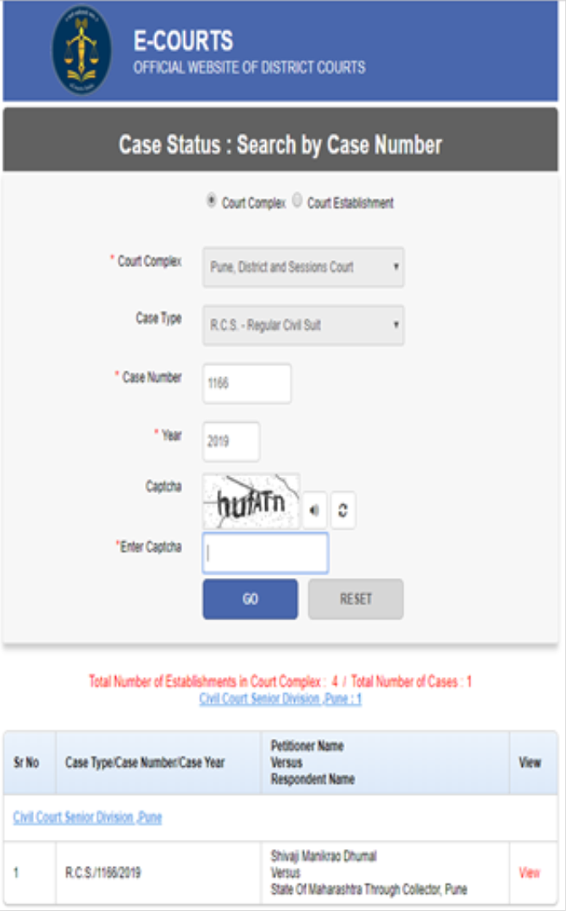
Case status:
Search by case number

Slide 9
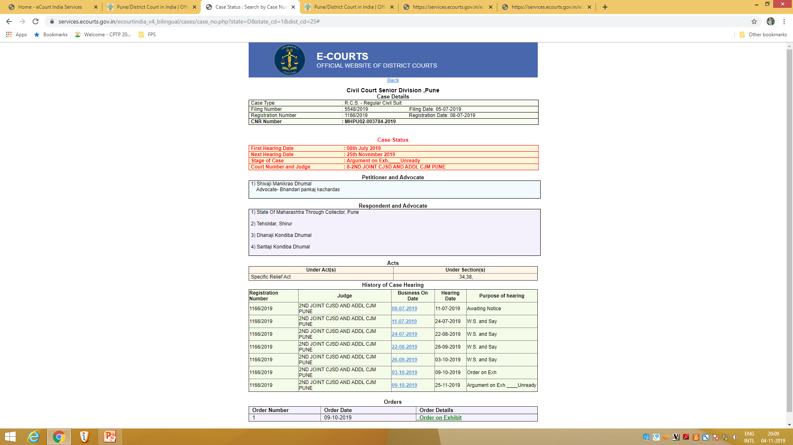
CASE
DETAILS

Slide 10
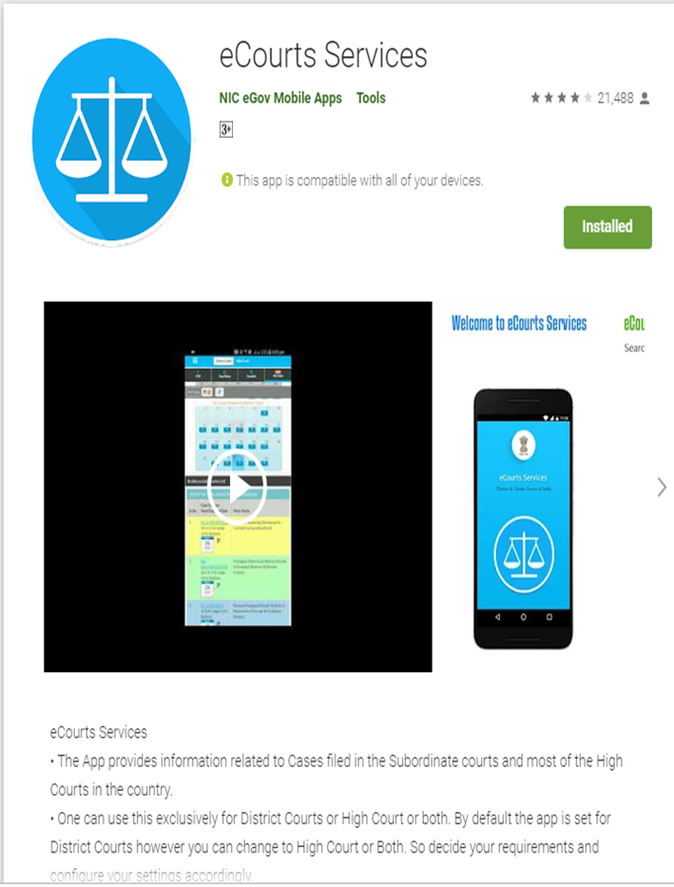
E COURTS
SERVICES
APP

Slide 11
THANK YOU

