Slide 1
Just Because It’s Free, It Doesn’t Mean It’s Safe
Presented By : Mr. Sushant Laxman Shinde
Designation: Deputy Collector
Roll No. : D30

Slide 2
Free Internet Services
Types Of Services | Examples
Application | Facemaker
Websites | Alibaba
Streaming Services | YouTube
Social Media | Facebook ,Telegram

Slide 3
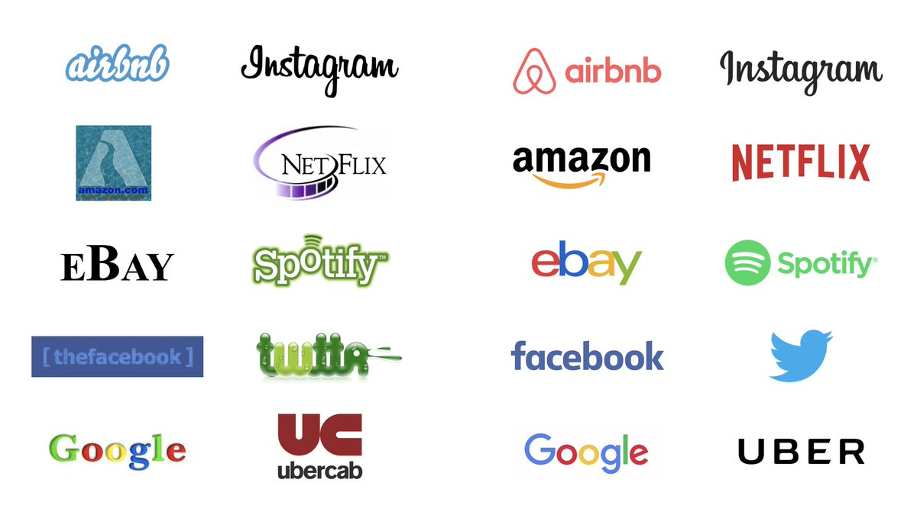

Slide 4
Benefits Of Free Internet Services
Beneficial to new customer and low income group people
Entrepreneur can attract new customer
Ex. Zomato
3. Connect to world and bring people closer
4. Does the work in minimum time

Slide 5
कुछ पाने के लिए कुछ खोना भी पड़ता है
BUT Every coin has two sides
क्योंकि

Slide 6
Negative Aspect of Free Internet Services
1. Takes Personal information
Ex. Name, Contact, Email, T&C etc
2. Big Data Collection
3. Analyse the data Ex :Understanding Personal behaviour
4. Manipulate the behaviour Ex. Election campaign
5. Breach of Privacy Article 21

Slide 7
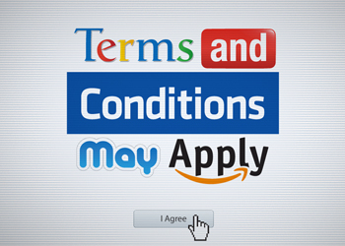
Think Before Click

Slide 8
How to deal with Free Services
Put least information on Web platform
Ex. Name , Contact etc.
Close incoming unnecessary email or spam mail
Don’t put physical or sensitive information
Read terms and Conditions Carefully

Slide 9

After All I’m very Important

Slide 10
Any Questions….?
Thank You..!!!

