Slide 1
Tips On Green Computing
By
Sumit Shinde (B.Tech IT)
Prob. Deputy Collector
Batch D Roll no. 1 (CPTP-6)

Slide 2
What is Green Computing?
Practice of using computer resources efficiently.
Designing, Manufacturing and Disposing of computer devices without any impact on environment.
Minimizing the hazardous materials and maximizing Energy efficiency.
Energy Star Program (1992) was first manifestation of Green computing.

Slide 3
Need of Green Computing
To Avoid :
Energy wastage
Computing devices consume too much energy when kept ON even when not in use.
Resource Wastage
Unnecessary Printing of papers often leads to wastage of papers.
Pollution and Toxicity
Disposal of Hardware may increase pollution and toxicity due to hazardous matter like Lead, Mercury, Cadmium etc.

Slide 4
Tips for Green Computing
Turn off the computer when not in use.
Use Sleep mode, Hibernate mode, Power saver mode whenever possible.
Use of Hardware having Energy Star label.

Slide 5
Don’t Print unless necessary.
Use of LCDs rather than CRTs.
Use Cloud services that minimizes Hardware needs.

Slide 6
Green Design, Green Manufacturing and Green Disposal
Green Design:
Designing the Energy efficient Computer equipments.
Green Manufacturing:
Manufacturing of computer devices keeping environment in mind.
Examples: Bamboo casings, recyclable plastics etc.

Slide 7
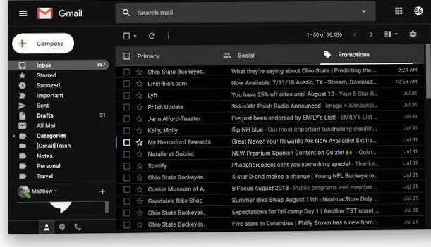

Slide 8
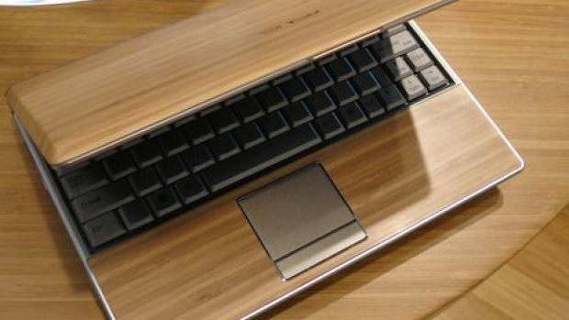
Manufactured ‘Green’

Slide 9
Green Disposal
Reuse
Recycle
Refurbish

Slide 10
Reuse : Donate the old computers to the people with less hardware requirements.
Refurbish : Replace the hardware component rather than replacing the whole computer device Eg. RAM update
Recycle : The correct way to dispose of old and used computer materials is to recycle them. If you recycle them, they can be broken down into new materials. Computers contain many useful materials such as Copper, Gold, Silver, Iron etc. which can be used again.

Slide 11
THANK YOU !
“Go Green, Save Earth”

