Slide 1
REDUCE DIGITAL CARBON FOOTPRINT
By
SHINDE ROHAN BHIMRAO
TAHASILDAR
Class :D, CPTP 5,
Yashada ,Pune.

Slide 2
Digital Carbon Footprint
“Carbon footprint” is often used as shorthand for the amount of carbon (usually in tones) being emitted by an activity or organization.
Digital carbon footprint is amount of carbon emitted by an activity or organization related to the information and communication technology.

Slide 3
Carbon Emitting Sources
The Internet Network
Cloud computing and hosting
The end consumer’s devices: laptops, workstations and smart devices.
Internet software providers, especially media providers: Youtube ,Netflix
Satellite mobile network

Slide 4
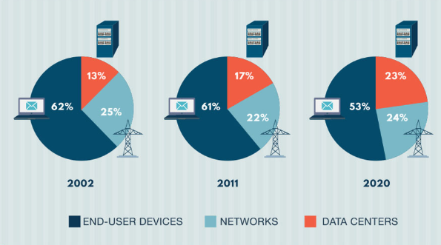
Emission of CO2 By different sources
IT global industry amounted to an approximate 10% of world’s global Energy in 2015.
Data centers consume 3% of all globally generated power.
Emission of Co2 by Source

Slide 5
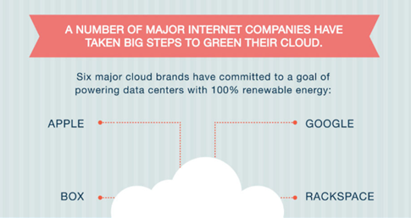
How to reduce Digital Carbon Footprint
Use of Green Clouds for data storage, Servers.
Using renewable energy sources for energy consumption. Such as, Apple and Google.
Unsubscribe from all unwanted newsletters.

Slide 6
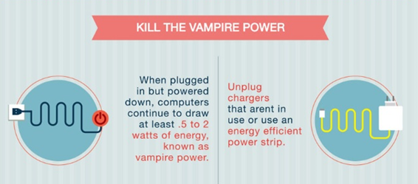
Killing the ‘Vampire Power’.
Efficient disposal of e-waste.
If you’re a techie person:
There are multiple actions you can take to reduce your energy footprint during the whole development cycle: development and testing, building, running.
During development, you can choose a programming language that does not require high end development environment, that uses less memory and CPU

Slide 7
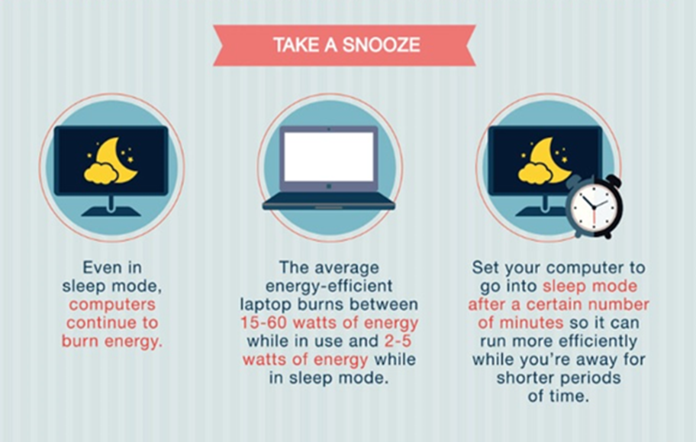
Blackle is a website p0wered by Google custom search and created by a Heap media which aims to save energy by displaying black background and using greyish-white font for search result .
Blackle save energy because screen is predominantly black.

