Slide 1
ONLINE APPOINTMENTS IN GOVT. HOSPITALS
by
JITENDRA SHIKTODE
CPTP-5
YASHADA, PUNE

Slide 2
WHY
LONG QUEUES
CITIZENTS OPT FOR PRIVATE HOSPITALS
TIME CONSUMING
To tackle this, the government under the Digital India programme had launched the common patient portal in 2015.

Slide 3
Features
Through this portal, you can book an Out Patient Department (OPD) appointment with a doctor at any registered government hospital across India.
You can also check the availability of doctor’s appointment on a particular date.
Getting Lab Reports, blood availability in any govt. hospital

Slide 4
HOW TO REGISTER ON ONLINE REGISTRATION SYSTEM (ORS)

Slide 5
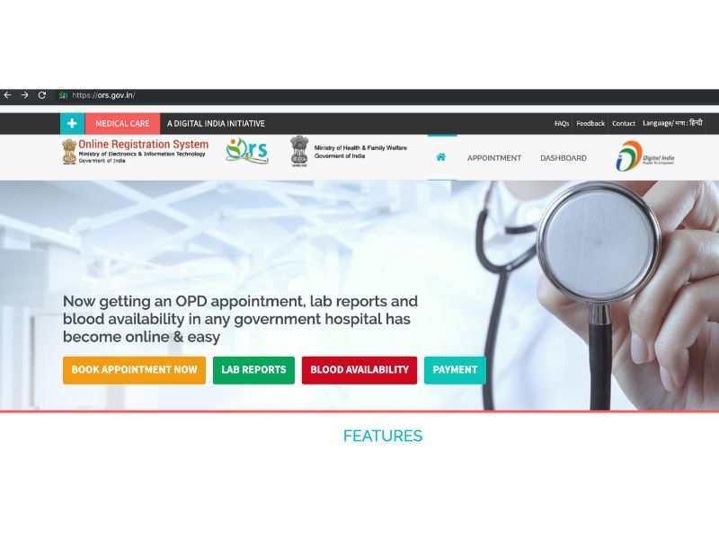
Open the official website of Online Registration System on mobile or PC
ors.gov.in
Click on “Book Appointment Now” on the ORS website

Slide 6
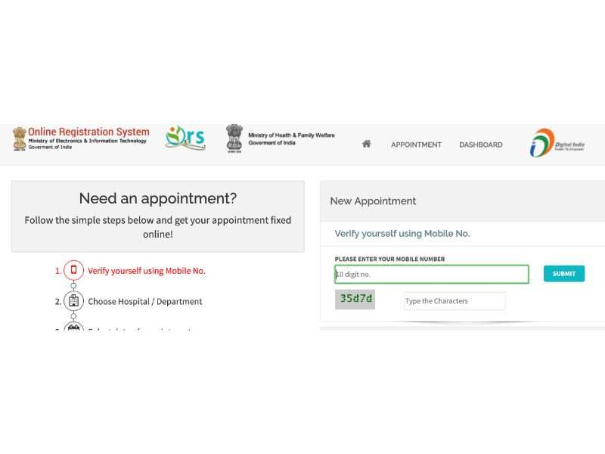
Under “New Appointment” section, enter the mobile number, captcha code and click submit
OTP

Slide 7
You can register with phone and Aadhaar number or without Aadhaar card as well

Slide 8
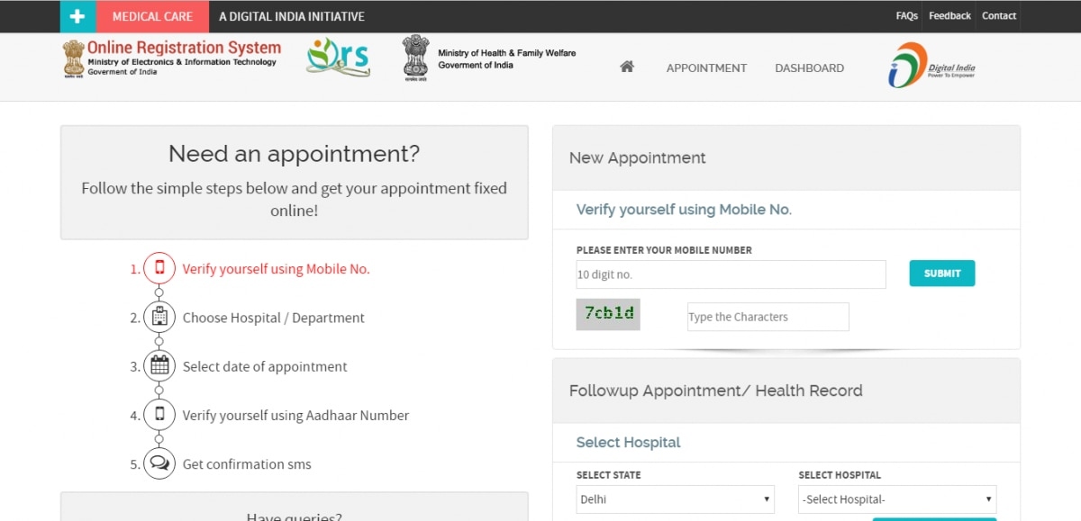
Select the hospital and department you want to visit from the list

Slide 9
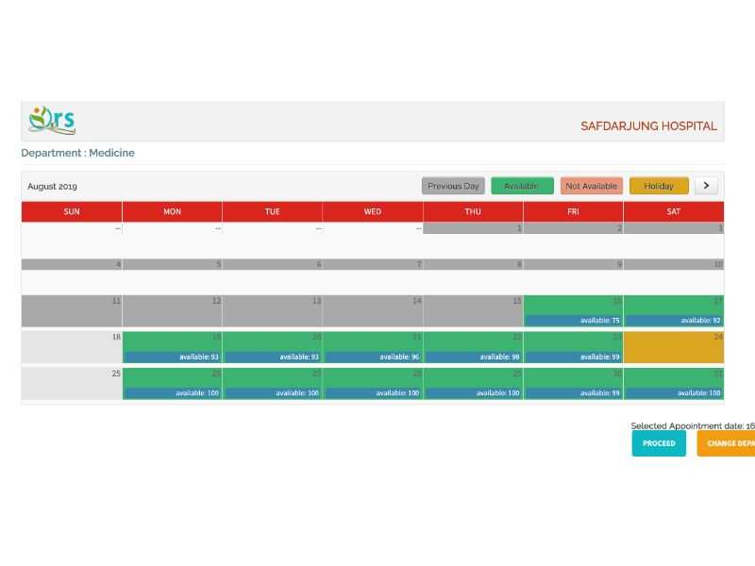
Select date and availability

Slide 10
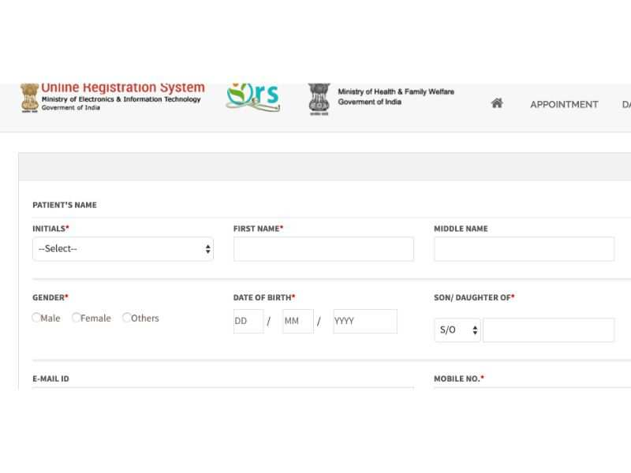
Enter personal details

Slide 11
Take printout of the appointment slip generated
A confirmation SMS about your appointment will come
Carry online receipt and government ID proof when you visit hospital

Slide 12
HOSPITALS IN MAHARSHTRA CONNECTED WITH ORS
ALI YAVAR JUNG NATIONAL INSTITUTE OF SPEECH AND HEARING DISABILITIES DIVYANGJAN, BANDRA WEST MUMBAI
ALL INDIA INSTITUTE OF PHYSICAL MEDICINE AND REHABILITATION, MUMBAI
KASTURBA HOSPITAL, SEVAGRAM, WARDHA
NNMC GENERAL HOSPITAL, VASHI, NAVI MUMBAI
PHC VALSANG, VALSANG, TAL- SOUTH SOLAPUR

Slide 13
THANK YOU

