Slide 1
Store certificates online using digilocker
BY
Dattu Balu Shewale
Deputy Collector
CPTP-5 (2019)
Yashada,Pune

Slide 2
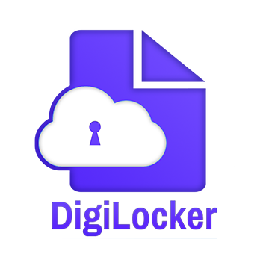
introduction
Digilocker is a service launched by government of India in 2015
To provide a secure dedicated personal electronic space for storing the documents of resident indian citizens.
The storage space (maximum 1GB) is linked to the aadhar number of the user.
The space can be utilized for storing perosnal documents like university certificates,PAN cards,voter id etc.

Slide 3
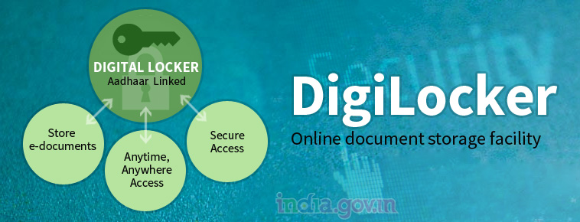
Key features of digital locker
It minimises the use of physical documents
Digital locker of each resident is linked to their aadhar number.
Facility to upload e-documents in a standard XML format in the digilocker
Ensure authenticity of e-documents and thereby eliminating usage of fake documents.
Anytime, anywhere access to the documents.

Slide 4
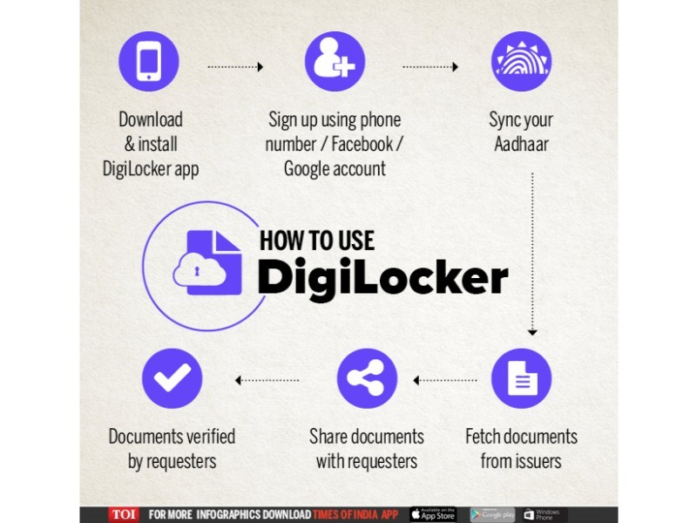
Digilocker flowchart

Slide 5
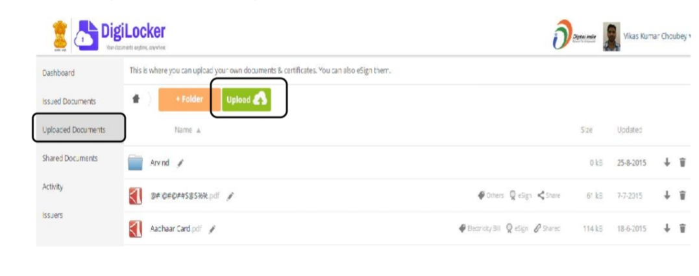
Uploading Certificates & Documents
Step 1: Document Upload Screen
After signing into Digital Locker, click on Uploaded Documents and then click on Upload to upload your documents in the Digital Locker Account .
Multiple documents can be uploaded at a time.

Slide 6
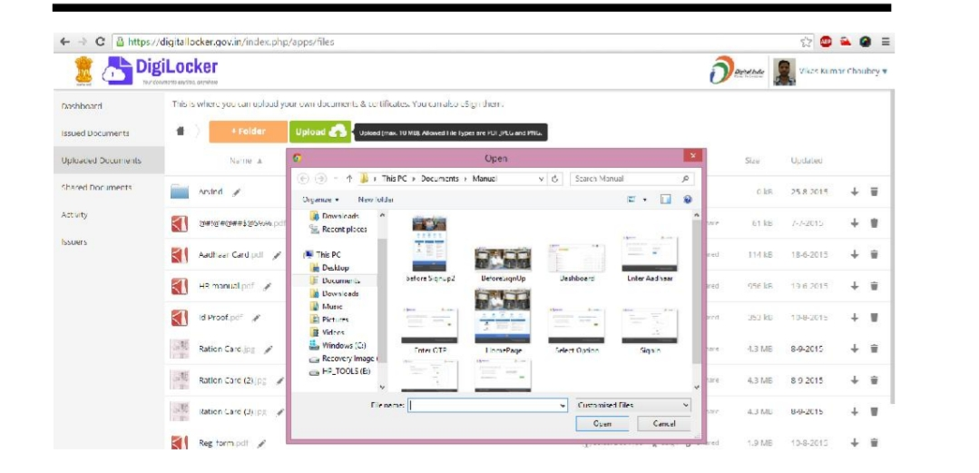
Step 2: Document Upload Screen

Slide 7
Step 2: Document Upload Screen
Click on the Upload button as shown in the image.
Choose the location and select the file(s).
After selecting file(s).
click on Open button.
Multiple documents can be uploaded at a time.

Slide 8
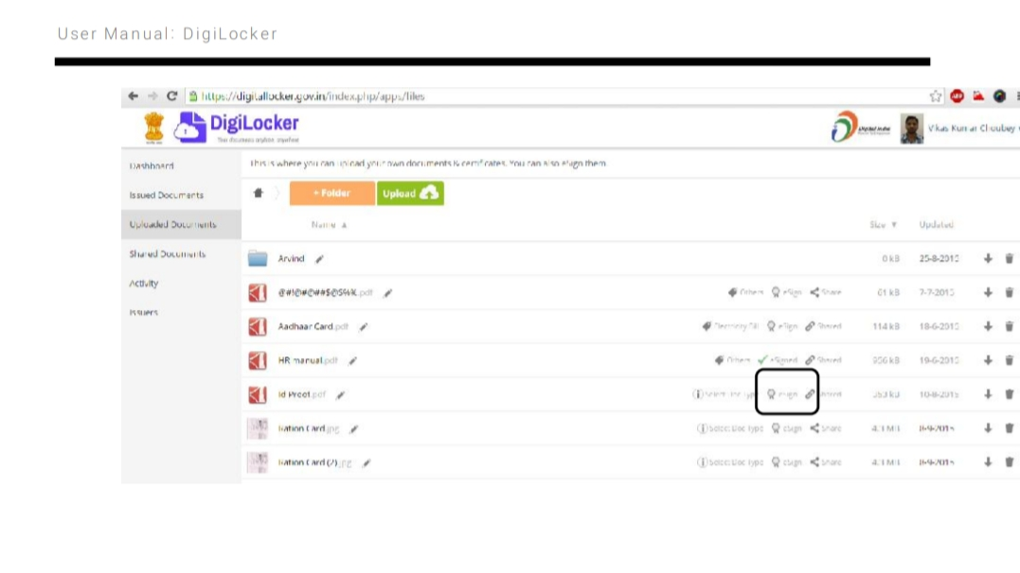
The sample screen will look as below
Documents uploaded will be visible in ‘Uploaded Documents’’ section

Slide 9
Select Document Type
Click on ‘Select Doc Type’ for any document listed in Uploaded Documents list.
Choose the Document type from the given drop down.
If your document does not match with any of the predefined document types then select “Others” from the drop down.
After above mentioned steps, click on Save button.

Slide 10
Select Document Type

Slide 11
Viewing Certificates
After login into Digital Locker account, click on Uploaded Documents to view all user uploaded certificates and documents.
Users can edit (file names, Doc type), download, and share files from here.

Slide 12
Viewing Certificates

Slide 13


