Slide 1
Protect Myself From Fake Emails Which Pretend To Be Genuine
By
Jeetkumar Shejao
ACST
CPTP 5

Slide 2
Objectives
Understand fake Emails and identify their various types
Recognize common baiting tactics used
Examine some fake Email messages
Understand how to protect yourself from them

Slide 3
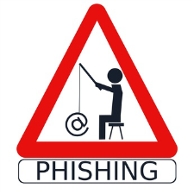
Fake Emails - Phishing
A phishing email is a fraudulent message carefully crafted to trick you into giving up your password or other sensitive information.
Financial gain and criminal activity are the key motivations for email phishing.
Designed to trick you into clicking a link or providing personal or financial information
Often in the form of emails which may appear to come from legitimate companies, organizations or known individual
Take advantage of natural disasters, epidemics, health scares, political elections or timely events
Notes:
What is spam?
Spam is unsolicited or undesired electronic junk email. Some characteristics of spam are:
Mass mailing to a large number of recipients
Usually a commercial advertisement,
Annoying but usually harmless unless coupled with a fraud based phishing scam

Slide 4
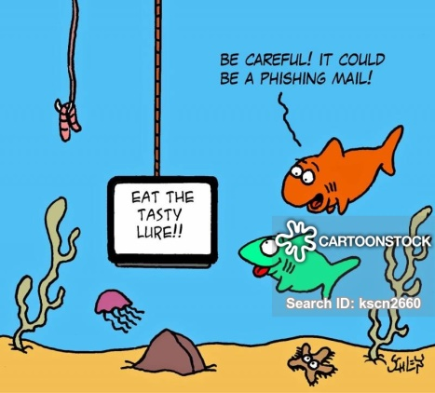
Types
  Spam: unsolicited or undesired junk mail,
  mass mailing e.g. commercial advertisement
  Phishing Email: to trick you into giving up your password or other sensitive information
  Malware: software used to disrupt computer operation, gain access to private computer systems or gather sensitive information. Attachments in emails and internet advertising

Slide 5
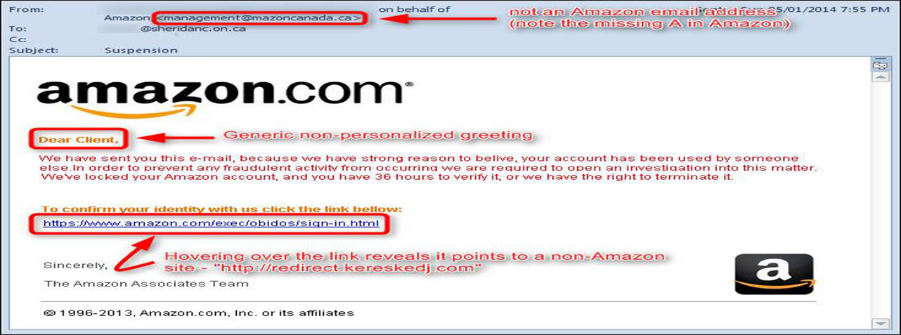
Recognize Fraudulent E-mails
Invoke a sense of urgency
Asking you to click on a link
Asking for passwords or other sensitive
information such as credit/debit card number
Generic greetings and signatures
Odd spelling or grammar

Slide 6
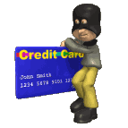
How To Tell If An E-mail Message is Fraudulent
Contain phrases like :
"Verify your account."
"If you don't respond within 48 hours, your account will be closed."
"Dear Valued Customer.”
"Click the link below to gain access to your account.“
For example, the URL "www.microsoft.com" could appear instead as:
www.micosoft.com
www.mircosoft.com
www.verify-microsoft.com

Slide 7
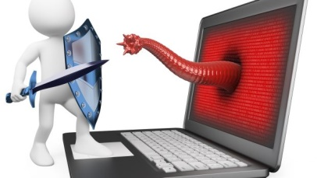
Protect Yourself: Refuse the Bait
STOP
THINK
CONNECT
Install and maintain antivirus software on your electronic devices
Use email filters to reduce spam and malicious traffic
Never send passwords, bank account numbers or other private information in an email

Slide 8

Protect Yourself: Refuse the Bait
Do not click on any hyperlinks in the email
Examine websites closely
  Malicious websites may look identical to legitimate sites
  Look for “https://” or a lock icon in the address bar before entering any sensitive information on a website
Keep your browser updated
Use a firewall

Slide 9
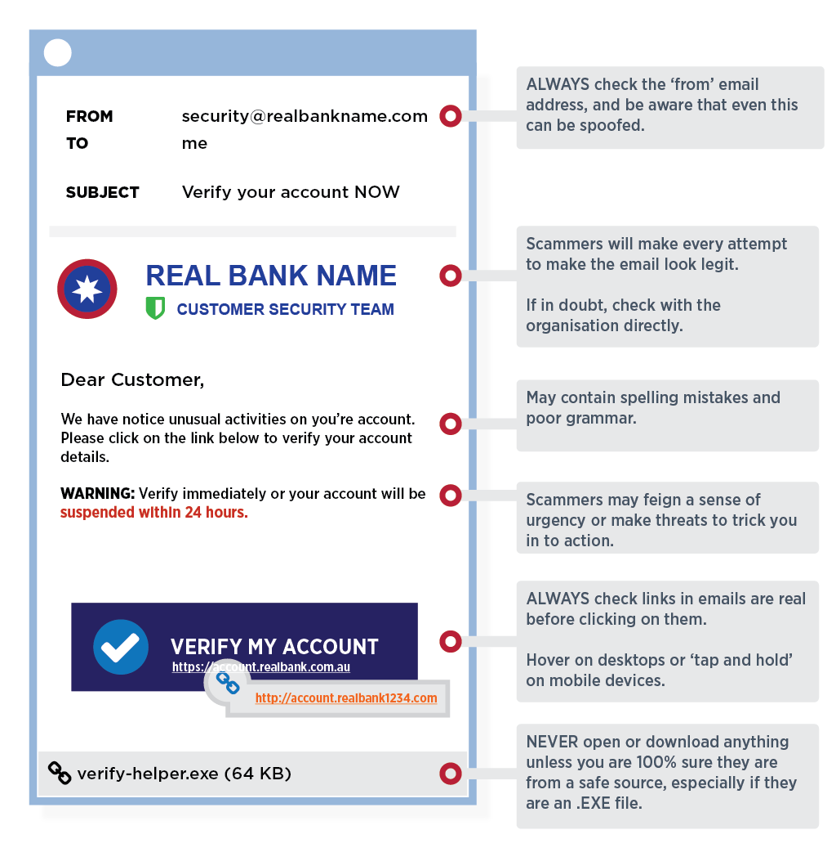
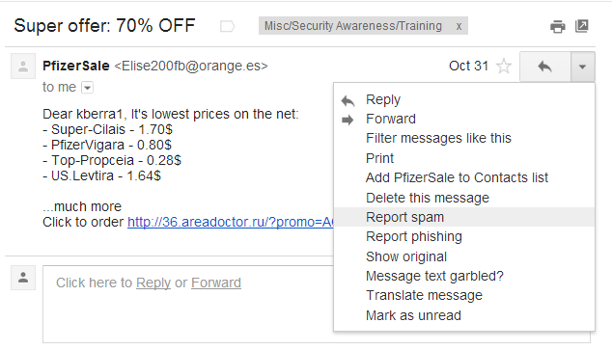
Protect Yourself: Report a Phish

Slide 10
Summary
The easiest way for cybercriminals to gain access to our resources is through unaware end users. Because this activity will continue to increase, it is imperative that we critically evaluate emails we receive.
We cannot stop cybercriminals from sending bad email, however, by becoming aware of what we should be looking for, we can limit our response to them which in turn will protect our resources as well as our personal information.

Slide 11
Thank you!

