Slide 1
Apply for Toilet Certificate online
BY
Samadhan Ghanashyam Sonavane
Tahasildar
Class: B, CPTP-5
YASHADA, PUNE.

Slide 2


Necessity of Toilet Certificate
It is necessary for filing election form to contest all election from Gram Panchayat to Zilha Parishad.
It is necessary to get benefits of several government schemes , such as:
  MGNREGA.
  Bhausaheb Phundkar Falbag Lagavad Yojana .
  Magel Tyala Shet Tale Yojana.
  Dr. Babasaheb Ambedkar Krushi Swavalamban Yojna.
For all employees of Zilha Parishad who are residing in village area.

Slide 3


Process To get Toilet Certificate Online
This service is available on RTS Maharashtra APP.
This app is available on Google play store.
Before using the service it is necessary to register on the app.
After registration we have to select the particular service
After application our application goes to concern Gramsevak.
Gramsevak issues certificate based on the information available and field visit to household.
Gramsevak uploads the certificate on the portal and user can download it.

Slide 4
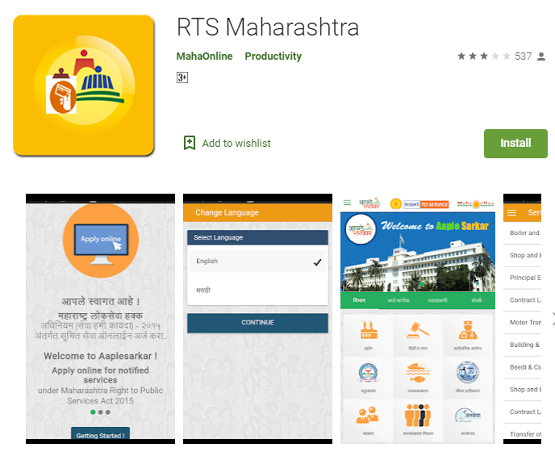
Process to Download the Application
Go to ‘Google Play store’.
Search for ‘RTS Maharashtra’
Then click on ‘install’.

Slide 5
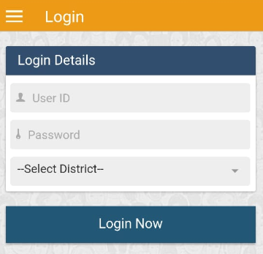
Registration to the App
Click on ‘Register’.
After registration user name and password will be generated
Using that user name and password you can log in into app.

Slide 6
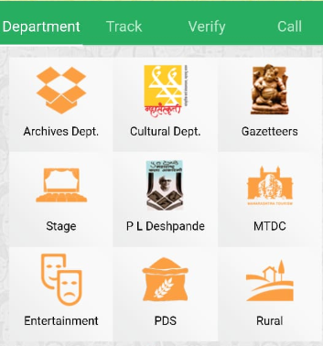
Applying for certificate
After log in into App select the department as ‘Rural development department’.

Slide 7
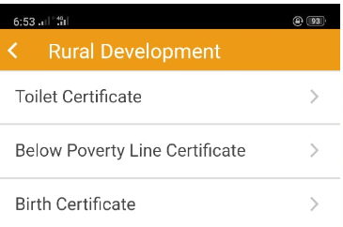
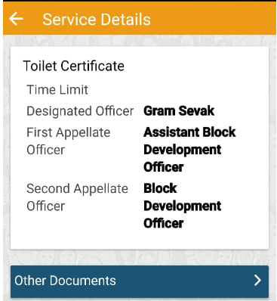

Applying for certificate
Then select the service
as ‘Toilet certificate’
Next step Service details
For this service no documents are required.

Slide 8
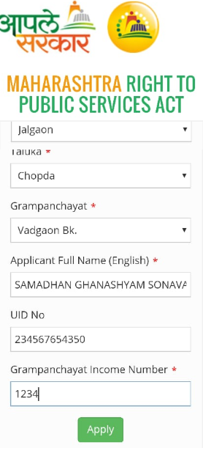
Selecting Credentials
District
Taluka
Gram Panchayat
Full Name
ADHAR No.
Gram Panchayat Income Number
Then Apply

Slide 9

Appeal for denial of service
Service should be provided by gram sevak within five days.
If service is denied.
First appeal to ABDO, Panchayat Samiti.
Second Appeal to BDO, Panchayat Samiti.

Slide 10

Benefits of Online Service.
Global access, 24 hours a day, 7 days a week
Improved client service through greater flexibility
Cost savings
Faster delivery of products
Increased professionalism
Less paper waste

Slide 11


