Slide 1
CIT ASSIGNMENT 1 CPTP 6
SAKHARAM PRAKASH MULE
DEPUTY COLLECTOR
04-11-2019
Notes:
This template can be used as a starter file for presenting training materials in a group setting.
Sections
Right-click on a slide to add sections. Sections can help to organize your slides or facilitate collaboration between multiple authors.
Notes
Use the Notes section for delivery notes or to provide additional details for the audience. View these notes in Presentation View during your presentation.
Keep in mind the font size (important for accessibility, visibility, videotaping, and online production)
Coordinated colors
Pay particular attention to the graphs, charts, and text boxes.
Consider that attendees will print in black and white or grayscale. Run a test print to make sure your colors work when printed in pure black and white and grayscale.
Graphics, tables, and graphs
Keep it simple: If possible, use consistent, non-distracting styles and colors.
Label all graphs and tables.

Slide 2
TOPIC:
Protect myself from social media blackmailing.
Notes:
Give a brief overview of the presentation. Describe the major focus of the presentation and why it is important.
Introduce each of the major topics.
To provide a road map for the audience, you can repeat this Overview slide throughout the presentation, highlighting the particular topic you will discuss next.

Slide 3
What is Social Media?
websites and applications that enable users to create and share content or to participate in social networking.
Notes:
This is another option for an Overview slides using transitions.

Slide 4
Blackmailing--Negative Side of Social Media
This is a criminal act in which a depraved individual uses information he gathered from social media to threaten a person to do what he demands or the victim will be exposed to society.
Blackmailer’s demands may not only be monetary but acts that are immoral and criminal.
According to statistics, 43% of teeners have been victims of cyber blackmail.

Slide 5
STRATEGIES
WEBCAM BLACKMAILING
EXTORTION
SEXTORTION
CYBERSTALKING
PHISHING
Notes:
What will the audience be able to do after this training is complete? Briefly describe each objective how the audience will benefit from this presentation.

Slide 6
CYBERSTALKING

Slide 7
5 PREVENTIVE Steps TO PROTECT FROM Social Media Blackmail
Do not write your personal thoughts about anybody in your social media account
Avoid uploading pictures of yourself and what valuables you have
Adjust your social networking so only your friends can see private information about you. Do not post your phone number, mobile number, email address, street address and any personal information in the Internet.
Avoid communicating with anyone other than legitimate, bonafide friends.
If a message looks dubious, delete it.

Slide 8
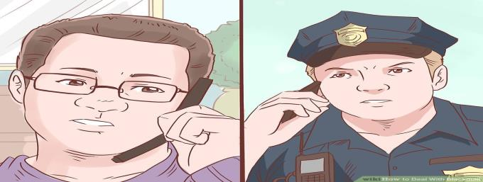
initial stepS IF SOMEONE BLACKMAILS YOU…
1
Inform the authorities
Notes:
This is another option for an Overview slide.

Slide 9
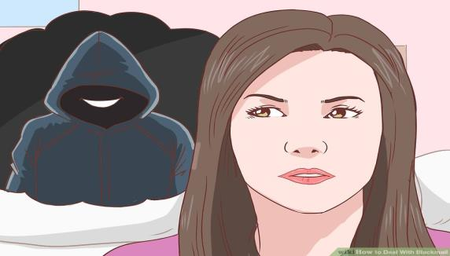
2
end all contact with them immediately.

Slide 10
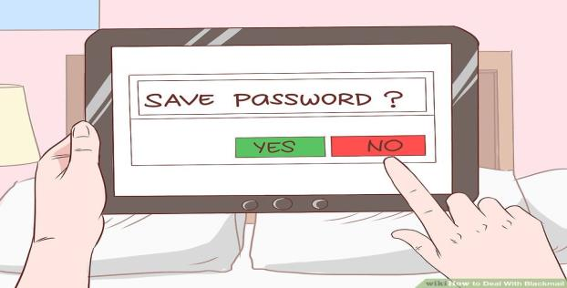
3
Place filters on your email account(s) to block their email address

Slide 11
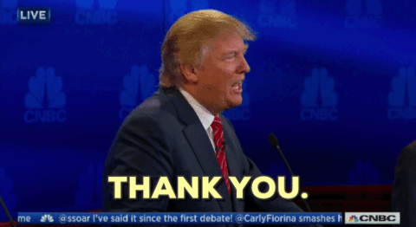
THANK YOU !

