Slide 1
HOW TO APPLY FOR DRIVING LICENSE ONLINE
AMRUTA SABALE
TAHSILDAR CLASS : B
ROLL NO: 4

Slide 2
Detailed Topic name
Apply for learners liense online.
Book appointment for learners license test.
Apply for driving license online.

Slide 3
WHAT IT IS
Driving license is an official document certifying the license holder’s qualification to drive a motor vehicle of a particular category on Indian roads.
The central government’s motor vehicle act of 1988 states that any person who is operating a motor vehicle on Indian roads must have a valid driving license issued by the concerned state governtment’s Regional Trasport Office(RTO) or Transport Authority(RTA).

Slide 4
NEED OF DRIVING LICENSE

Slide 5
TYPES OF DRIVING LICENSE
3 Types :
1. Learner’s License
It is a temporary license valid for six months.
Only after completing 30 days of training lessons, a person is allowed to apply for a driving license.
2. Driver’s License (Private)
A Driver’s License can be obtained by people who have successfully completed their training for driving a vehicle.
Minimum age limit : 16 years for motorcycles of 50cc or less.
: 18 for all the other vehicles.
3. Driver’s License (Commercial)
Driving a commercial vehicle means taking responsibility for other individuals traveling in it. Hence it is necessary to carry a fitness certificate while driving a commercial vehicle.
Minimum age limit: 21 years.

Slide 6
DRIVING LICENSE ONLINE
Need of online process:
To define same standards for these documents on a pan-India level.
To ensure interoperability and correctness.
For the timely availability of information.
Authority : The Ministry of Road Transport & Highways
SCOSTA committee recommendation : a uniform standardized software.
National Informatics Centre deployed:
The software VAHAN for Vehicle Registration
The software SARATHI for Driving Licenses.

Slide 7
HOW TO FILE AN APPLICATION
Here is a complete step-by-step guide for filing an RTO application for Driving License Online:
APPLY ONLINE FOR LEARNER’S LICENSE
On the website of https://sarathi.parivahan.gov.in/ the online application for all types of licenses can be made.
Following are the stages in Application Submission in Issuing Learner's Licence in the following order
1. Fill Applicant Details
2. Upload Documents
3. LL Test Slot Booking
4. Payment of Fee

Slide 9
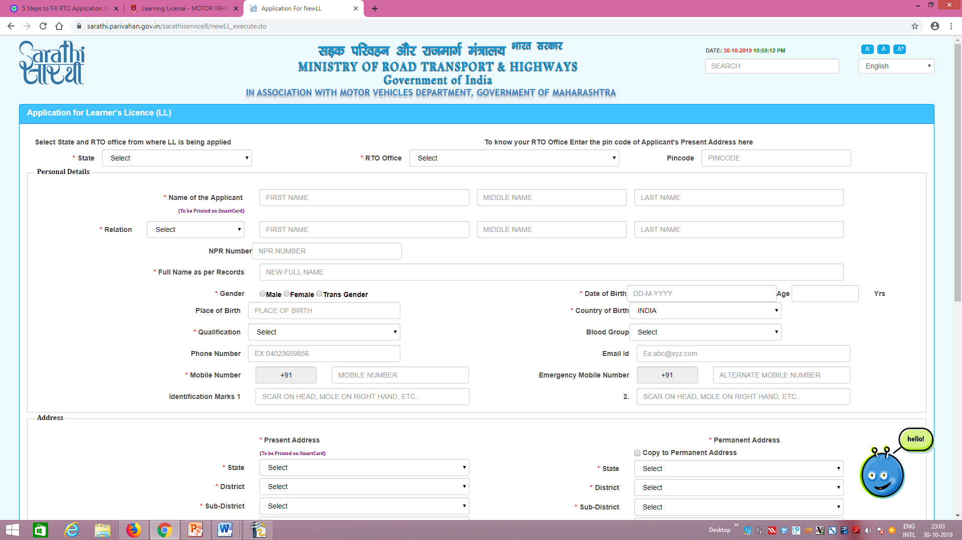
Step 1-File applicant details

Slide 10
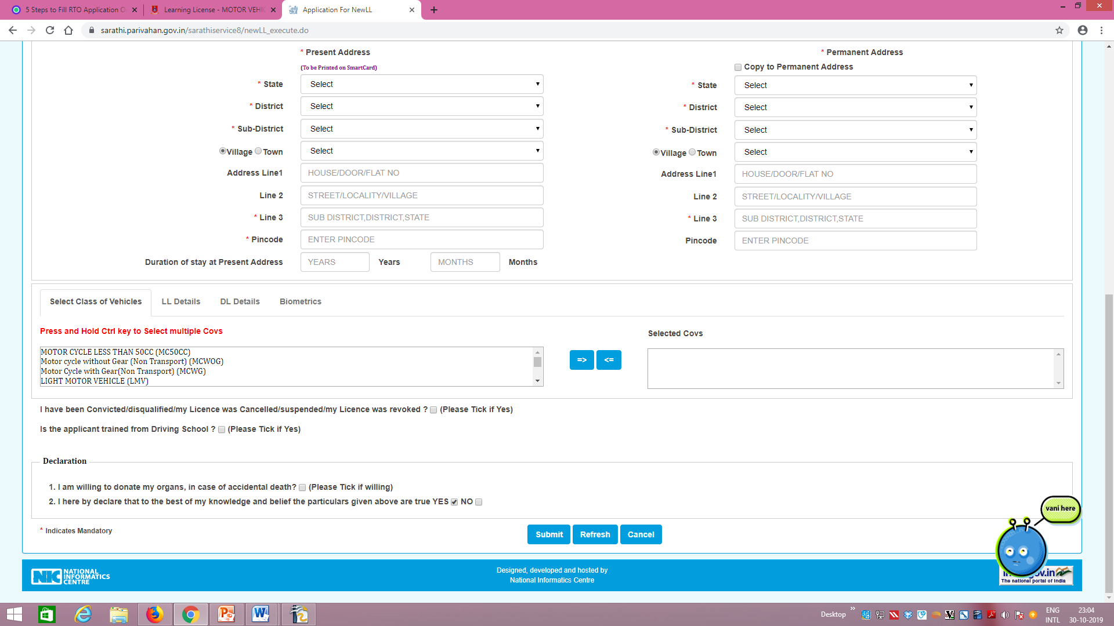

Slide 11
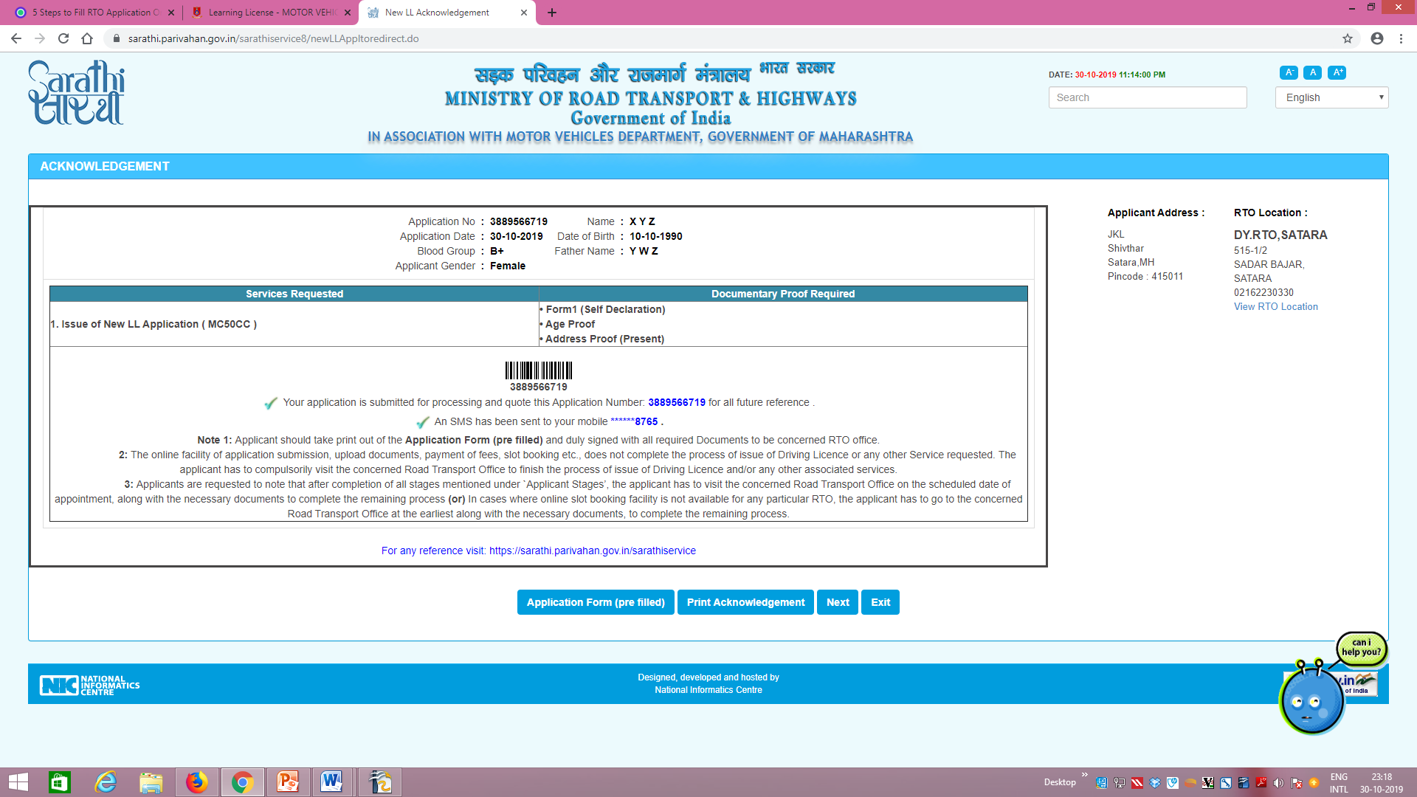
Step 2-Upload documents

Slide 12
Step 3- LL Test Slot Booking
After filing an application, as per comfort of the person, driving Test slot booking can be done.
Step 4- Payment of Fee
The fees to be charged are:
Rs 150 for a learner's licence.
Rs 50 for a repeat licence.
Rs 300 for a repeat test.
If you pass this test, you will receive the learning license. 30 days later, you can apply for a driving license.
Before applying for a driving license, it is mandatory to have a valid learning license.

Slide 13
APPLY ONLINE FOR DRIVING LICENSE
The process of applying for a driving license is similar to the process of applying for a learning license.
Step 1. Fill Applicant Details
Step 2. Upload Documents
Same as required for learners license.
Additional : Learning License
Step 3. DL Test Slot Booking (applicable for only some states)
Step 4. Payment of Fee
Rs 200 for a driving licence,
Rs 200 for renewal of driving licence,
Rs 1000 for international drivers permit.
If you pass the test, you will be given a receipt which will act as your Driving License (DL) until the time you receive the permanent smart card.
Within 30 days Driving license is sent to your address via post.

Slide 15
VALIDITY OF PERMANENT DRIVING LICENSE
A piece of information :
RTO Counter inaugurated in Orrisa’s Jagatsinghpur district Collector Office on October 25, 2019.

