Slide 1
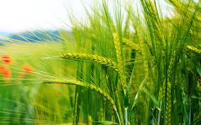
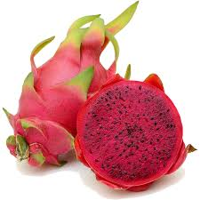
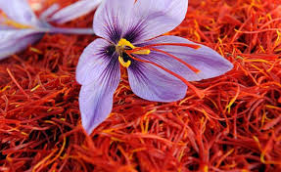
Use mkisan portal and kisan app
by
Rajashree Patil
Pro.DySP/ACP
CPTP-4A

Slide 2
Need of the portal
May, 2014,about 38 crore mobile telephone connections in rural areas.
Internet penetration-countryside is still abysmally low.
Mobile messaging-outreach to nearly 8.93 crore farm families.
To give information/services/advisories to farmers by SMS in their language, preference of agricultural practices and location.
Inaugurated on July 16, 2013

Slide 3
1.Go on mkisan.gov.in 2.Home screen of mkisan portal

Slide 4
3.Registration for SMS 1. Kisan call centre registration- ->Call to toll free number 1800-180-1551. ->Call centre agent records the personal details of farmer in KKMS. ->Cfter registration welcome message is received. 2.web registration -> With internet access, registration through portal or nearest CSC with help of VLE-charges rs.3 per registration. -> http://mkisan.gov.in/wbreg.aspx ->Farmer registration form need to be filled. -> 1.Name 2.Mobile number 3.State 4.District 5.Block mandatory details. -> Press Register button, verification code sent to farmer’s registered mobile number.
Notes:
Kkms-kisan knowledge management system, csc-common servise centre, VLE-village level entrepreneur

Slide 5
3. Registration through SMS- ->Send an SMS on 51969 or 7738299899. ->Format for typing in the message text box is “KISAAN REG < NAME > , <STATE NAME >, <DISTRICT NAME>, and <BLOCK NAME>” (only first 3 letters of State, District & Block Names are needed) ->After typing the message send it to 51969 or 7738299899.Farmer will be charged for this SMS. 4. Collection of farmers details for mKisan Portal by Extension Workers - ->During their field visits, database is created.

Slide 6
Information about the portal
Pull SMS is used by farmers and various stakeholders to extract information from databases by sending SMS in a particular format to any of the following two numbers.
Interactive Voice Response System (IVRS) is an automated telephony system that interacts with callers, gathers information and routes calls to the appropriate recipient.
Push SMS gives information/services/advisories to farmers by SMS in their language, preference of agricultural practices and location.
Ksewa-
https://mkisan.gov.in/ksewa/registrationForm.aspx

Slide 7
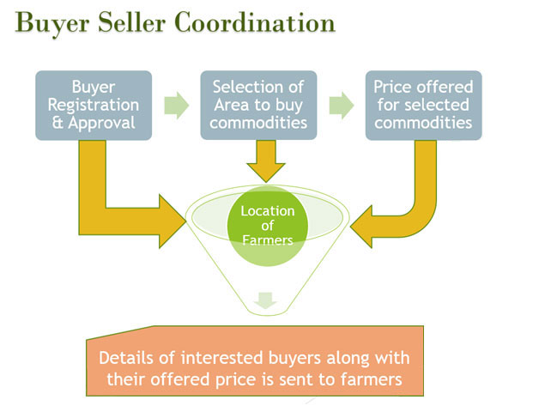
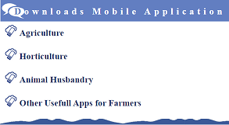
Information about the portal
Kisan Call Centres (KCCs) is to answer farmers' queries on a telephone call in their own dialect.
Buyer seller platform-
https://mkisan.gov.in/BREG/BReg.aspx
Mobile apps

Slide 8
Various apps under mkisan app
Agriculture
Kisan suvidha
Pusa krishi
Mkisan application
Shetkari Masik Android App
Farm-o-pedia
Bhuvan Hailstorm App
Crop Insurance mobile app
AgriMarket
Horticulture
Sikkim Horticulture And Cash Crop Assistance
Animal husbandry
Sikkim Allotment Of Breeding Bull
Application for Poultry
Pashu Poshan
Other useful apps
Digital Mandi India
Karnataka Bhoomi
HP Soil Testing
PMIS - Brinjal
PMIS-Tomato

Slide 9
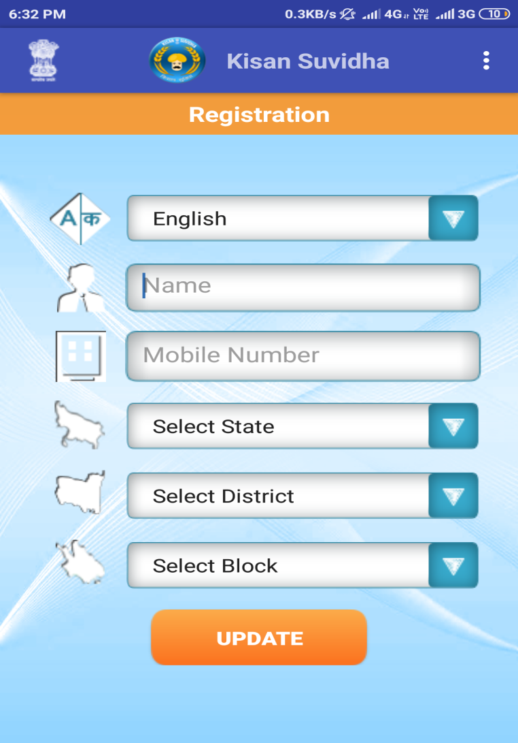
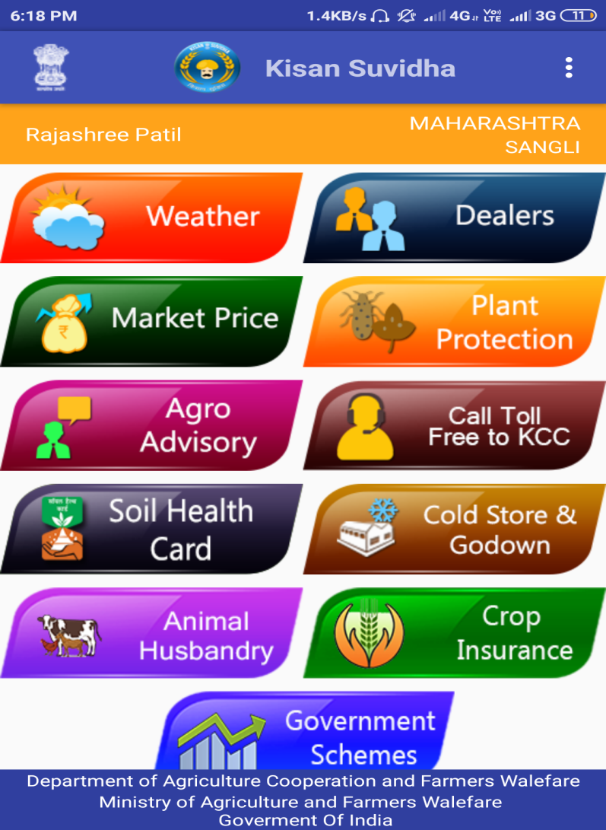
Kisan suvidha app

Slide 10
Participants suggestions, queries and feedback

