Slide 1
Safe e-Commerce tips
Rahul Zalte
Assistant Commissioner of State Tax
CPTP 4A

Slide 2
What is e- Commerce
electronically buying or selling of products on online over Internet. It involves -
Data Collection
Payments
Internet Marketing
Mobile Commerce
e-Commerce
Mobile commerce

Slide 3
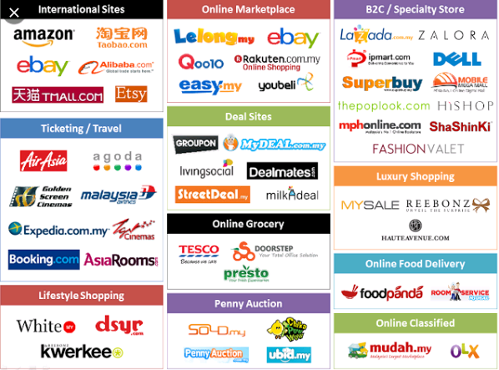
What is e- Commerce
E-Commerce Sites Examples

Slide 4
Safety issues Involved
Credit Card Fraud
Man-in-the-middle Attacks
Listening to the communications made by users of an e-commerce website.
Occurs when a hacker gains unauthorized access to customers’ personal and payment information.
Hackers get to see a people’s browsing history, credit card numbers,
passwords and usernames if the websites they are visiting lack strong encryptions.

Slide 5
Safety issues Involved
Phishing Scams
Man-in-the-middle Attacks
Listening to the communications made by users of an e-commerce website.
an email to an online shopper, a phishing scam may contain a link to a malicious site that resembles an e-commerce site
Hackers get to see a people’s browsing history, credit card numbers,
passwords and usernames if the websites they are visiting lack strong encryptions.
focus on targeting important user data like credit card numbers and login credentials

Slide 6
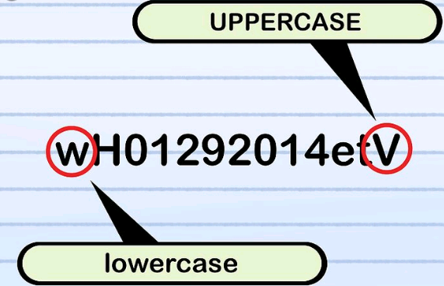

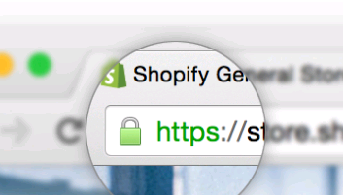
Safety Precautions
Password
Require stronger passwords
Antivirus
Good Antivirus Software
Regular Updates
HTTPS
HTTP Versus HTTPS
HTTPS is secured website
A strong password contains a mix of alphabetical letters and numbers.

Slide 7
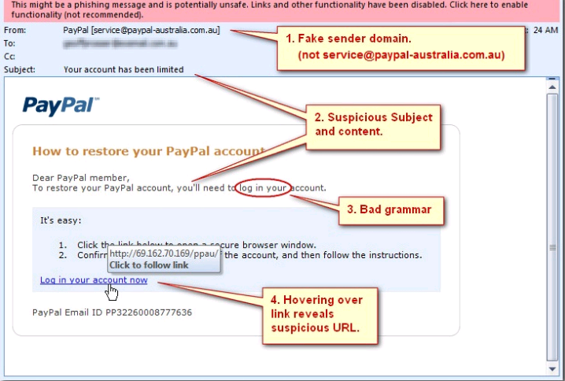


Safety Precautions
Phishing
Careful reading of emails from unknown sources.
SSL Certificate
Secure Socket layer
Sensitive Details
Birth Date, Pet Name, Nick Name
Mothers maiden name
Suspicious domain name, Subject, Content, URL etc.
Secure encrypted communication

Slide 8


