Slide 1
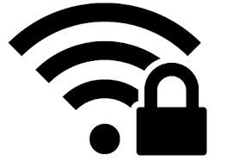
USE SAFETY TIPS FOR USING PUBLIC WIFI NETWORKS
PRESENTED BY- Mr. RAHUL BALU AWARE
(DY.SP)
BATCH- C

Slide 2

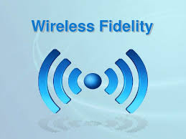
WHAT IS WIFI ??
WiFi is a technology that uses radio waves to provide network connectivity. A connection is established using a wireless adapter to create hotspots — areas in the vicinity of a wireless router that are connected to the network and allow users to access internet services.

Slide 3
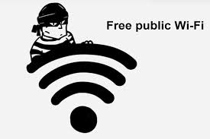
Risk of using a public wi-fi
It might not be a legitimate connection at all:
Yes, hackers have the knowledge to create fake hotspots which are not password protected to lure potential victims.

Slide 4

SECURITY TIPS
1. Look for the padlock.
Websites that use HTTPS encrypt your activity; therefore, anything you do on that site is confidential. Look for a padlock in the address bar or simply check the URL for "https://....” , which is an add-on that will force an encrypted connection on many popular sites; however, not all websites allow this add-on.

Slide 5
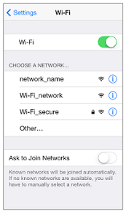
2. Be sure you are using the appropriate Wi-Fi network.
Check with an employee at the place where you are using the hot spot to make sure you are logging into the correct network. Some hackers may set up fake networks like “FREE Public Wi-Fi,” or use the name of the venue as a way to access your information.

Slide 6
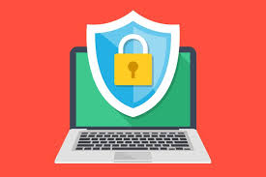
3.Make sure you have updated anti-virus and anti-spyware software on your computer.
You never want to be “unarmed” when you are using a hot spot. Make sure your anti-virus and anti-spyware software programs are updated. If something seems wrong when you are using the Internet using public wifi, get out as soon as possible. Don’t take a chance with your information.

Slide 7
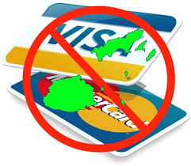
4.NO E-COMMERCE ON WIFI
You should treat all open networks as a security risk. We would recommend not doing any type of banking, online shopping or anything else that would expose your private information while on a Wi-Fi network. The rule of thumb to consider is that if you aren't willing to share the information with the public, it is wise to simply wait until you get home to do it (or do it with the secure network of your phone).

Slide 8
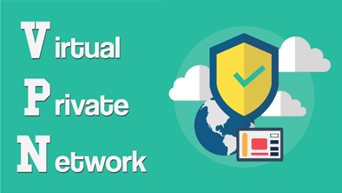
5.Use a VPN to keep yourselves safe online
A VPN is one of the best defensive weapons available on the market today. What this program does is that it works as a deterrent, an antivirus and a comprehensive tool for anonymous browsing on the internet. The risks of information leak on a public wi-fi hotspot are high but it is not very low on home networks either. A VPN makes sure that your IP address is masked, making your location invisible to everyone except yourself. This means that even when you are on a public internet connection, all your data traffic will be encrypted so that no one else can spy on it and causes you harm.

Slide 9


