Slide 1
Online Forms and Their Risks
Name:- Dr. Priyanka S. Patil
Designation :- Deputy Collector
Class :-D
Roll no:-14

Slide 2
What is online form…….?
An application form that is completed and submitted via internet.
It is an interactive page that mimics a paper document or form where users fill out particular fields.

Slide 3
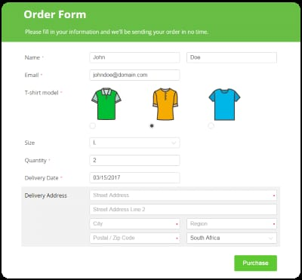
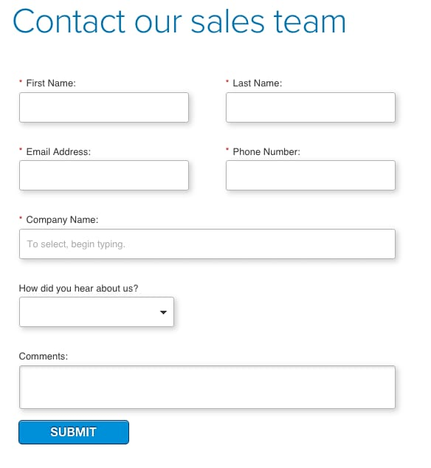
Where is online form used…?
1.Examination form
2. Newsletter sign up
3.Event registration
4.Online orders and payments
5.Contest registration
6.Account sign up
7. Sales Contract
8.Customer feedback
9.Free assessment and audit

Slide 4
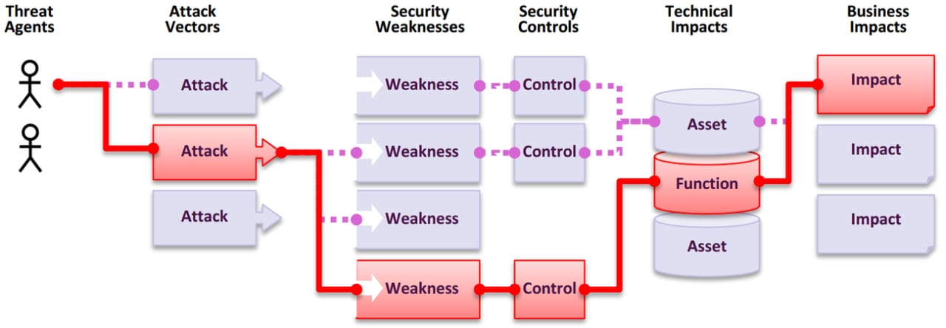
What are the Risks of Online Forms?
Online forms come with many risks which may harm ourselves or our interests.
Such Risks may include
Breach of privacy
Identity theft
Monetary frauds
Sensitive information
theft.

Slide 5
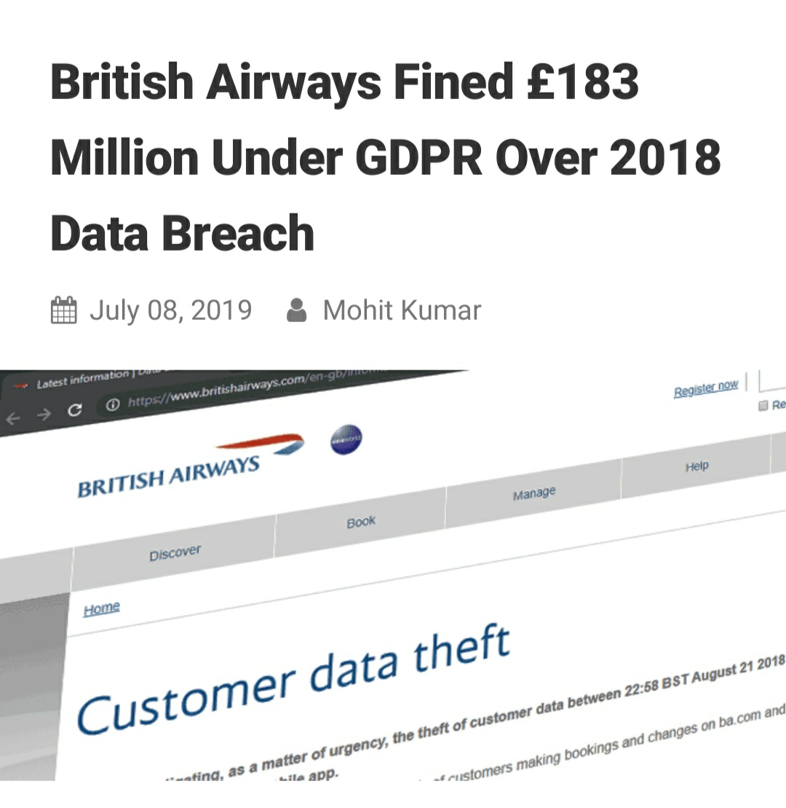
1. Injection
Injection happens when an attacker injects a bit of code to trick an application into performing unintended actions.
The most common and well-known injection attack is SQL injection (SQLi),
Here, an attacker inserts an SQL statement (type of program)that, for example, exposes the contents of a database table.
2.Broken authentication
Attackers can hijack user identities and hide behind genuine user IDs .
To gain easy access to your data and programs.
3.Sensitive data exposure
Unintended data display is a serious problem
to anyone operating a web application
that contains user data.
Such Data may include
Monetary details
Sensitive personal data
Medical history etc.

Slide 6
4: Broken access control
Broken access control occurs when users can perform functions that gets access to other users’ information.
Allow function access only to users you trust and implementing access control checks for each user-accessible object (such as files, webpages, and other information).
5: Security misconfiguration
“Security misconfiguration” is a general reference to
application security systems that are incomplete or
poorly managed. Security misconfiguration can occur
at any level and in any part of an application,
so it’s both highly common and easily detectable.

Slide 7
6: Cross-site scripting (XSS)
This vulnerability extendss the trust a user has given a specific site to a second, potentially malicious site.
Users generally permit trusted sites to perform certain actions. But malicious actors can modify a page on a trusted site to interact with an untrusted site.
exposing sensitive data or spreading malware.
XSS vulnerabilities are common, but they’re not difficult to remediate.
Eg;- MHADA website was scripted in such a way.
7: Insecure deserialization
Serialization is used to turn an object into data that can be sent somewhere or stored. In this way, the object can be recreated in the same state by another system and/or at another time via the process of deserialization.
An attacker could provide an object that, when deserialized, gives the attacker access privileges or runs malicious code.
This vulnerability is difficult to exploit.
difficult to detect..

Slide 8
8. Using components with known vulnerabilities
Open source development practices drive innovation and reduce development costs.
But despite the benefits of open source software, significant challenges remain in security and management practices.
It’s critical that you gain visibility into and control of the open source components in your applications.
9. Insufficient logging and monitoring
Sufficient logging and monitoring can’t prevent malicious actors from launching an attack.
But without it, you might find it difficult to detect attacks, shut them down, and determine the scope of the damage.
Insufficient logging and monitoring is common.
But it’s also difficult to detect.
Even if your logs have enough detail to reveal an attack in progress, there’s no guarantee that the systems that monitor those logs are working.

