Slide 1
Sharing Photos Online
-Pranil Prafulla Gilda
D 17
Prob.DySP/ACP
Notes:
Hey u can add now in next slides
Just add content I'll do editing

Slide 2
In todays era where life has become all about internet, sharing photos online has become a part of lifestyle.
Your online status is judged by how much likes and shares you get to your shared photos.
And this is true for people of all age groups, n every strata of society.
This has become a new way of sharing your happines, sadness n every aspect of your life with your dear ones.

Slide 3
When you want to share a photo or a gallery with friends, family or even the entire internet, an image hosting site is the best way to upload, store and share your files.
There are many image hosting sites with different features.

Slide 4
Some of best online photo sharing sites are as follows:-
1) Google photos( previously Picasa Web Albums)
2) Facebook
3) Instagram
4) Flicker
5) Amazon Photos
6) Photobucket
7) Shutterfly
8) Pinterest

Slide 5
How to share photos online?
Ways of sharing the photos online varies with the app or website that you choose.
Lets see few examples of how to share photos online.

Slide 6
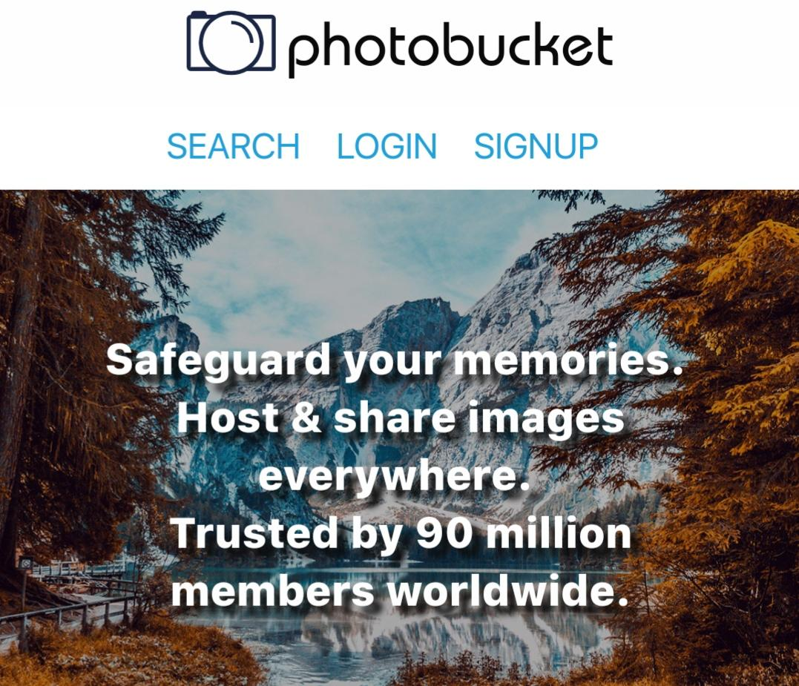
1)How to share photos on
Photobucket?
Steps:-
1. Log into your Photobucket
account.
2. Open an album where a photo or image is
located.
3. Click on “ Edit setting” button and change
to public.
4. Click on the photo you want share.
5. Click on the share button.

Slide 7
2) How to share photos on
Facebook?
Steps:-
1. Log into your Facebook account.
2. Click share a photo/video at top of your page’s
timeline.
3. Choose an option: upload photo/video : add photo
/Video from your mobile/ computer.
4. Select photos/videos you want to add.
5. Write an optional update and click publish. (you
are provided with flexibility of privacy.)

Slide 8
“Are people sharing too much
Online..?”
In this way we tend to share
every moment of life online to
create memories and this has
become a new way of being happy.
But sharing too much photos on internet which has no opening or closing doors and which is as vast as open sky is really safe?
This online sharing craze has created many new societal problems and given rise to different kinds of

Slide 9
cyber crimes.
For example, Photo morphing, romance and dating scams, cyber bullying, blackmailing etc.
So as a need of time it has become necessary that everyone should be careful and aware while sharing photos on internet because precaution is always better than cure.

Slide 10
Thank you ….

