Slide 1
Apply for Ration Card online
By Vaibhav daulat Pawar
Tahsildar (Group A)
Cptp-6
Batch – b
Roll no.- 15

Slide 2
What is Ration Card ?
It’s a document given to the targated group for purchase of essential commodities at subsidized rates.
Provided by Government.

Slide 3
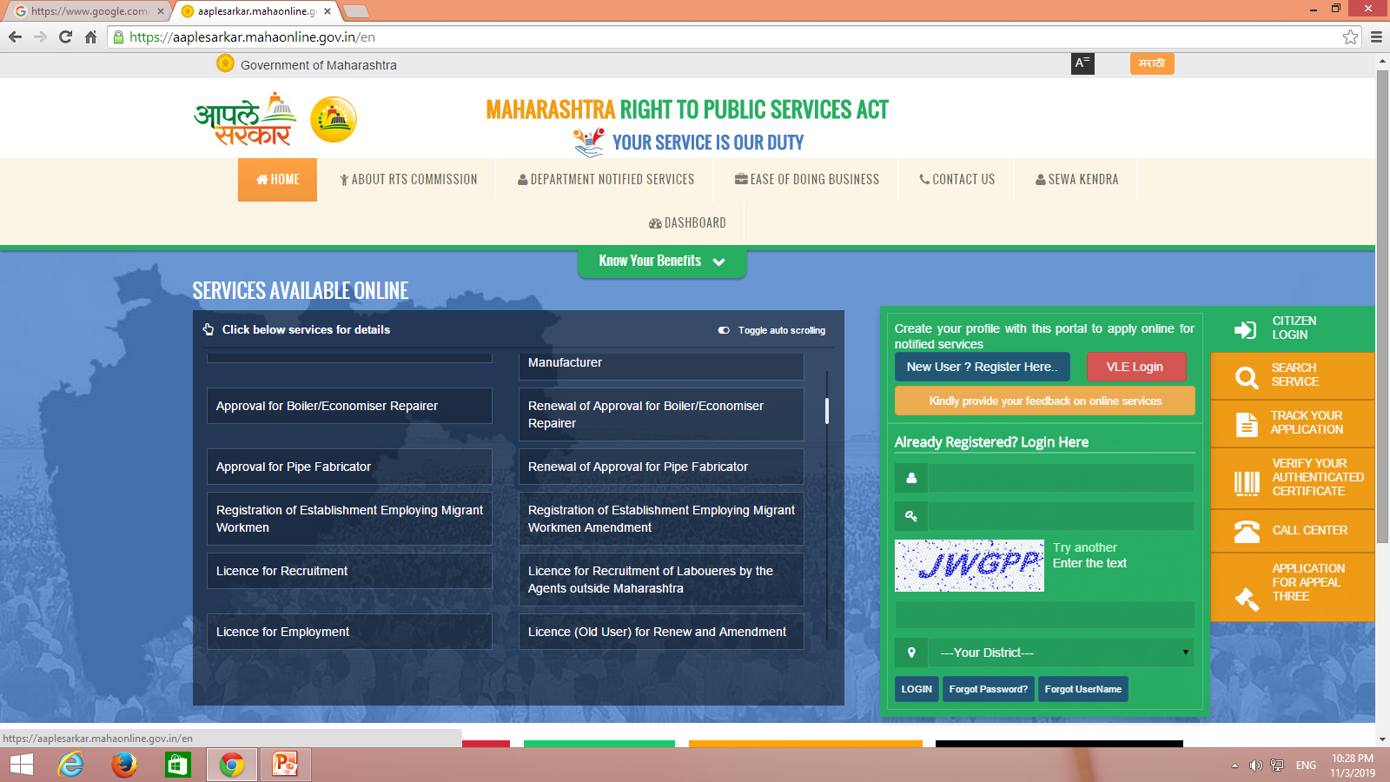

Slide 4
How to Apply :
Go to www.aaplesarkar.mahaonline.gov.in
New User
registration
Applicants details
Get email id and password
Demand for new Ration Card
Food and public distribution system
Citizen Login
Again Home
Required Documents
Fill up form and register
Successfully Apply for new Ration Card

Slide 5
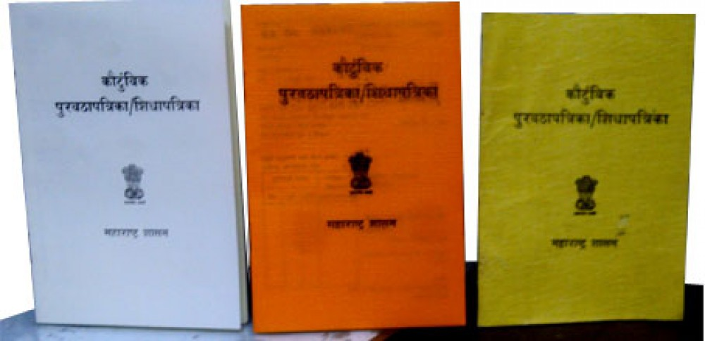
Types Of Ration Card
There are 3 types of Ration Card
Yellow Ration Card
Saffron Ration Card
White Ration Card

Slide 6
Yellow Ration Cards
Yellow color ration cards are issued only to families who fall under Below Poverty Line (BPL) category.
Saffron Ration Cards
Families having yearly income of more than Rs.15,000 and less than 1 lakh can apply for the saffron smart ration card.
White Ration Cards
Families having annual income of Rs. 1 Lakh or above can apply for white smart ration cards.

Slide 7
Required Documents
Application form
Proof of Identity
Proof of Address
Proof of Age
Surrender/Deletion Certificate of the previous Ration Card, if exists.

Slide 8
Commodities Covered
BPL Yellow Ration card holders are provided with 35 Kgs food grains (Wheat + Rice) and APL Saffron Ration card holders are provided with 15 Kgs food grains (Wheat + Rice )
subsidized rate - Rs 3/kg for Rice, Rs 2/kg for Wheat and Rs 1/kg for coarse grains via PDS as per the National Food Security Act (NFSA).

Slide 9
Thank you

