Slide 1
Make My Trip App To Organise My Trip Online
Presented by
Kishor Kashinath Pawar
Assistant Commissioner Of State Tax
Class A

Slide 2
Steps to Use the App
Install Make My Trip App from Google Play store or Apple store
To use app you must login using Google or Facebook or MMT Id or create account using valid email and password.

Slide 3
Home Page of the App
Make My Trip Limited is an Indian online travel company founded in 2000. Headquartered in Gurugram Haryana, the company provides online travel services including flight tickets, domestic and international holiday packages, hotel reservations, and rail and bus tickets. As of 31 March 2018, they have 14 company-owned travel stores in 14 cities, over 30 franchisee-owned travel stores in 28 cities, and counters in four major airports in India. Make My Trip has offices in New York , Singapore Phuket, Kuala Lumpur , Bangkok, and Dubai.

Slide 4
Feature provided in the App
Flight Bookings-Travel within India and abroad
Hotel Booking-Book a cheap hotel in India and the world’s best cities
Bus booking
Railway ticket booking-IRCTC authorized
Cab booking
Holiday booking- India and International
Best recommendation engine for traveling user.
Integrated with multiple payment gateways.

Slide 5
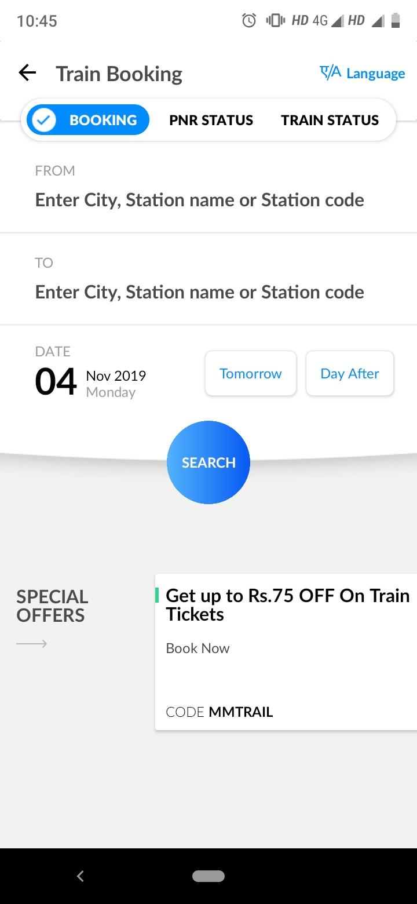
To search and book various services

Slide 6
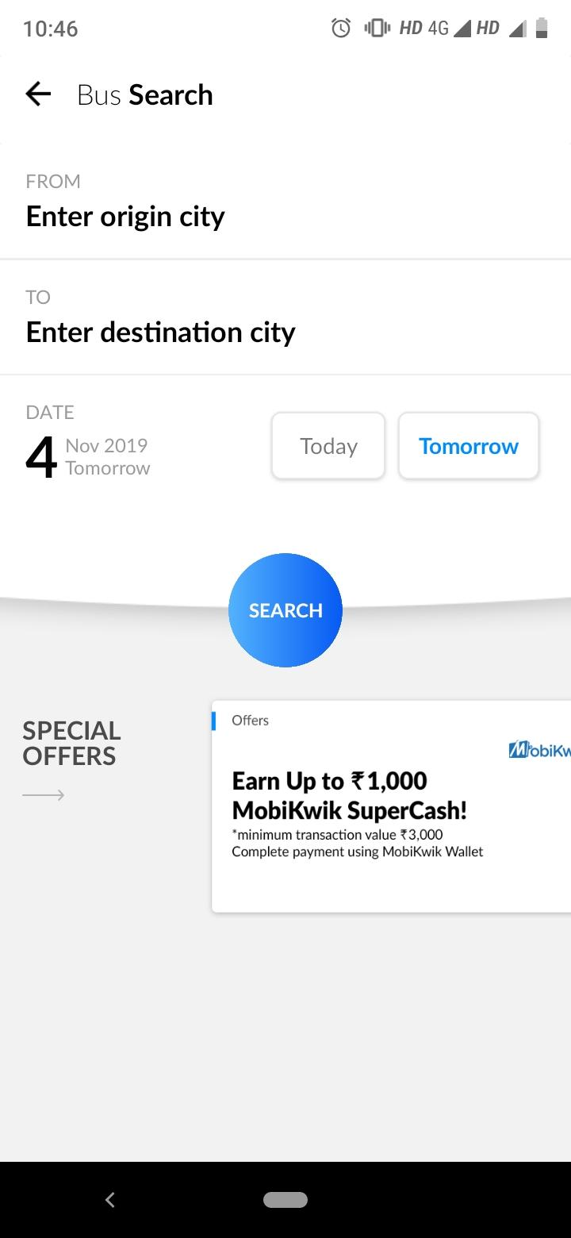
Continue boooking and search

Slide 7
Continue booking and search

Slide 8
Help option
If there is any problem at any step while booking trip we can use this option which will provide quick solution.

Slide 9
Why to use MMT app?
Easy and simple interface
Various filter options
Various payment options like UPI,online banking etc.
Attractive discount
Loyalty / bonus points
Fast refund
Reliable and verified partners

