Slide 1
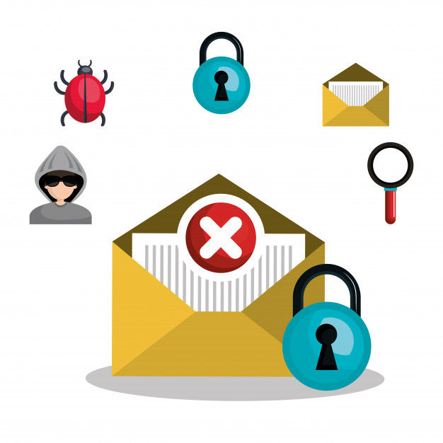
The Consequences Of Downloding Unknown Email Attachments And Safety Tips.
Ganesh Laxman Pawar
Deputy Collector
Roll No. C-21

Slide 2
INTRODUCTION
Email became one of the most used means of communication in the last decades. It just takes seconds to make appointments, to send files or to communicate anything, whether it is personal or business related.
But it also only takes those few seconds to cause a lot of damage. Most computer viruses are spread via email attachments.

Slide 3
Why can email attachments be dangerous?
Email is easily circulated – Forwarding email is so simple that viruses can quickly infect many machines. Most viruses don't even require users to forward the email—they scan a users' computer for email addresses and automatically send the infected message to all of the addresses they find.
Email programs try to address all users' needs – Almost any type of file can be attached to an email message, so attackers have more freedom with the types of viruses they can send.
Email programs offer many "user-friendly" features – Some email programs have the option to automatically download email attachments.

Slide 4
THE CONSEQUENCES OF DOWNLODING UNKNOWN EMAIL ATTACHMENTS
Web Bugs- Web bugs are invisible icons, that detect when a certain email address is active so that they can continue to clog your mailboxes.
Corrupt Your Hard Drive- Documents, voicemails, and PDFs are designed in such a way that they can launch the attack on the victim’s computer.
Keep Your Data Hostage- This type of virus is highly harmful to individuals and organizations. These viruses keep your data hostage and demand a ransom in return for your data. According to the study by Datto, ransomware causes businesses $75 billion per year.

Slide 5
Spy On Your Activities & Share Your Data- Each virus serves a specific purpose such as writing code on your hard drive, which turns your computer into an agent that spys on your activities and sends data to external locations. Spyware tends to steal your personal information.
Steal Personal Information- Opening email attachments from unknown sources can allow the sender to access your passwords, bank information, and other critical stuff on your computer. Then they can steal your identity or your money or in worst cases, your valuable data.
Trojan Horse- Tojan horse is harmful. If you witness unexpected changes to your computer settings and unusual activity even when your computer is idle, then these are strong indications of Trojan.

Slide 6
SAFETY TIPS
Be aware of unsolicited attachments, even from people you know-Just because an email message looks like it came from your mom, grandma, or boss doesn't mean that it did. Many viruses can "spoof" the return address, making it look like the message came from someone else.
Use an anti-virus scanner – Install software on your computer yourself or with your MSP provider that will safeguard you against the latest malware or virus attack.
Save and scan any attachments before opening them

Slide 7
Stop automatic downloads – Don’t allow your email or computer to automatically download attachments. You can control this setting yourself and reserve the right to choose whether or not you want to download information that is being sent to you.
Type in correct URL directly – Don’t click financial links in emails. Instead, type the correct URL into your computer browser yourself and go directly to the genuine website. This should be the case for important transactions such as banking or any reputable company that is asking you to open or download an attachment.
Delete when you are in doubt – It is better to delete an email and attachment that you are unsure of then to inadvertently open it.

