Slide 1
APPLY FOR INCOME CERTIFICATE ONLINE
By- Dr. Dattatray R. Pawar
ACST

Slide 2
OVERVIEW
Income certificate is a very important Document.
It is needed as a basic document for various certificates eg. For caste certificate, for caste validity certificate, for college admission etc.

Slide 3
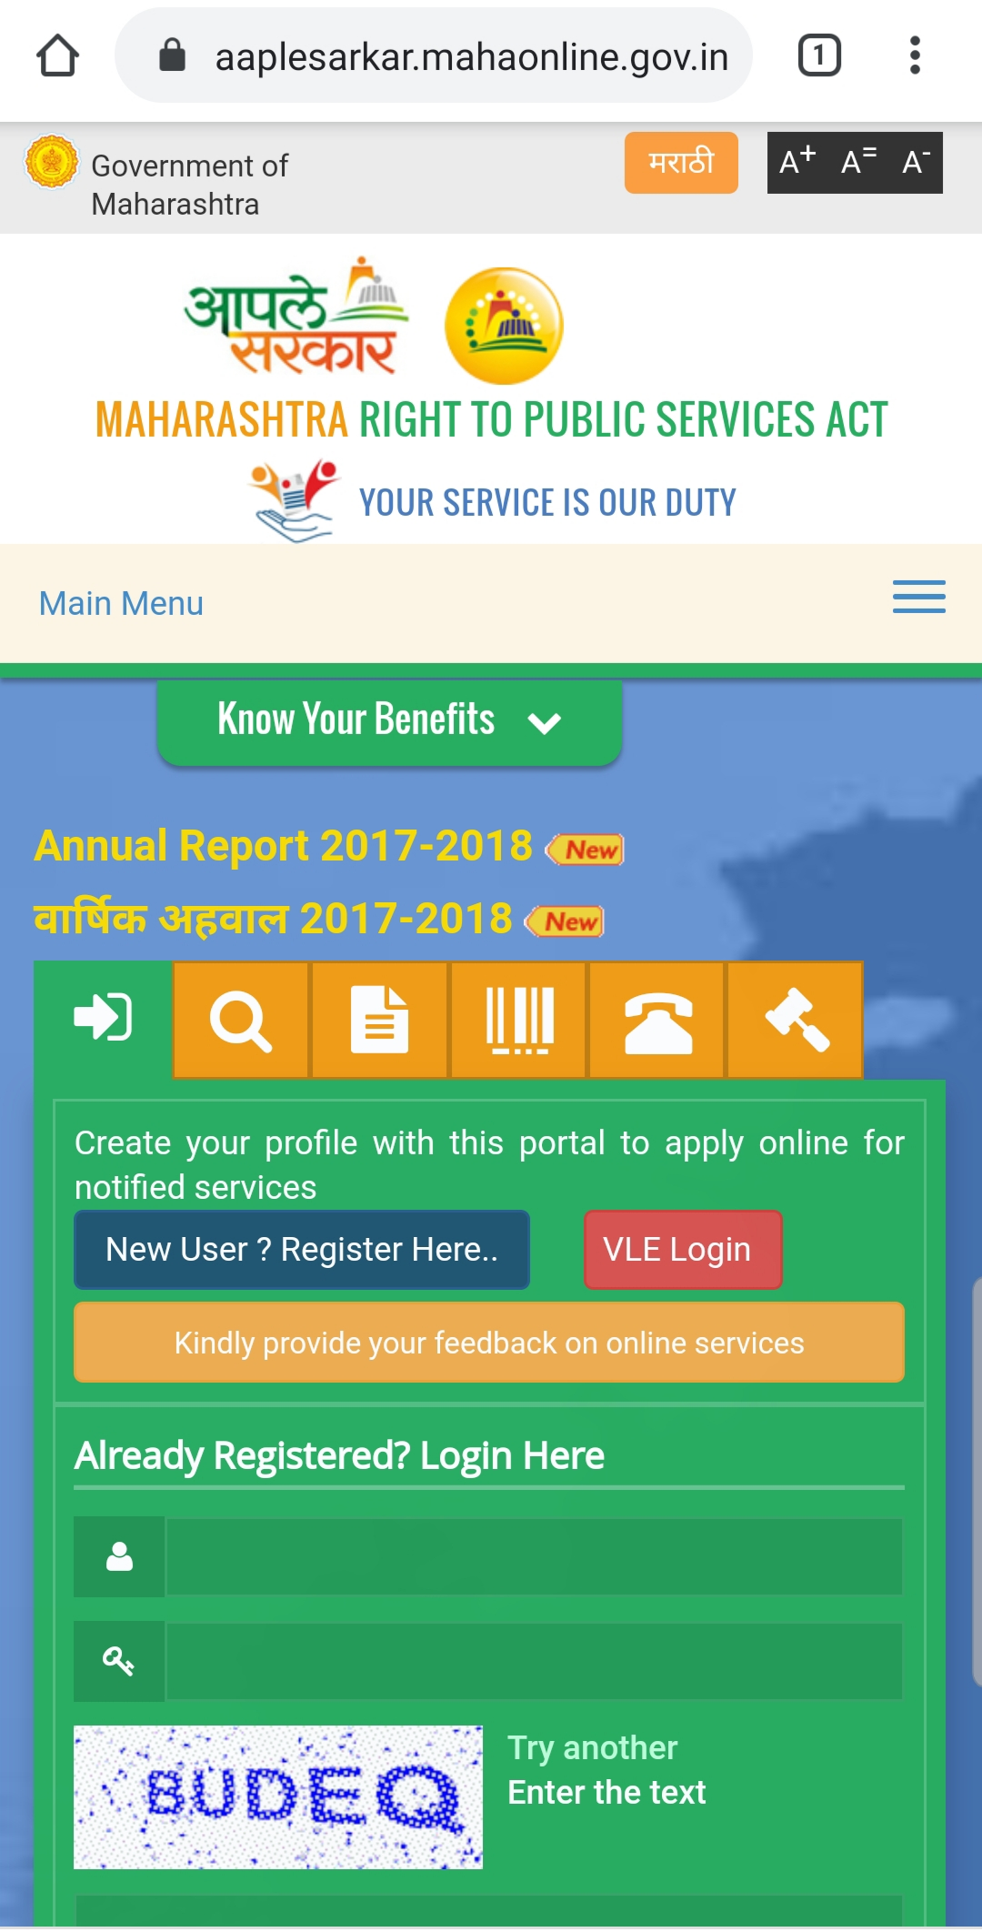
HOW TO APPLY?

Slide 4
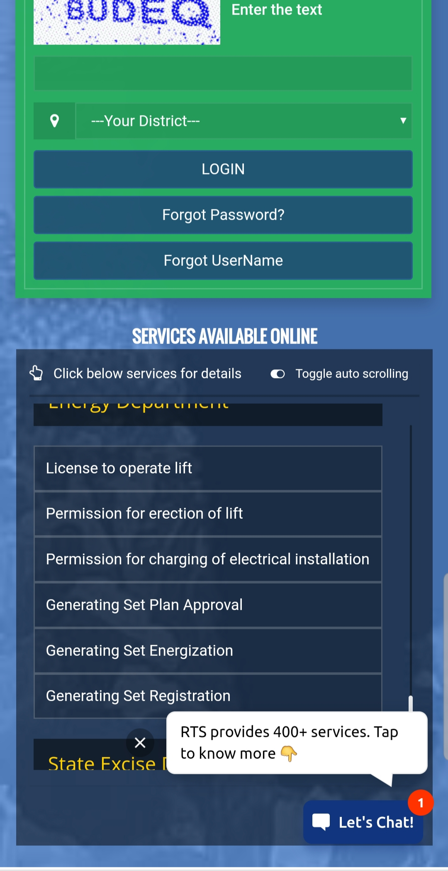

Slide 5
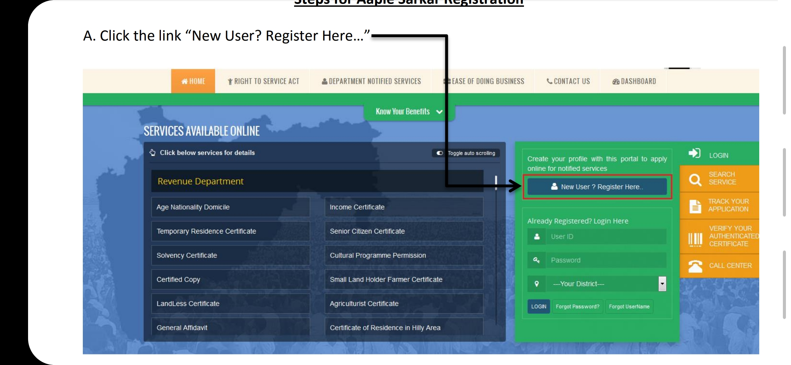

Slide 6
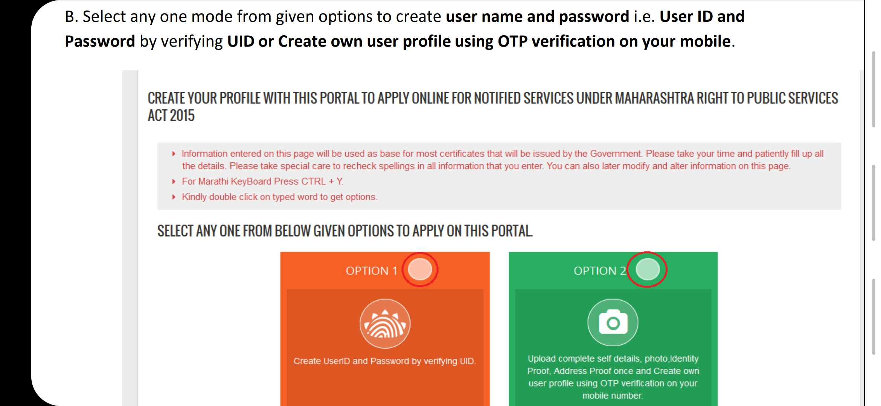

Slide 8
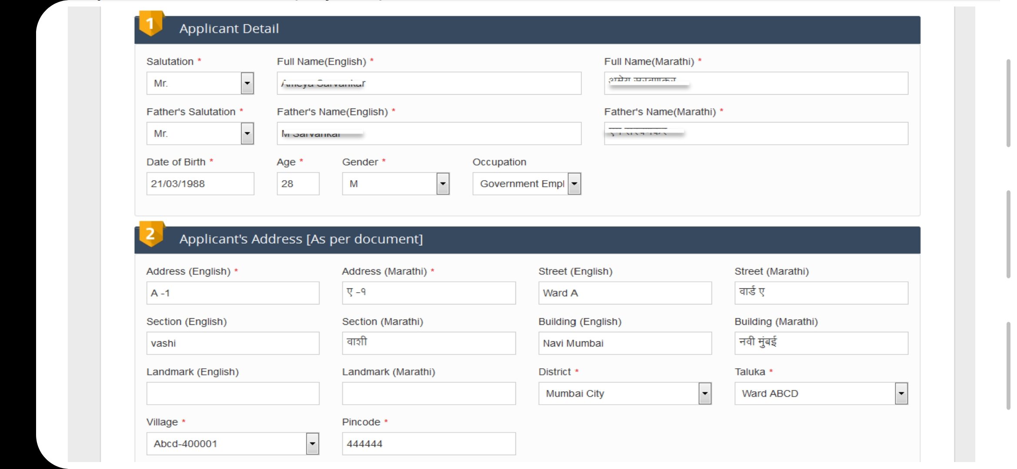

Slide 9
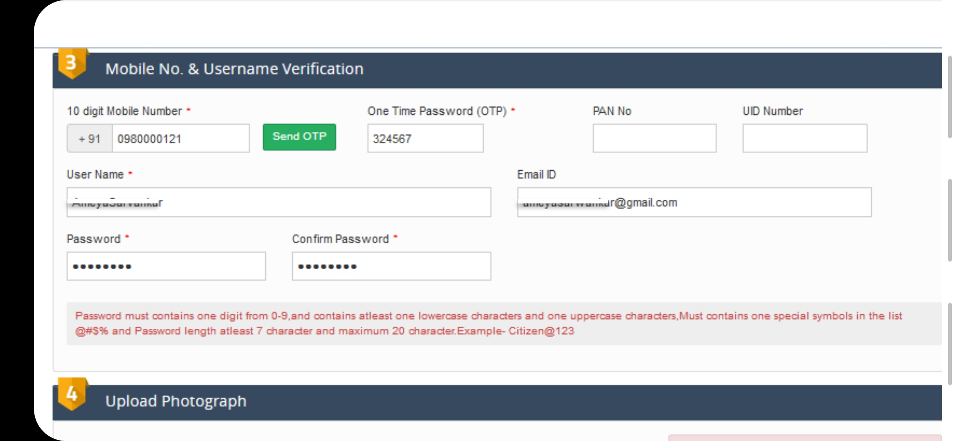

Slide 10
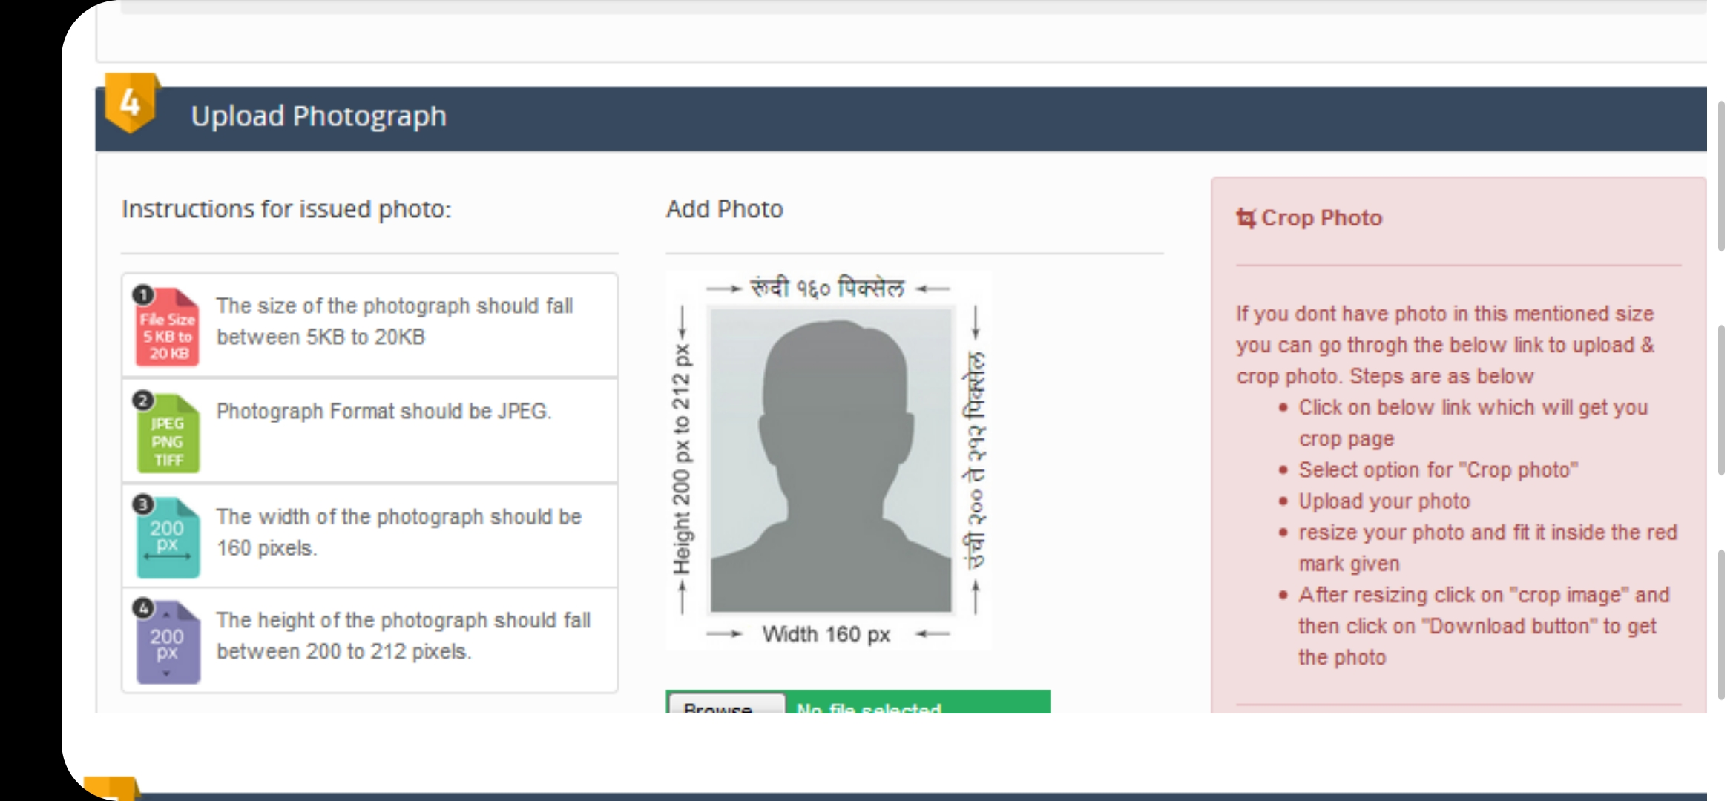

Slide 11
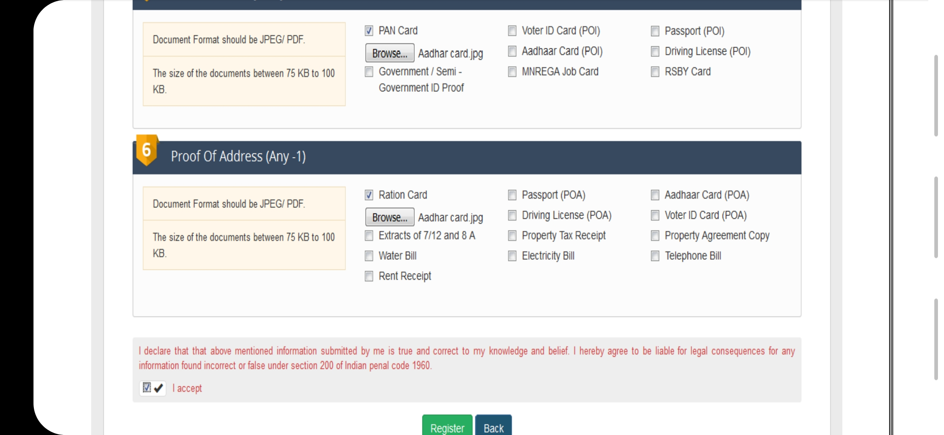

Slide 13
Proof of Identity (Any -1)
1) PAN Card.
2) Passport.
3) RSBY Card.
4) Aadhaar Card.
5) Voter ID Card.
6) MNREGA Job Card.
7) Driving License.
8) Photo of Applicant.
9) Identity card issued by Govt or Semi Govt organisations.

Slide 14
Proof of Address (Any -1)
1) Passport.
2) Water Bill.
3) Ration Card.
4) Aadhaar Card.
5) Voter ID Card.
6) Telephone Bill.
7) Driving License.
8) Electricity Bill.
9) Property Tax Receipt.
10) Extracts of 7/12 and 8 A/ Rent Receipt.

Slide 15
Age Proof (In Case of Minor) (Any -1)
1) SFC Certificate.
2) Birth Certificate.
3) Bonafide Certificate.
4) School Leaving Certificate.
5) Extract from primary school entry.

Slide 16
Proof of Income (Any -1)
1) Income tax statement letter.
2) Circle Officer Verification report.
3) If Recieved Salary Provide Form no16.
4) Retirement/Salary holders Bank Certificate.
5) If applicant is owner of the land then 7/12 to yield 8-A Talathi report.

Slide 17
Issuing Authority & Time Limit
Sr.No | Service name | Time limit | Designated Officer | FirstAppellateOfficer | SecondAppellateOfficer
1 | lncome Certificate | 15 | Nayab Tahsildar | Tahsildar | Sub-Divisional Officer

