Slide 1
It skills assignment presentation on- File my income tax return ( itr )
By- Sudhir Subhash Patil
Cadre- Deputy Collector
CPTP- 5
Class- B
Roll No- B- 11

Slide 2
Introduction-
Income Tax Act- 1961 ( w. e. f.- 1 April 1962 )
Section- 139- RETURN OF INCOME
(1) Every person,—
(a) being a company or a firm; or
(b) being a person other than a company or a firm, if his total income or the total income of any other person in respect of which he is assessable under this Act during the previous year exceeded the maximum amount which is not chargeable to income-tax, shall, on or before the due date, furnish a return of his income or the income of such other person during the previous year, in the prescribed form and verified in the prescribed manner and setting forth such other particulars as may be prescribed
Income Tax Return (ITR)- is a prescribed form through which the particulars of income earned by a person in a financial year and taxes paid on such income are communicated to the Income-Tax Department ( ITD ).
- It also allows carry forward of loss and claim refund from ITD.

Slide 3
Different types of ITRs-
- for different status and nature of income.
Form No. | For Whom It is VALID ?
ITR- 1 (SAHAJ) | For Individuals having Income from Salary & Interest.
ITR- 2 | For Individuals & HUFs not having Income from Business or Profession.
ITR- 3 | For Individuals & HUFs not having Income from Business or Profession and Capital Gains and who do not hold foreign assets.
ITR- 4 (SUGAM) | For Individuals/HUF having income from presumptive business.
ITR- 5 | For a person being a firm, LLP, AOP, BOI, artificial juridical person, cooperative society and local authority.
ITR- 6 | For a company, other than a company claiming exemption under section 11.
ITR- 7 | For a persons including companies required to furnish return under section 139(4A) or section 139(4B) or section 139(4C) or section 139(4D).

Slide 4
Modes of filling ITR-
furnish the return-
(i) in a paper form;
(ii) electronically under digital signature;
(iii) by transmitting the data in the return electronically under electronic verification code;
(iv) by transmitting the data in the return electronically and thereafter submitting the verification of the return in Return Form ITR-V.
Due date of filing of return-
Companies / A Person whose accounts are required to be audited / A working partner of a firm whose accounts are required to be audited- SEPTMBER 30 of the assessment year
Any other assessee- JULY 31 of the assessment year .
If due date is NOT followed one has to pay INTERSEST on tax due and LATE FEE.

Slide 5
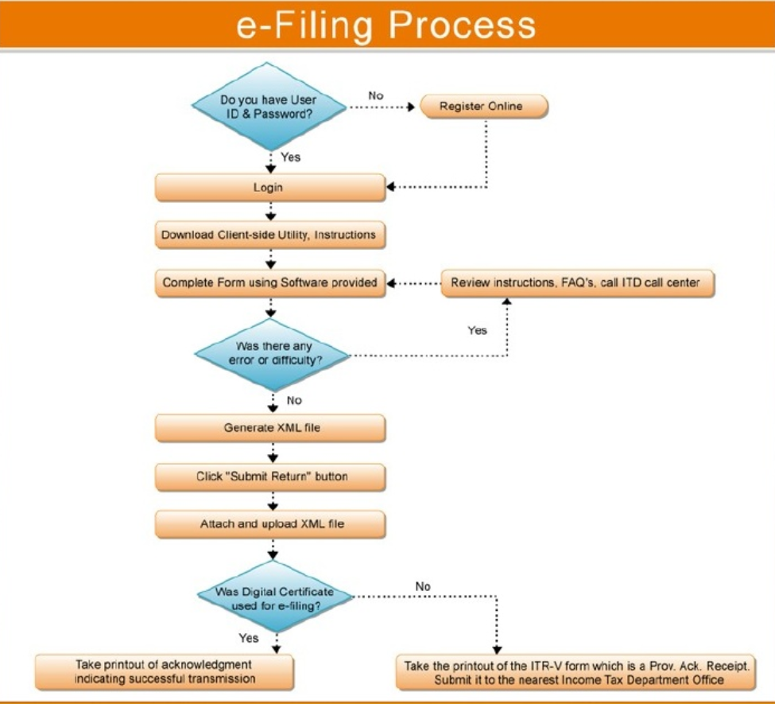

Slide 6
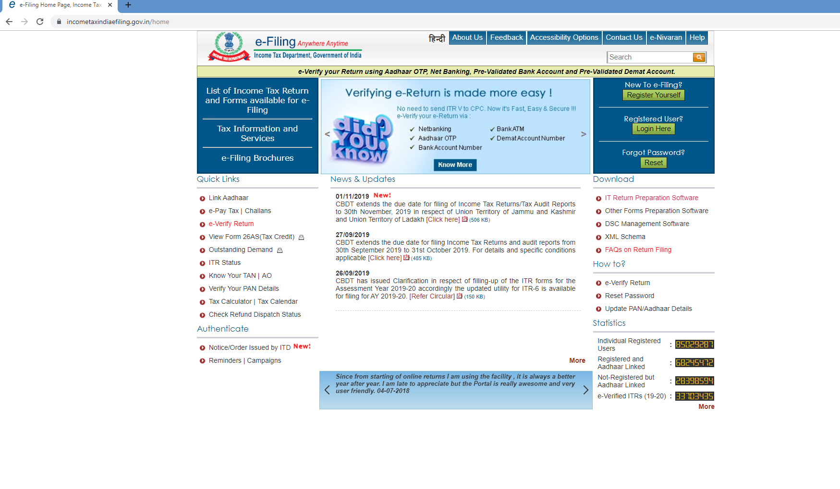
Steps involved in e-filing of itr- 1
Go to Website- https://www.incometaxindiaefiling.gov.in/home
2. Registration- New users must register on clicking ‘ Register Yourself ’ button on the top right corner in the website. And then
have to fill the required info. in subsequent steps.
For new users
For already registered users

Slide 7
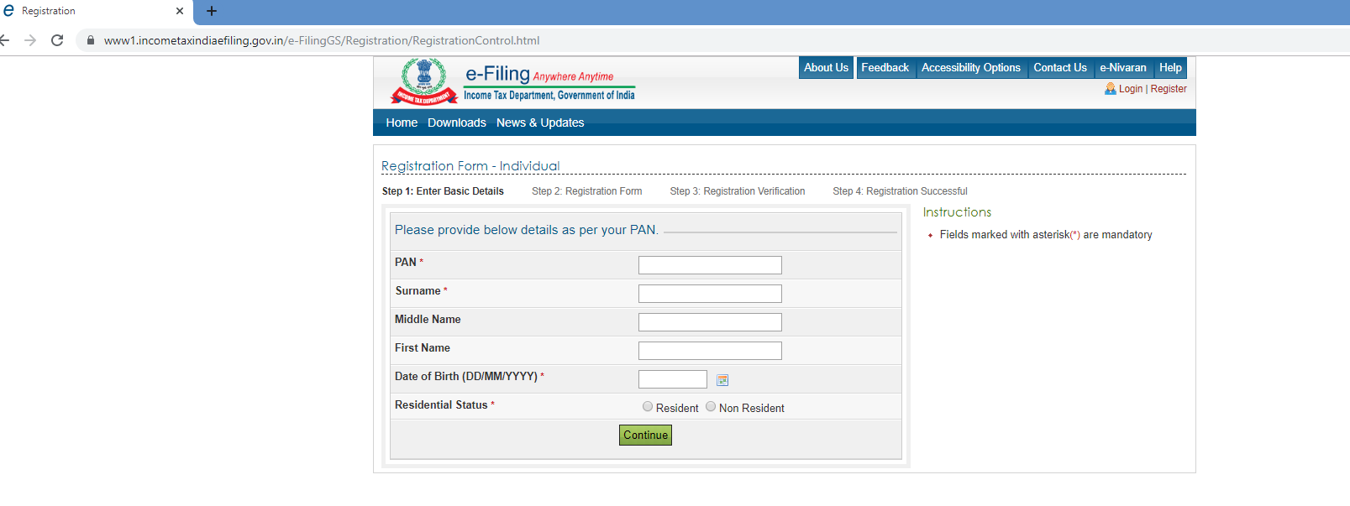
Select the proper user type-
Enter the required applicable details and likewise complete the registration-

Slide 8
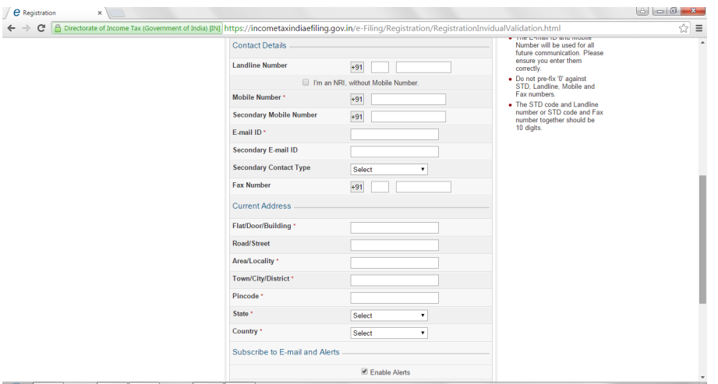
In the following screen one will need to enter a password, secret question and answer and other personal details such as contact number, email id, address etc. to complete the registration. And then one can file his returns.

Slide 9
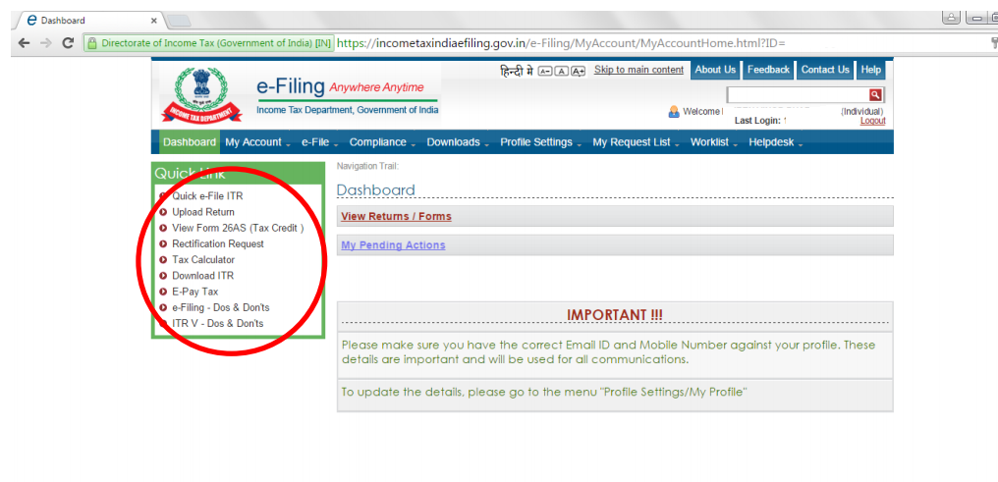
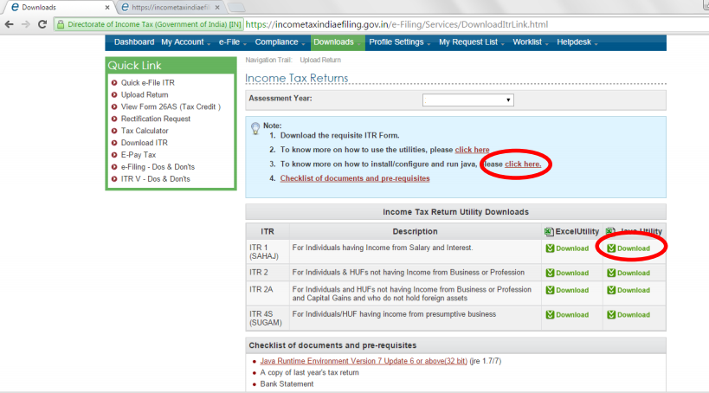
3. Preparation of ITR
a) Prepare and Submit ITR Online- only for ITR 1 / 4S
b) Upload ITR- Prepare the Return using the ITR preparation Software
downloaded from the IT departments website. Then Upload the return.

Slide 10
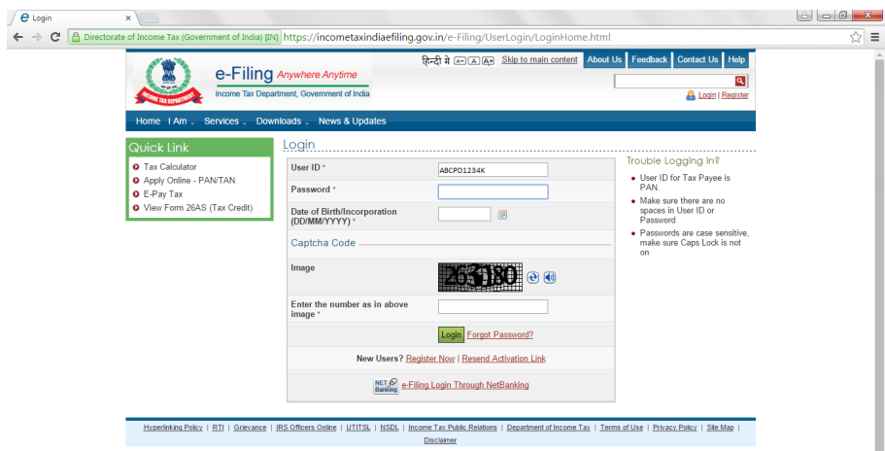
4. Login Process - Login with User ID- i.e. PAN ID, Password, Date of Birth / Date of Incorporation and enter the Captcha code.

Slide 11
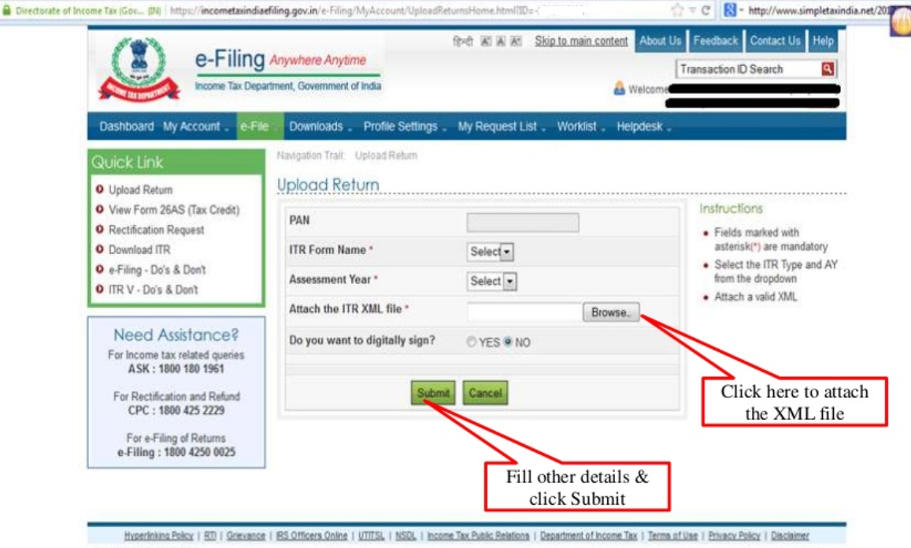
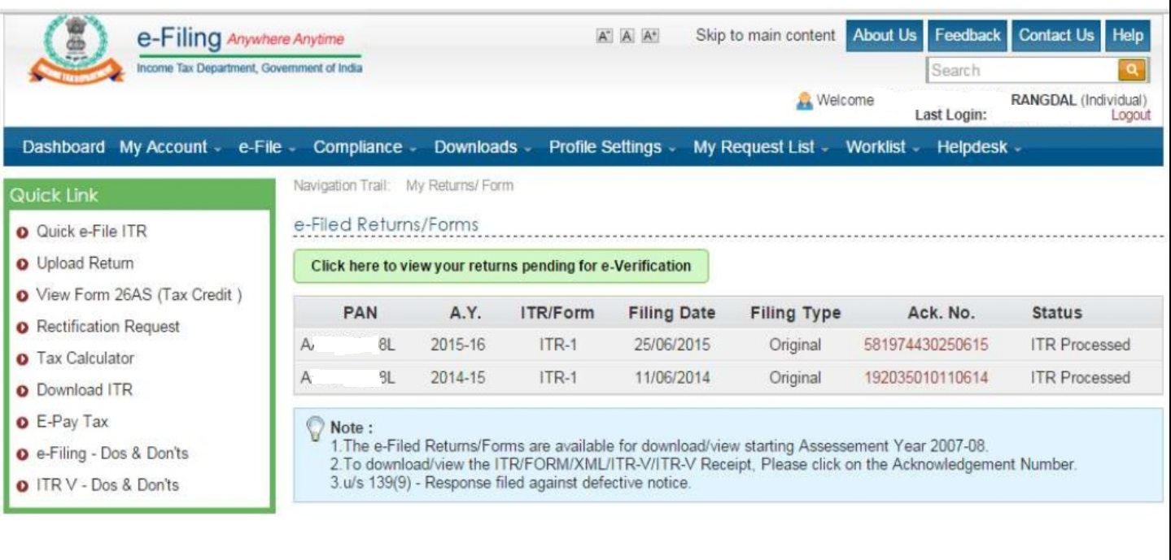
5. UPLOADING - Select the appropriate ITR, Assessment Year and XML file previously saved using Browse button. Then Upload Digital Signature Certificate (DSC), if applicable.
Download ITR- V( Not required for DSC users), sign it and send to CPC Banglore within 120 days.

Slide 12
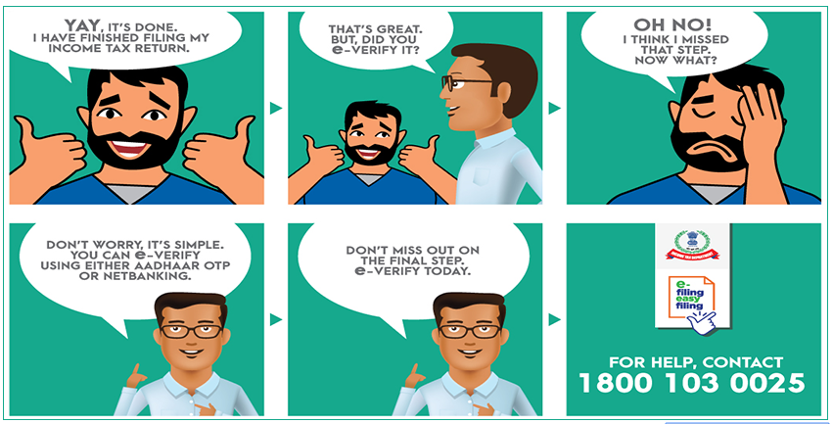
6. Verification-

