Slide 1
Email Etiquette
Presented by: Pooja Sudam Patil
Deputy Collector
CPTP5
Class:D , Roll No:D13

Slide 2
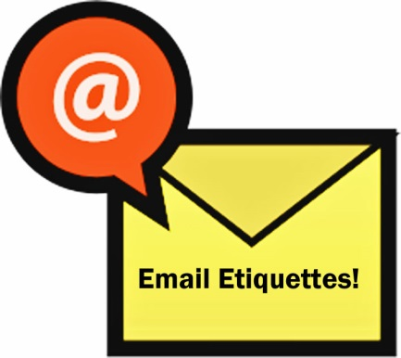
Email Etiquette
What is etiquette?
The customary code of polite behaviour in society or among members of a particular profession or group.
Email etiquette is especially important in the work place.
Purpose of email in the workplace
Quick communication
Share professional information
Keep records of communication

Slide 3
THANK GOODNESS FOR EMAIL!
Quicker Means of Communication
Cheaper
GO GREEN!
Easier

Slide 4
Email Etiquette: Do’s & Don’ts
Do include a heading in the subject line.With the number of emails and viruses that populate inboxes, a subject header is essential if you want someone to read your message.
Do personalize your message to the recipient. A personal greeting such as Dear,Hi is necessary. Failure to include a greeting can make your message seem cold.

Slide 5
Email Etiquette: Do’s & Don’ts
Do account for tone.The reader can not see your face or hear the tone of your voice , so choose your words carefully and thoughtfully.
Do look at your email address and determine how it represents you.Students sometimes embarrass themselves by communicating with an employer using an inappropriate address.
Do include your name or a signature with additional details and contact information. The recipient may want to communicate by means other than email.

Slide 6
Email Etiquette: Do’s & Don’ts
Don’t forget to check for spelling and grammar.It represents you.Poorly written messages may indicate a poor caliber of work in other ways.
Don’t forward email without permission.Often confidential information becomes global because of someone’s lack of judgement.Unless you were asked to forward something , don’t do so without permission.

Slide 7
Email Etiquette: Do’s & Don’ts
Don’t think that no one but the intended recipient will see your email.Do not use email to discuss confidential information.
Don’t write an essay. Email is intended to be a brief communication.Keep the message short and concise.Use only a few,brief paragraphs.

Slide 8
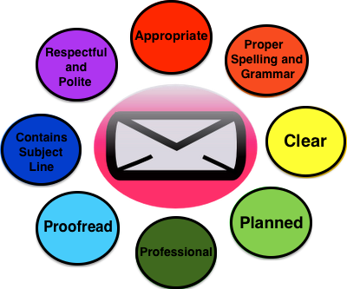

Slide 9
Well What Is Cc And Bcc?
Cc
Bcc
It stands for Carbon Copy.
Carbon copied recipients ARE visible to all other recipients.
Usually used when others are referenced in the email or for those you want included in the conversation.
It stands for Blind Carbon Copy.
Blind carbon copied recipients are NOT visible to anyone but the sender.
Use this when sending to a long list of recipients or to recipients that should not know each other.

Slide 10
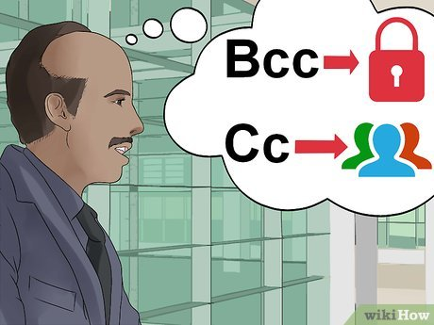

Slide 11
If You Answer Yes To Any Of These…
Could this information hurt/embarrass/offend someone?
Could this email be misinterpreted in a bad way?
Could this email get me into trouble?
Do Not Send An Email.

Slide 12
Email Etiquette Unspoken Expectations…
Try to reply to an email within 24
hours.
Establish an organized filing systems.
Keep copies of important emails for reference.
Use separate accounts for personal and business emails.

