Slide 1
How to protect myself from online lottery cheating and fake messages
BY
Parvanee ravindra patil
Deputy Collector
Cptp5 (2019)
Yashada,pune

Slide 2
Types of Online fake messages
Online lottery winning message
Online job offers
Fake messages from banks
Fake news on social media
Holiday pack messages

Slide 3
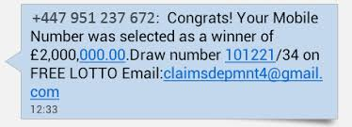
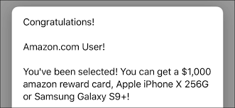
How it works

Slide 4
Lottery cheating messages
You may receive notification of winning prize.
It may be through mail,text message,social media,telephone.
The prize you have ‘won’ could be anything from a tropical holiday to electronic equipment , or even money from an international lottery.
To claim your prize, you will be asked to pay a fees.
The email, letter or text message you receive will ask you to respond quickly .

Slide 5
You may also be asked to provide personal details like bank account details so the prize can be sent to you.
scammers actually do send a cheque for part of your winnings to trick you into thinking the offer is legitimate.

Slide 6
How to protect yourself
If you haven’t entered a lottery or competition, you can’t win it.
If someone asks you to pay money up-front in order to receive a prize or winnings, it’s almost always a scam.
Verify the identity of the contact by calling the relevant organisation directly .
Never send money or give credit card, online account details, or copies of important personal documents to anyone you don’t know or trust.

Slide 7
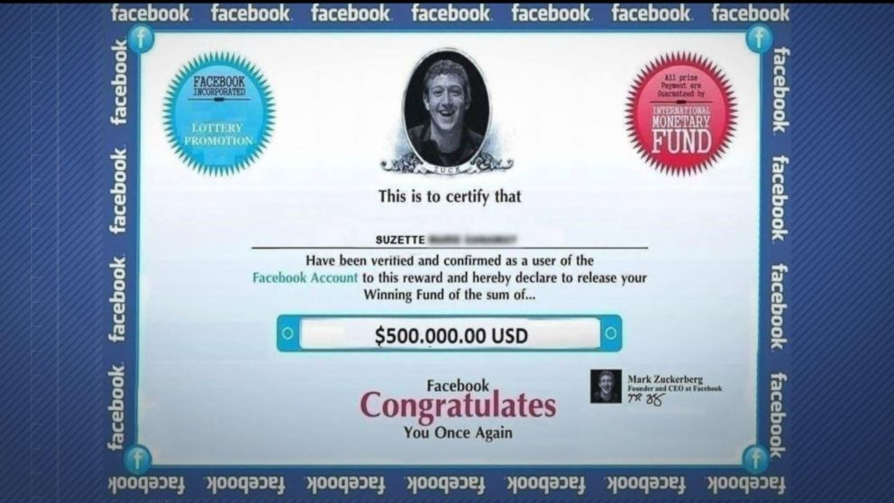
Facebook Lottery Scam 2019
Scammers will typically try one of three methods to try and steal money from people.
Official’ Facebook Emails
Friend Requests
Friend Requests from Real Life Friends

Slide 8
Some security measures
Crowdfunding and charities
Check the site,go directly to the original site.
Secure payment.
never click on links in suspicious texts or call the phone number in the message.
Remember, you cannot win a cash prize in a lottery you have not participated in.
Do not trust automatically translated messages or those containing obvious mistakes.
Always check the sender’s email address(es). Lottery organizers will not send messages from free mail services.
If you still think the message you have received is about a real win, check all the information. Use search engines to look at the lottery name, the senders’ names and telephone numbers.
Most importantly, always remember: there is no such thing as a free lunch.

Slide 9
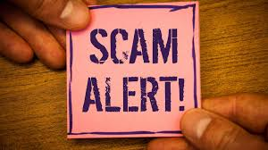
Technical Countermeasures
Secure Connections (HTTPS)
Web Browser Features and Settings
Use of Email SPAM Filters software

