Slide 1
IDENTIFY AND PROTECT MYSELF FROM FRAUD CALLS REGARDING ONLINE LUCKY DRAW
PRESENTATION BY:
GANESH PRAKASH PATIL
ACST (CPTP-6)
BATCH-C

Slide 2
BACKGROUND Now a days there is increase in use mobiles in daily life. It leads to treats like fraudulent calls regarding online lucky draw. It is happened in many cases .This is universal scenario but this problem can be tackle as to see a approach ‘No one can give you anything without efforts.’

Slide 3
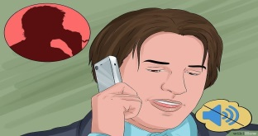
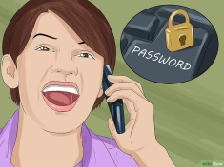
IDENTIFICATION OF FRAUD CALLS REGARDING ONLINE LUCKY DRAW:
1.Do not confirm or deny your identity until you know who is calling.
2.Decide how to proceed depending on your comfort level after getting the information.
3.Check the legitimacy of any agency, organization or company calling you cold by doing a quick online search while on the phone.
4.Do not disclose personal information or passwords.

Slide 4
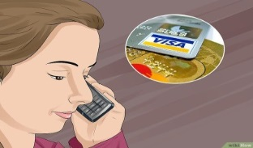
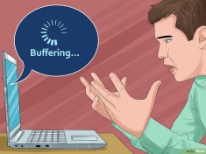
5.Ask what the caller wants early in the call.
6.Never use affirmative until you know that the call is legit.
7.Record the call.
8.Do not go to fake websites following the prompts of cold call
9.Be strong and put safety first.

Slide 5
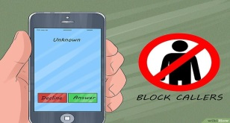
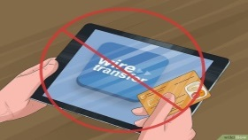
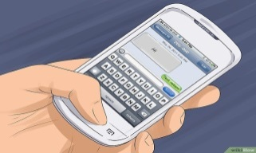
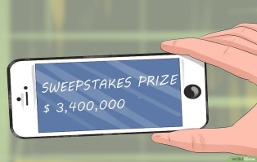
PROTECT MYSELF FROM FRAUD CALLS REGARDING ONLINE LUCKY DRAW:
1.Don’t answer unknown callers.
2.Don’t get into deal with wired money.
3.Never reply to messages asking you for financial/personal information.
4.Don’t fall pray to lottery scams.
5.Hang up on the robo calls.
6.Get a call blocking app.
7.Give complaint in police.

Slide 6
EXAMPLES OF FRAUD CALLS REGARDING ONLINE LUCKY DRAW:
1.There was such example found as in case of Snapdeal company product. There was call from a person pretend to be calling on behalf of company that a customer won a lottery that is Tata Safari .but if he want it he should first fill 35,200 rupees for vehicle. Also he ask for his Net banking, app information and bank details.
2.There was second example found in the case of Kaun Banega Crorepati (KBC).there was call from a unknown person talking about online lucky draw of winning amount 25 Lakh Rupees.

Slide 7
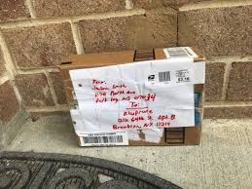
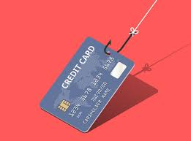
3.There are many cases found in case of online lucky draw that is bricks or stones in the parcel box instead of our required thing .
4.Nigerian scam is one of the proper example of online lucky draw. some person give information that you have got a gift but it is captured by custom department .If you want to release it pay some money.

Slide 8
THANKS

