Slide 1
Download Only The Apps and Programs You Need
Anup Shashikant Patil
Dy.CEO

Slide 2
Agenda
Importance of Mobile Apps in everyday Life
More Apps effect on Mobile.
Apps turn into Addiction.
Basic Apps & Programs necessary

Slide 3
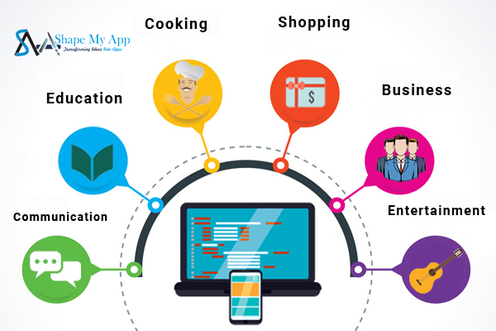
Importance of Mobile Apps in Everyday Life!
“My cell phone is my best friend. It’s my lifeline to the outside world” –
Connecting with People – Communication
Education – E-Books, E-Library
Banking
Entertainment – Songs, Videos
Social Media
Online Shopping
Bus/Train/Flight booking

Slide 4
More Apps – Effect on Phone
Hard drive gets full with more apps - which will start reducing performance of Phone.
Bigger Likelihood of A Security Breach.
The more apps that you download run in the background, the slower your phone is going to get
Updating all apps with eat up data.
Battery will drain sooner
Less phone memory can hang the phone.

Slide 5
Apps turns into Addiction.
You lose patience very easily.
Anxiety
You become anti-social.
Stress increases while also exposing you to content that might damage you mentally.
You tend to lose an essential part of your family bond.
Can lead to sleep disorder.

Slide 6






Basic Apps
Google maps- For navigation
Phone banking app- SBI Lite
Online food ordering-Swiggy
App for commuting- UBER
App for entertainment- Youtube
App for Bus/Flight/Train booking/Electricity bills/Landline bills/Mobile recharge/UPI Transactions - PhonePe

Slide 7
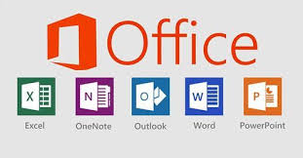



Basic Programs
Microsoft office Essentials- Word,Powerpoint,Excel
McAfee- Antivirus Protection
Google Chrome-For browsing
Adobe Reader- To read PDF files

Slide 8


