Slide 1
Unsecured wireless connections
Presented by:
Dr. Nilesh Shriram Palve
Prob. Dysp
Roll No. D-33

Slide 2
What are they?
Wireless connections are considered to be “secured” if access to them requires users to input a password that conforms to the WPA or WPA2 standards for security codes.
Networks become unsecured due to the absence of strong password validation procedures and encrypted data connections.
So they allow the movement of data across their airwaves without any form of encryption or security protection.

Slide 3
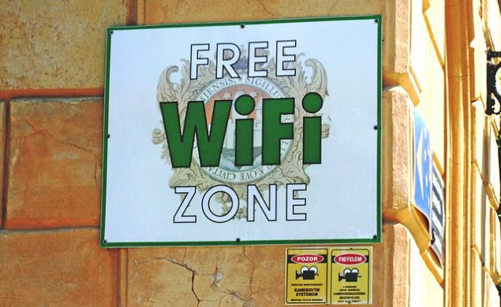
Unsecured free WiFi

Slide 4
Threats posed due to them
Internet hackers nearby can eavesdrop on one’s connection to gather useful information from his/her activities.
Interception, modification, and theft of data and sensitive information can occur.
Enables cyber-criminals to quite easily distribute malicious software such as malware and viruses.

Slide 5
Threats continued
The use of a network for the transmission of hate speech, illicit materials such as child pornography, or the movement of stolen documents and intellectual property etc.
Cyber crimes like online stalking, identity theft, online defamation, email bombing, harassment are more likely in an unsecured public network

Slide 6
Protective measures
Using a Virtual Private Network (VPN) service, imposes strong encryption on all data moving to and from your device during each session.
While accessing free, unsecured Wi-Fi hotspots, avoid accessing sites where you have to login or give away your financial information, such as social sites, email accounts, online bank accounts, online stores, etc.
If you should login, then prefer websites with an ‘https’ address.
If you have to carry out an urgent online banking transaction, always prefer a secure Wi-Fi network even if you have to pay for it.

Slide 7
Protective measures continued
Disable file sharing on your computer. This minimizes the risk of an attacker to barge into the personal data on your machine.
Create strong passwords – avoid using dictionary words, your name, birth date or pet’s name. Use uppercase letters, special characters, meaningless words or phrases.
Use different passwords for every online account.
Ensure that your computer’s antivirus or phone’s mobile security app is up-to-date, and so are its operating system, software, and Internet browsers.

Slide 8
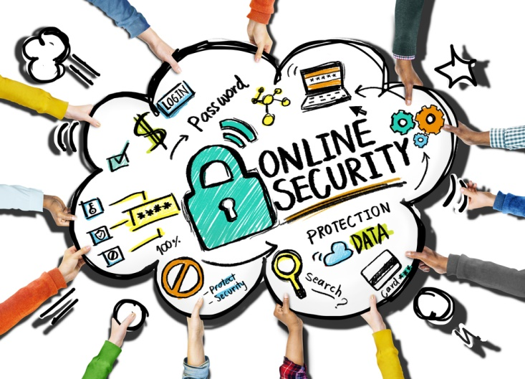
Be safe online

Slide 9
Thank you!

