Slide 1
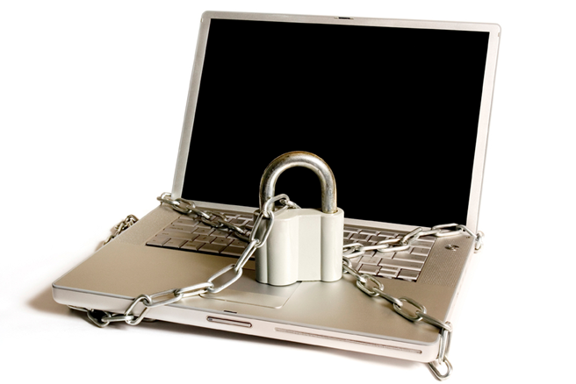
Sharing Is Caring But Not On The Internet
By Nikhil Dhuldhar
Prob. Tahsildar
Batch D
Roll no 34

Slide 2
The more people who have access to personal information like what you look like, who your friends are and what your habits are, the bigger the risks are.
One 2018 Harris Poll online survey put the number of Americans affected by identity theft at around 60 million, meaning that it is more important than ever to monitor and control privacy.

Slide 3
Todays’ Discussion
Overview of Computer and Internet Security
What is Computer and Internet Security
Who Should be Concerned
Why Should I Care
General Security Tips
Securing Mobile Devices and Social Networks
Mobile Devices – Risks
How are Location Sharing Technologies used
Risks of Location Sharing Technologies
Examples of Location Sharing Technologies

Slide 4
What is Computer, Our and Internet Security
Computer and our Security
Protecting ourselves, computers, information, and services from unauthorized access, change or destruction.
Internet and our security extends this concept to systems that are
connected to the Internet
Browsing the Internet
Electronic Commerce
Social Networking
Emailing

Slide 5
Who Should be concerned
Anyone who uses
Computers
Mobile Devices
The Internet
Email
Social Networks

Slide 6
Why Should I Care?
Infections from viruses, spyware, or malware
Virus - Program designed to infect your computer, replicates itself , and usually causes lost or corrupt data
Spyware is a type of malicious code that tracks your habits on the internet without you knowing it; usually collects personal information

Slide 7
Why Should I Care.. Cont’d
Phishing, Hoaxes, Malware, Scams and Spam
The most prevalent and persistent threats to your security come to you in your Inbox. They come by different names and may even appear legitimate and even supposedly from people you may know.
They all have this in common: they are designed to get you to click on an item like an attachment, link or picture.

Slide 8
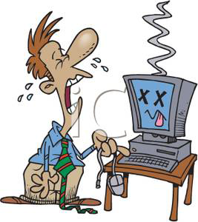
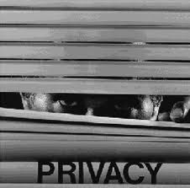
Why Should I Care.. Cont’d
Broken device
Devices that do not work when needed or as expected.
Privacy and personal security concerns
Preventing private, personal, or sensitive information from being disclosed

Slide 9
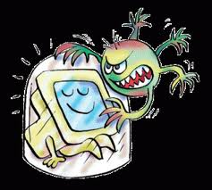
Basic Approaches to Security
Use anti-virus and anti-spyware Software
Detects and removes viruses and spyware from your computer
Must be kept up to date
Install security patches
Enable Firewalls
Protects computers by preventing unauthorized access

Slide 10
Basic Approaches to Security
Use strong passwords to protect computers
Be cautious about downloading free software or files from untrusted sites
Basic Approaches to Security
Most prevalent threats to your security come to you in your Inbox; are all designed to get you to click on an item like an attachment, link or picture.
If you click, you could launch harmful programs or be directed to a harmful website.

Slide 11
Basic Approaches to Security
Think before you click on links
Most threats are targeted in hopes that you will click on a harmful link, attachment, picture, video or icon in an email or web page
Stop: Do not automatically click on Internet links until you have confidence in them.
Think: Look at the actual address for the links in question.
For instance if the link indicates “Click Here” be sure to hover your mouse pointer over the link and investigate before you proceed.
Click: Only after you are confident that the site is safe.

Slide 12
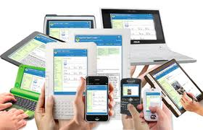
Security for Mobile Devices and Social Networks
Mobile Devices have become the devices of choice for communicating and connecting to the Internet
Smartphones
Tablets
Laptop Computers
Social Networks
Foursquare, Google Latitude, Twitter
Facebook, Google +
Pinterest, Gowalla

Slide 13
Mobile Devices - Risks
Mobile devices are easy to lose or steal
Can carry large amount of data
If stolen, an unsecured Smartphone grants access to your private information: email correspondence, address books, and any unsecured documents.
Often unprotected
Data may be “sniffed” during unprotected wireless communications

Slide 14
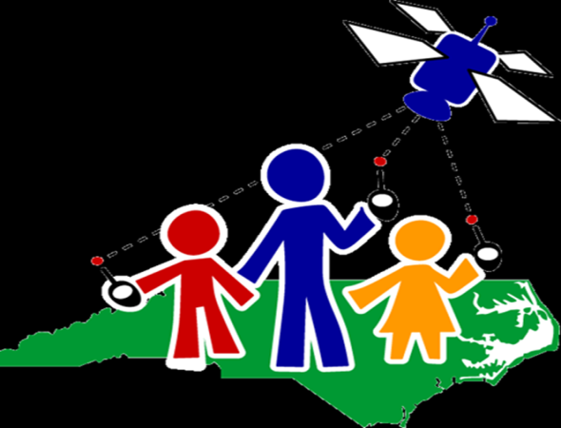
Mobile Devices - Risks
Location Sharing
Location-aware applications deliver online content to users based on their physical location.
Technologies employ GPS, cell phone infrastructure or wireless access points to identify where cell phones or laptops are located and users can share that information with location-aware applications.

Slide 15
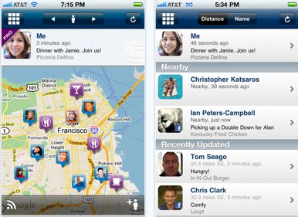
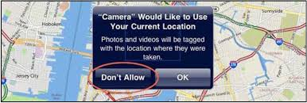
Mobile Devices - How are Location Sharing Technologies used?
Apps might provide you with information on nearby restaurants, notify you of traffic jams, or let your friends in a social network know where you are, prompting increased social connectivity.

Slide 16
Risks of Location Sharing Technologies
Makes users “human homing beacons”
Increases the chances of being stalked
May reveal when you are home or away

Slide 17
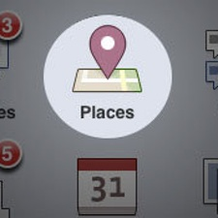
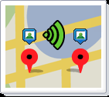
Examples of Location-Sharing Technologies
GPS Geo-tagging of photos
Location details added to photographs
Facebook places
Allows users to "share where you are with your friends, see where your friends are and discover new places around you.
Blip – Blackberry application updates location every 15 minutes.
Google Latitude – Allows you to see where your friends are and what they doing

Slide 18
Security Guidelines for Location Sharing Technologies
Most apps offer privacy controls-enable them
Some privacy controls are not always easy to access
Know what applications you have and research privacy controls
Disable GPS capabilities and geotagging features

Slide 19
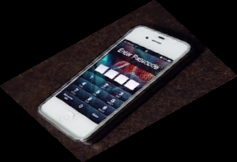
Security Guidelines - Mobile Devices
Enable auto-lock
Enable password protection
Keep the phone OS and apps up-to-date
Enable remote wipe feature where possible
Avoid connecting to public wireless network when possible.

Slide 20
Security Guidelines - Social Networks
Security Guidelines
Before you post, ask the following:
Will this post/picture cause a problem for me?
Would I say this in front of my mother?
Limit the number of people that see it
Share public information with the public
Share inner thoughts and personal feelings with close friends

Slide 21
Security Guidelines - Social Networks
Limit your visibility on services
Do not Friend or Connect with people that you have not met in person or know well
Limit your check-in information to friends only
Never check in at your home, school, work

Slide 22
Security Guidelines - Social Networks
Avoid public lists for a location
Review posts you are tagged in
Turn off geo location data in photos
Turn off “find my face” in photos and videos
Disable location data for tweets
Delete old location data too

Slide 23
Stay Safe.
Think before you click and try to share when online or offline.

