Slide 1

ONLINE APPLICATION
FOR
SENIOR CITIZEN CERTIFICATE
BY
DR.ANURADHA A. NIKAM
[ACST]

Slide 2
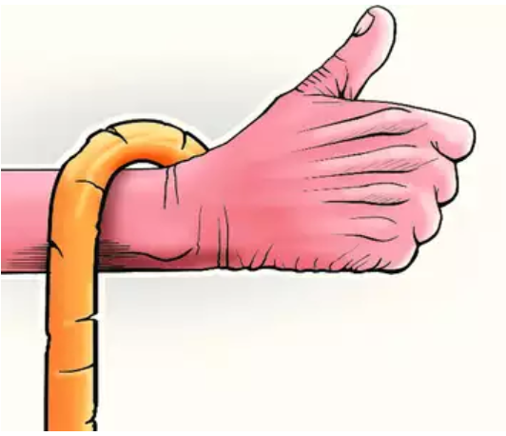
NEED FOR SENIOR CITIZEN CERTIFICATE :-
The Government of India provides facilities
for citizens above the age of 60 years.(In Maharashtra above 65 years). In order to avail those facilities one has to get
the senior citizen certificate.
This certificate will allow the holder to receive numerous benefits like discounts in Railways, Flights and other benefits from the government. Like
• Railway concession - 30% (60 Years)
• Maharashtra State Transport - 50% (65 Years)
• Air travel concession - 50% on only basic fare (65 Years)
• Govt.hospitals give free treatment (60 years)
• Maharashtra professional tax - 100% (65 years)
• M. T. N. L.- 25% discount on monthly rentals(65 years)

Slide 3
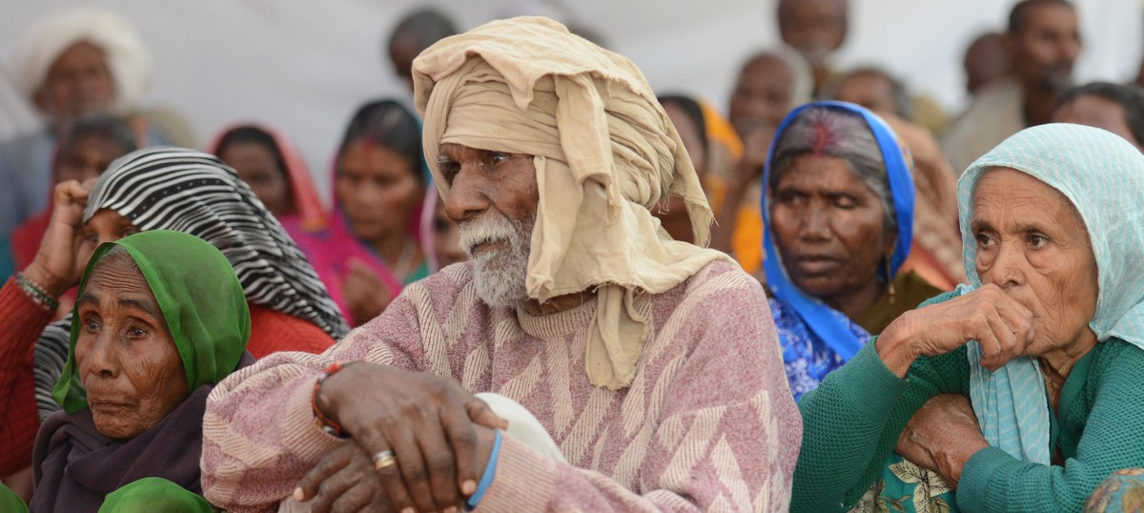
SENIOR CITIZEN CERTIFICATE PROCEDURE

Slide 4
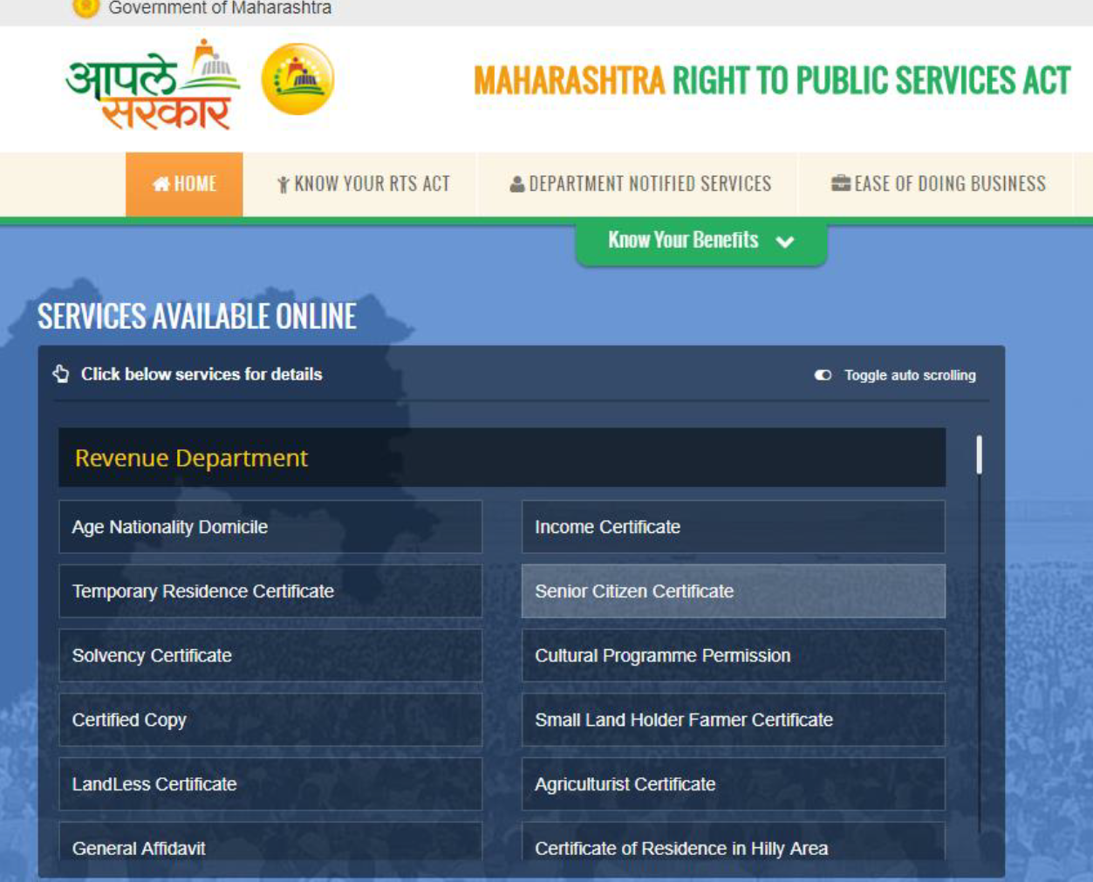
Online Procedure To Apply :-
https://aaplesarkar.maharashtra.gov.in/
1) Create a new user account. Once it is
created, log in using username and
password. A window will appear.
2) Then search for Revenue Department
and click on Senior Citizen Certificate
3) fill necessary information required like
Name, District name,
Taluka name.A window will appear which will
be your application form.Fill it carefully and
click on submit.

Slide 5

4) Then window will appear which shall ask you to
upload the passport size photograph and
all required
Document
5) Click on upload documents
6) Post click on submit, the window will appear
which will ask you for payment then
select proper payment option, make payment and
submit
7) Then after 5 to 6 or 20 days you can download
Soft copy of senior citizen certificate

Slide 6
REQUIRED DOCUMENTS :-

Slide 8
Information required for applying
Senior Citizen Certificate:-
Name and Gender
Date of Birth and age
Blood group
Address, District, contact numbers and
email address.
Religion
Year of Retirement
Retired From
Spouse’s Details
Relative’s Details

Slide 9
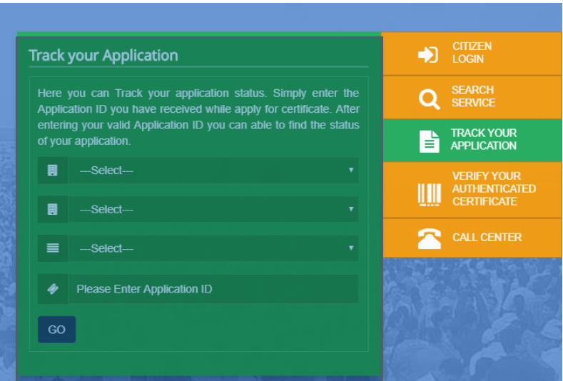
TRACKING PROCEDURE OF
ONLINE APPICATION :-

Slide 10
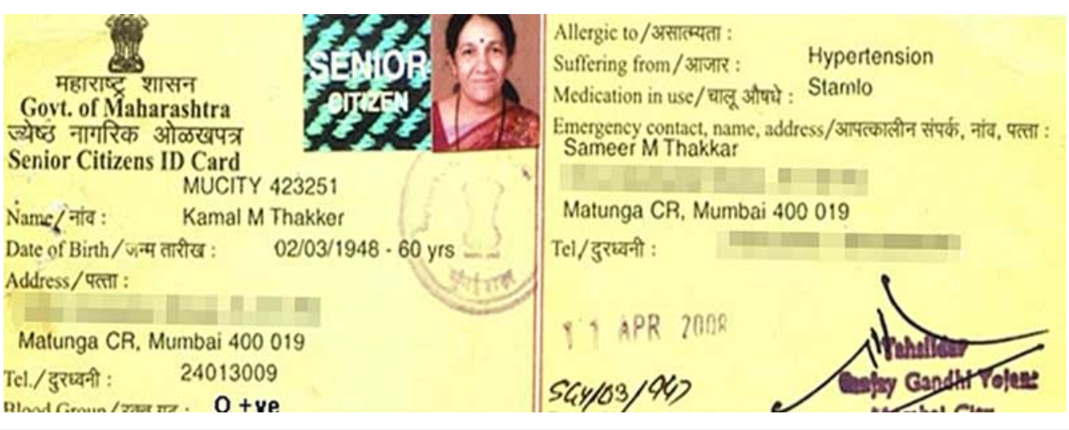

Slide 11



