Slide 1
Use ShareIt App To Share The Files With Others
Nikalje Darshan Jagdish
(Deputy Collector)
Classroom : A
Roll No : 37

Slide 2
Company Information
SHAREit (SHAREit Technologies Co.Ltd) is a technology company founded in April 2015.
SHAREit is a global internet technology company, mainly dedicated to mobile internet application development.
SHAREit business network has reached up to 200 countries and regions, and has been regarded as “Nationally Favoured App” in India, Indonesia, Mid-East, Africa, Russia etc.

Slide 3
Company Information
SHAREit has more than 1.8 billion users worldwide, and there are more than 500 employees in the company.
It has offices in Singapore, New Delhi, Bangalore (Silicon Valley of Asia), Beijing and Shanghai.
SHAREit’s Monthly Active Users (MAU) has exceeded 500 million users

Slide 4
ShareIt
Users can use SHAREit to transfer files including photos, videos, music, contacts, apps and any other files.
SHAREit application allows Windows, Windows Phones, Android, and iOS devices to transfer files directly.
It is currently available in 45 languages including English, Hindi, Bangla, Indonesian, French, Spanish, Russian, Arabic and Chinese

Slide 5
ShareIt
The SHAREit application uses a secure connection protocol and has transfer speeds faster than Bluetooth and NFC.
SHAREit was developed, based on Wi-Fi Direct method.
SHAREit is also one of the top 10 most downloaded apps on Google Play for the past 10 years.

Slide 6
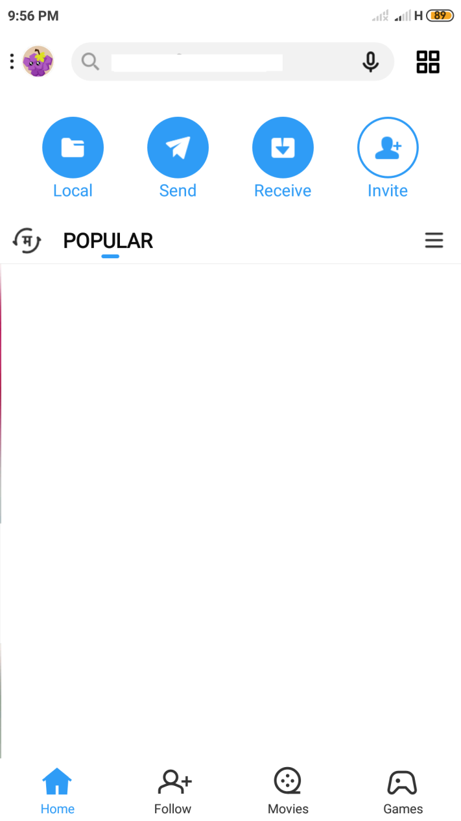
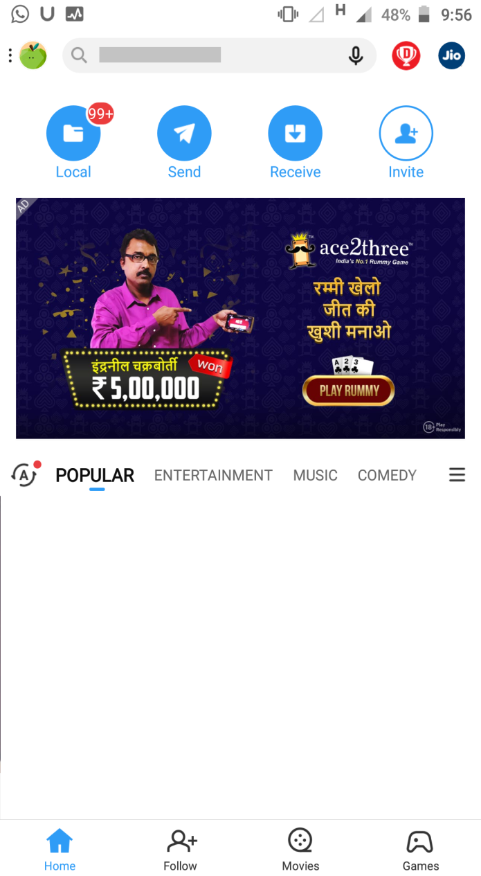
Steps to follow
Sender
Receiver

Slide 7
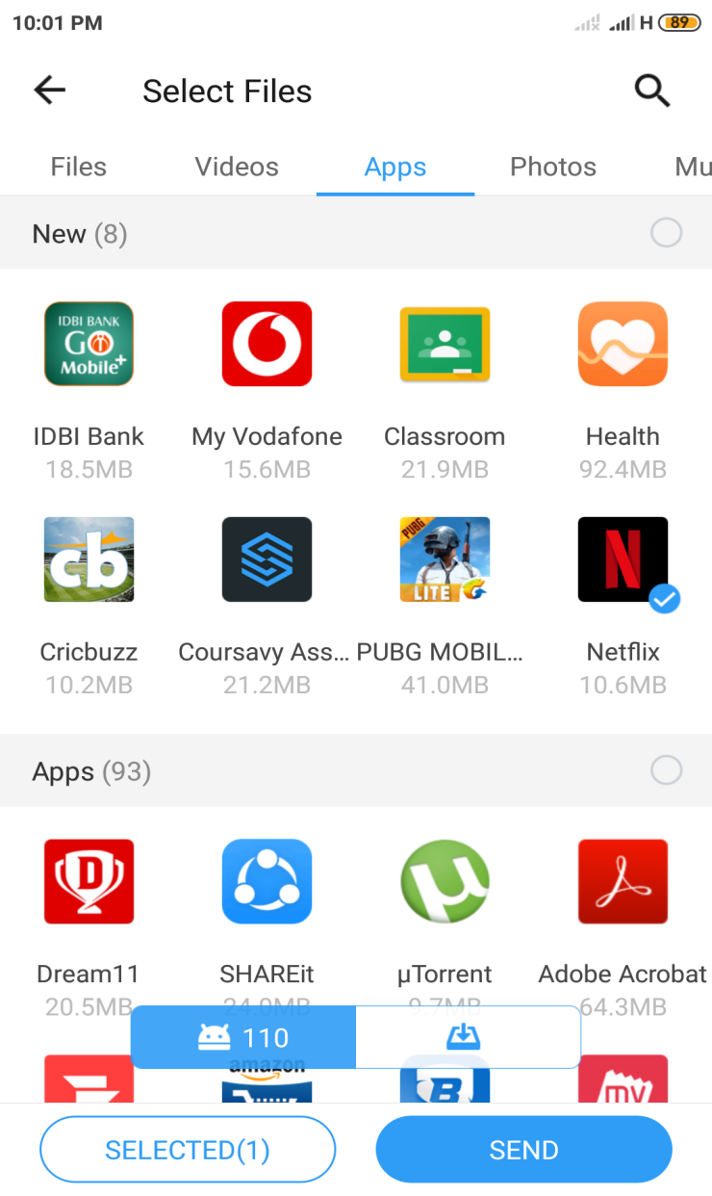
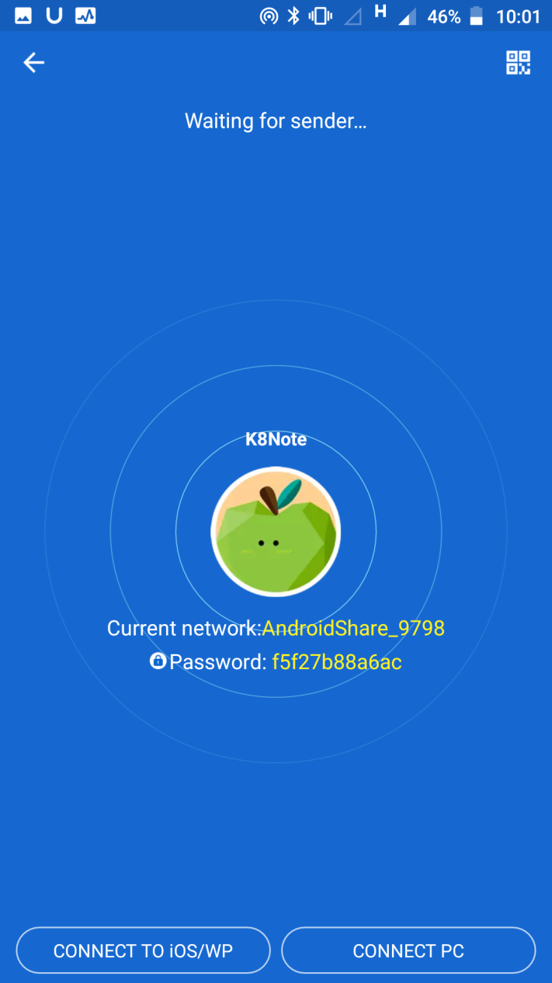
Steps to follow
Sender
Receiver

Slide 8
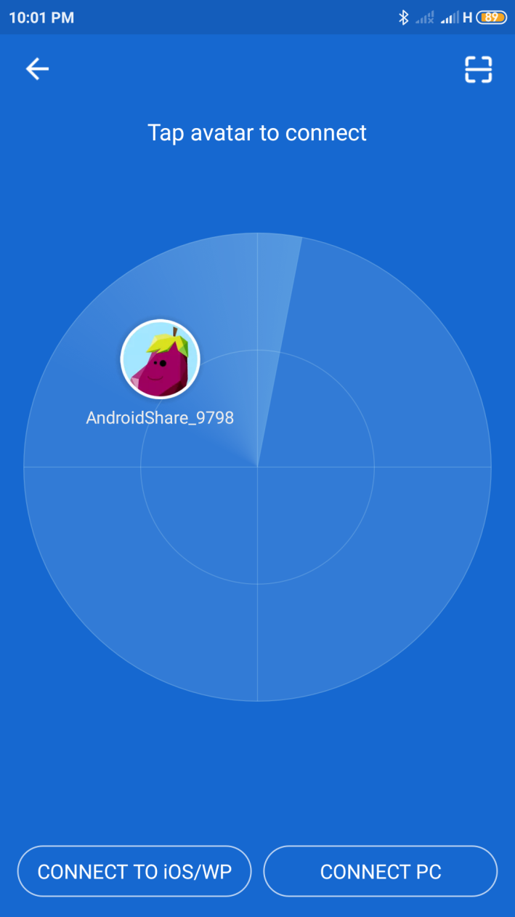
Steps to follow
Sender
Receiver

Slide 9
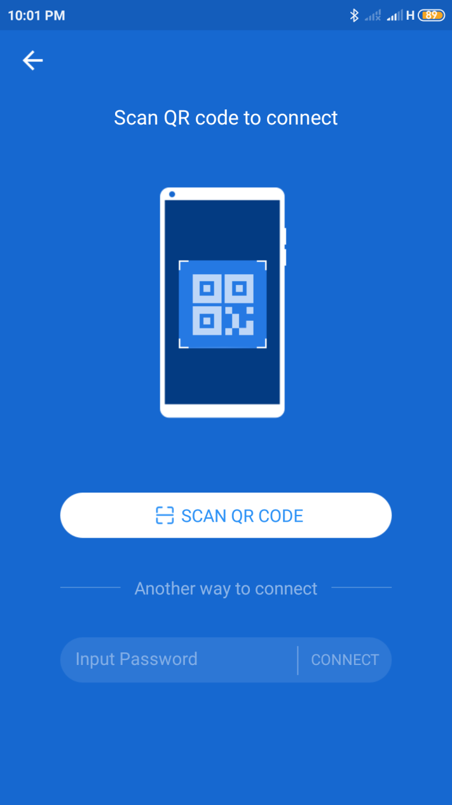
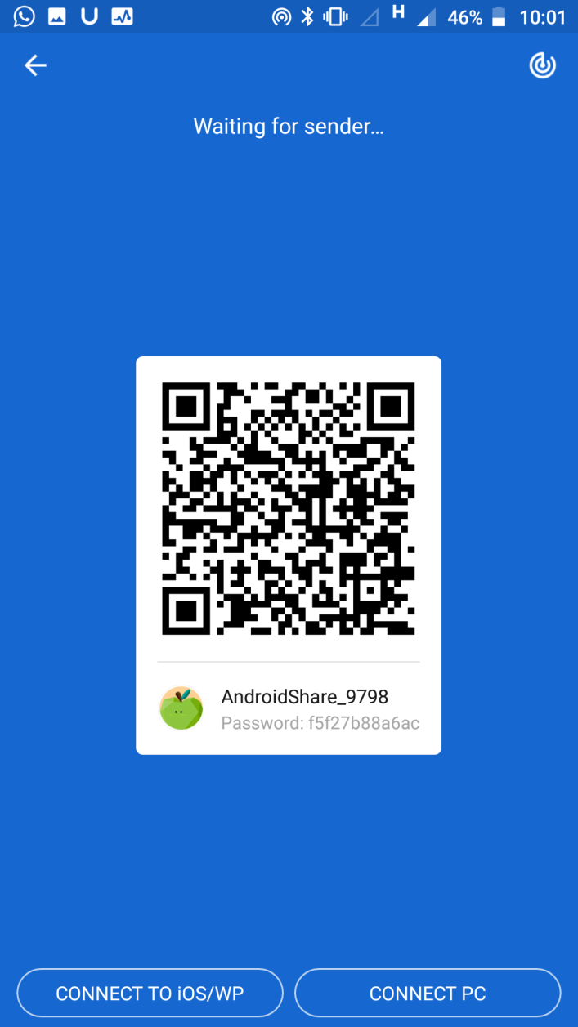
Steps to follow
Sender
Receiver

Slide 10
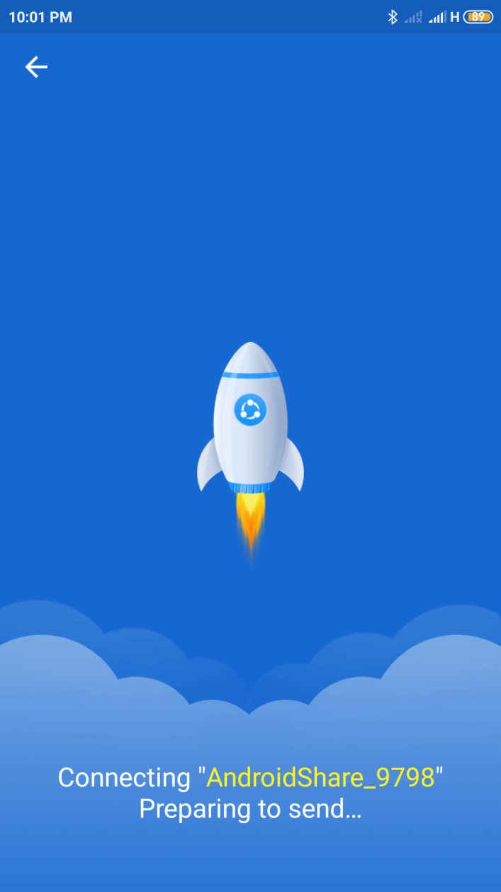
Steps to follow
Sender
Receiver

Slide 11
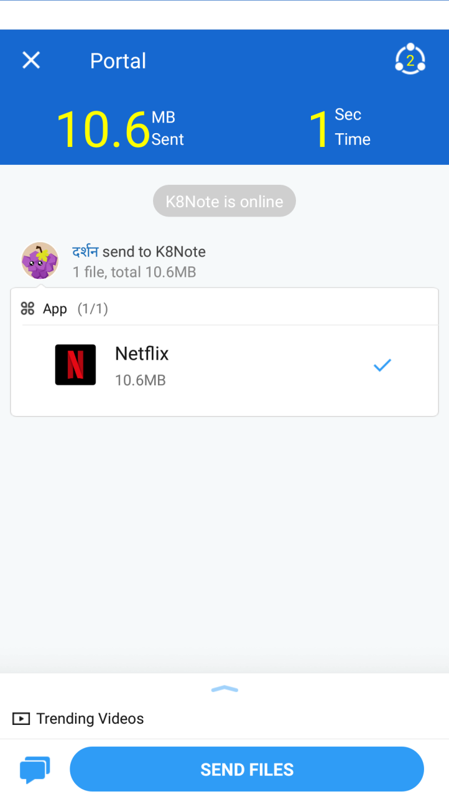
Steps to follow
Sender
Receiver

Slide 12
Thank You

