Slide 1
How To View My Details On MGNREGA
By- Anand O. Navhal
Assistant Commissioner of State Tax (CPTP 6)
Class-B
Roll no.- B9

Slide 2


Slide 3
About MGNREGA
National Rural Employment Guarantee Act 2005
Mission statement | "It aims to enhance livelihood security in rural areas by providing at least 100 days of wage employment in a financial year to every household whose adult members volunteer to do unskilled manual work"
Launched | 2 Feb 2006

Slide 4
About MGNREGA…
Adult members of a rural household, willing to do unskilled manual work, may apply for registration in writing or orally to the local Gram Panchayat.
The Gram Panchayat after due verification will issue a Job Card within 15 days of application.
Employment will be given within 15 days of application for work.
Work should ordinarily be provided within 5 km radius of the village.
Social Audit has to be done by the Gram Sabha.

Slide 5
Job Card
Worker/Applicant’s details are stored in his/her Job card.
Job Card is a key document that records workers’ entitlements under MGNREGA. It legally empowers the registered households to apply for work, ensures transparency and protects workers against fraud.
The Job Card will bear the photograph of all adult members of the household willing to work under MGNREGA and is free of cost.

Slide 6
How to View My Details in Job Card on MGNREGA Portal

Slide 7
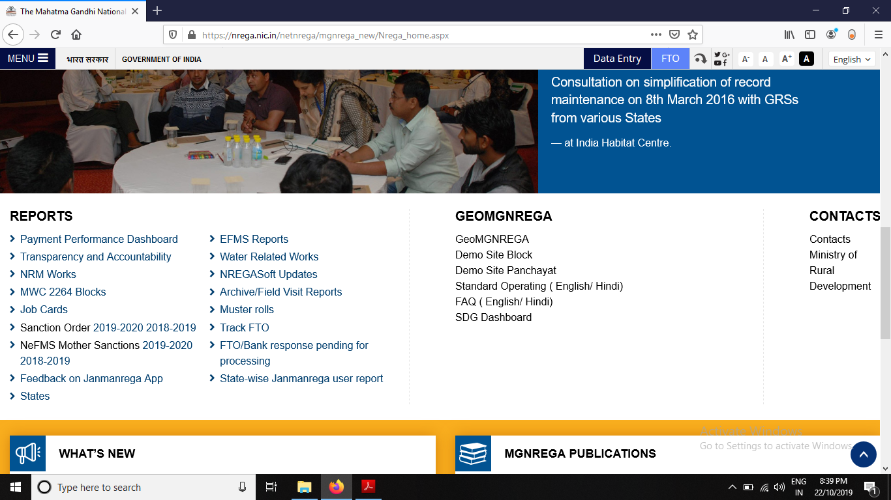
Open MGNREGA Portal on browser window.
www.nrega.nic.in
2. Click on Job Cards

Slide 8
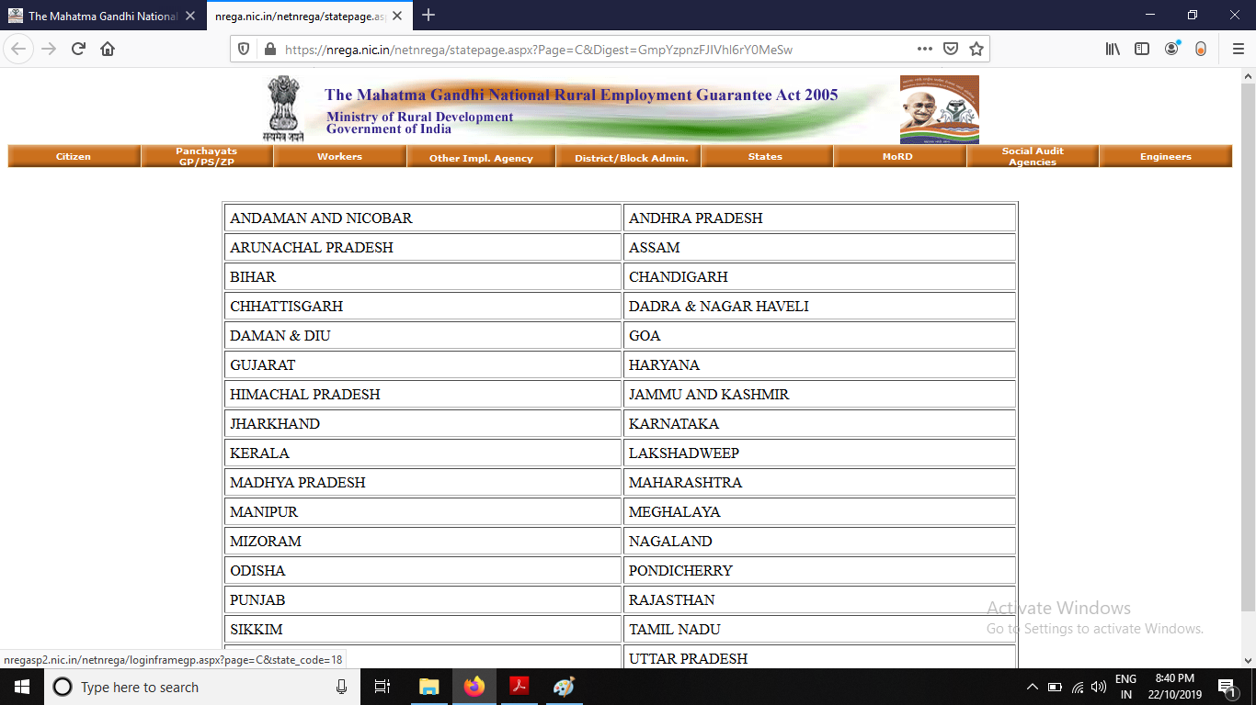
3. Select State

Slide 9
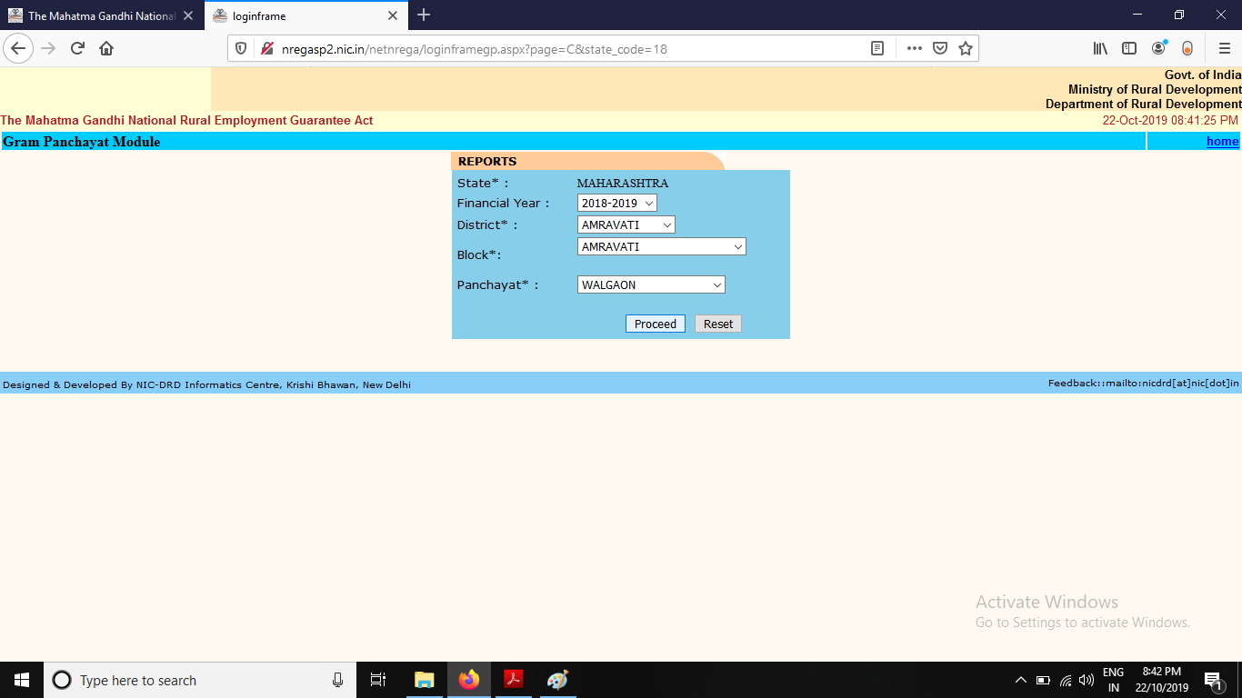
4. Enter the details in the fields.
Financial Year
b) District
c) Block
d) Panchayat
And Click on Proceed.

Slide 10
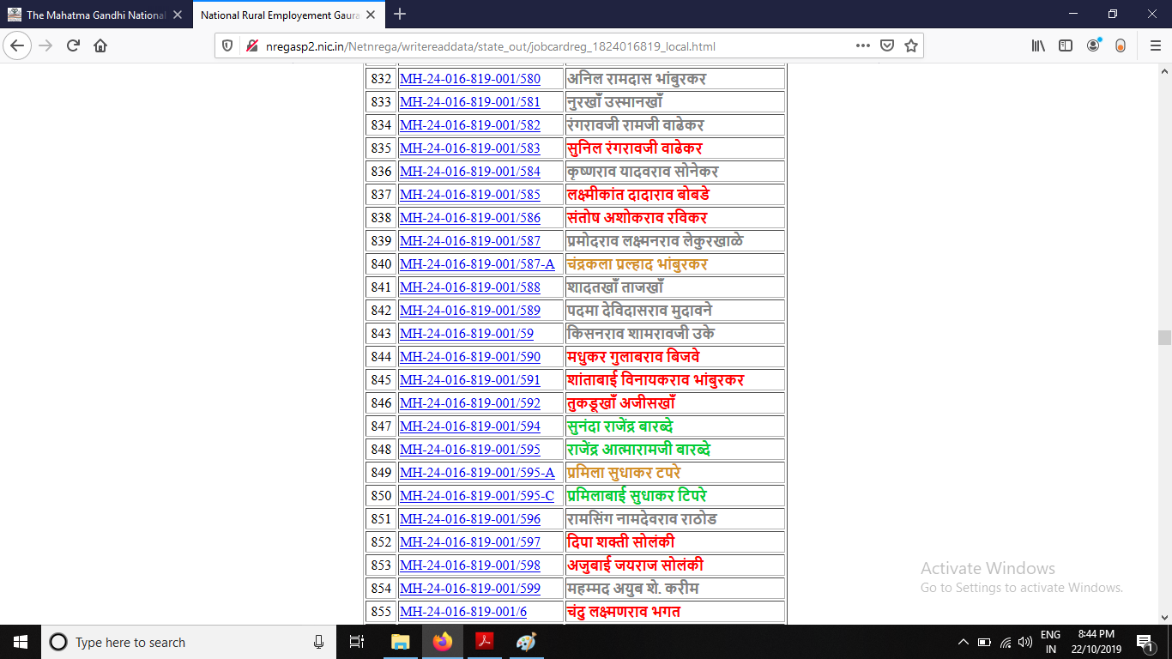
5. Find your name in the list and Click on the Job card number adjacent to it..

Slide 11

The list has names in 4 different colours as follows:

Slide 12
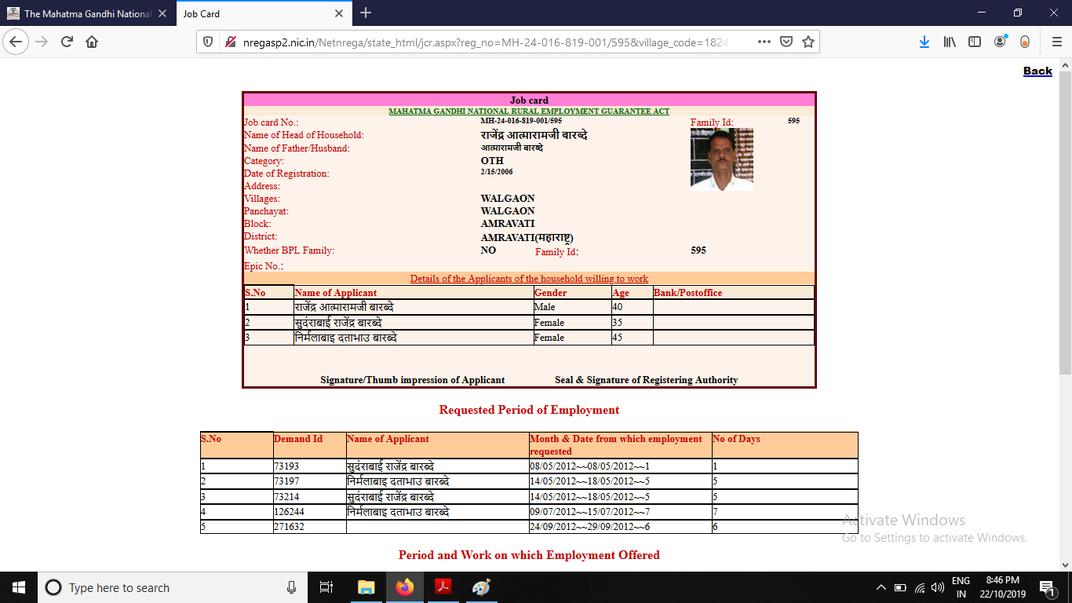
6. The Job Card window will be displayed with the details as follows:
Job Card No.,
Photograph,
Name of Head of Household,
Category,
Address,
Whether belonging to BPL family,
Details of applicants of household,
Signature of Authority.

Slide 13
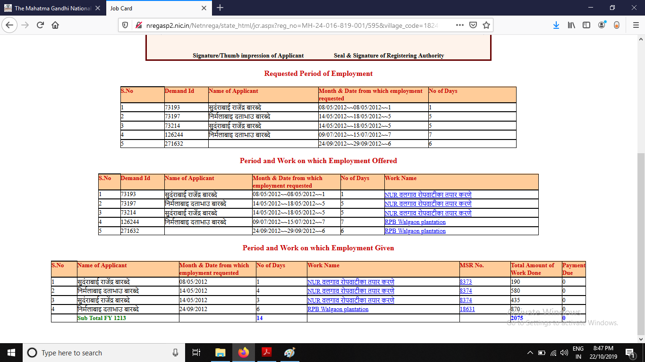
The Job Card also displays:
Requested Period of Employment
Period and Work on which Employment offered
Period and Work on which Employment Given.

Slide 14
Thank You!

