Slide 1
URL AND HYPERLINK
NAME:NASHTE AJAYKUMAR CLASS C
DEPUTY COLLECTOR

Slide 2
URL(Uniform Resource Locator)

Slide 3
URL
A URL (Uniform Resource Locator) is a unique identifier used to locate a resource on the internet.
It is also referred to as a web address.
URLs consist of multiple parts -- protocol
domain name
path
that tell a web browser how and where to retrieve a resource.

Slide 4
Parts of a URL
https://whatis.techtarget.com/search/query?q=URL
The protocol:
Used to access a resource on the internet
eg. http, https, ftps, mailto
Host name or domain name:
The unique reference the represents a webpage.
Port name:
Usually not visible in URLs, but necessary
port 80 is the default port for web servers
Path:
refers to a file or location on the web server.
Query.
Found in the URL of dynamic pages. The query consists of a question mark, followed by parameters.
Parameters.
Pieces of information in a query string of a URL. Multiple parameters can be separated by ampersands (&). For this example, q=URL.

Slide 5
Importance of a URL design
URLs can only be sent over the Internet using the ASCII character-set.
Because URLs often contain non-ASCII characters, the URL must be converted into a valid ASCII format.
URL encoding replaces unsafe ASCII characters with a "%" followed by two hexadecimal digits.
URLs cannot contain spaces.

Slide 6
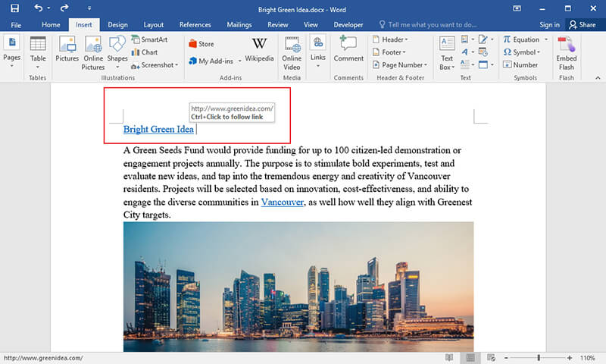
HYPERLINK

Slide 7
HYPERLINK
A hyperlink is a word, phrase, or image that you can click on to jump to a new document or a new section within the current document.
Text hyperlinks are often blue and underlined.

Slide 8
Why are hyperlinks used on web pages?
Hyperlinks are what allow web pages to connect to other web pages and without them you would need to know the URL for every page on the Internet.
What happens when you click a hyperlink?
When you click, tap, or select a hyperlink, the browser leaves the current page you are viewing and opens the link for the new page.

Slide 9
Why are some hyperlinks different colors?
For usability, many websites (including Computer Hope) change the color of visited hyperlinks as a way to let the reader know what page they have already visited.
example:
unless you have already viewed our motherboard page, the link should be blue. However, the link to this hyperlink page should be purple because you've visited the page since you are reading it now.

