Slide 1
ICT for Rural Development
BY SANTOSH R. NAGTILAK

Slide 2
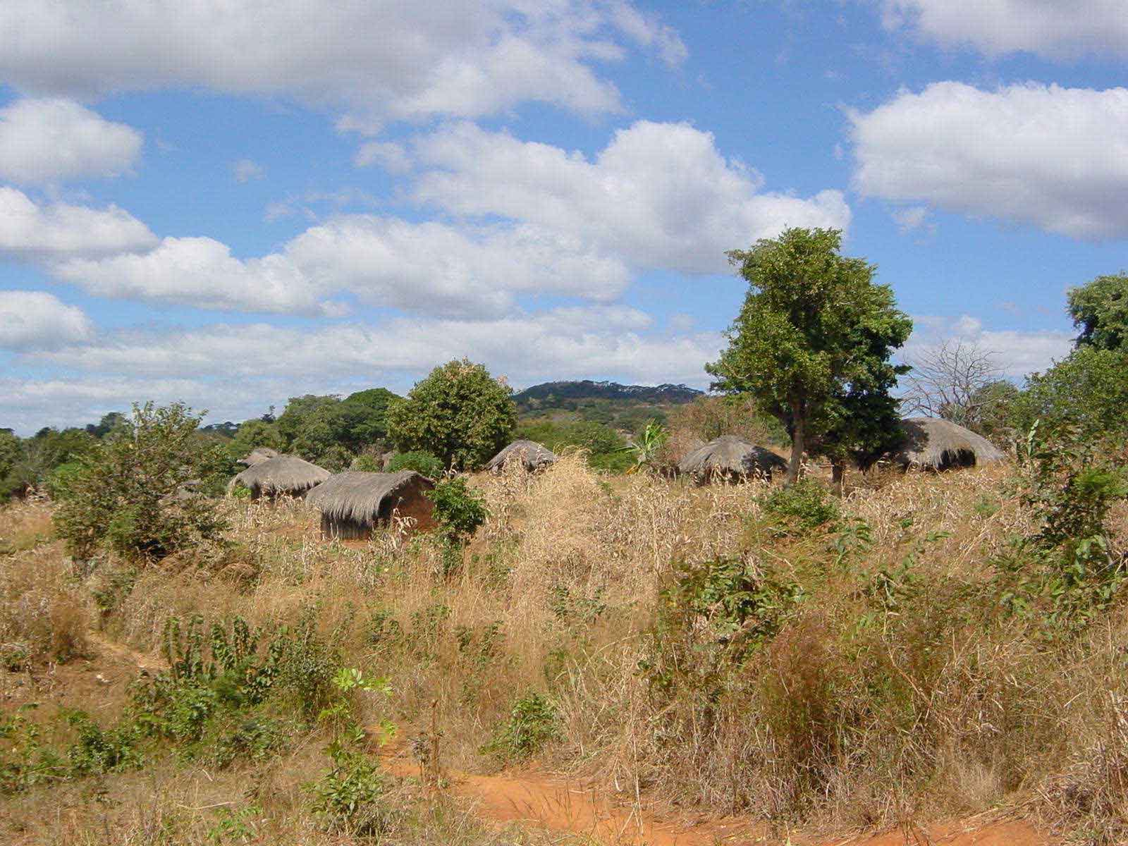
Outline
Setting the scene
Identifying the rural
The potential of ICTs for rural development
  Constraints
  Potential solutions
Case studies

Slide 3
Setting the scene
Understanding Livelihoods: complexity, choices and policies in Southern India
  A 20 minute video by Catcher Media for DFID
  Designed “to spark discussion about sustainable livelihoods approaches”
  “Resource for development professionals in the NGO and Government sectors working at both policy and field levels”

Slide 4
Setting the scene
What are the core messages this video is trying to get across?
What strengths does the video format have in delivering these?
How would you use the video in a learning context with
  NGOs?
  Government officials?

Slide 5
Identifying the rural
What do we think of when we consider the ‘rural’?
  Low density
  Extensive production
    Forestry
    Agriculture
  Generally poor
    Why else would people migrate to towns?
  ‘Backward’
  Limited services
The Urban as dominant and ‘civilised’

Slide 6
Identifying the rural
How much ‘rural’ development have you learnt in your courses so far?
  An example of bias against ‘the rural’!
  Yet almost all the world’s food and raw materials come from rural areas
Michael Lipton (1977) Why Poor People Stay Poor
  Urban bias
  Dominance of interests designed to increase unequal terms of trade between urban and rural areas and people

Slide 7
ICTs in rural development
Potential to
  Provide services to dispersed rural people
    Radio, TV, Internet, Mobile telephony
  Disseminate information more broadly
    Market information
    Agricultural extension services
  Breakdown the urban bias
But
  Infrastructure is needed
  Costs must be affordable

Slide 8
Key constraints in rural communication
Dispersed low density populations
  Therefore high cost of providing services
Distances
  High transport costs to peripheral regions
Terrain
  Mountain ranges
  Impassable roads in rainy seasons
Traditional lack of technological knowledge
  Need for easy to use solutions

Slide 9
Technological solutions
Radio can reach everywhere
  Soaps for health and rural development
Satellites can likewise overcome line of sight constraints
  Especially VSAT (Very Small Aperture Terminal)
    Gilat in Rwanda, Kenya, DRC, Mozambique
      Posta Kenya http://www.gilat.com/Solutions_CaseStudies_Posta.asp
  The WorldSpace solution http://www.worldspace.com/about/index.html
    Established in 1990 - satellite radio
    Downloading learning content to rural areas
Telephony
  Mobiles: dramatic impact on communication

Slide 10
Case studies
Agricultural Information Systems
M.S. Swanimathan Research Foundation (India)
Gilat VSAT solutions in Africa
African Agricultural Technology Foundation
Philippines: e-Learning for agricultural communities
Bangladesh NGOs Network for Radio and Communication
HP KNUST Digital Villages

Slide 11
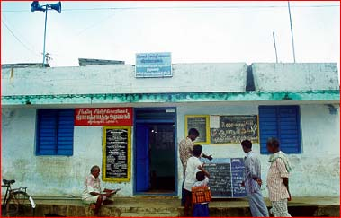
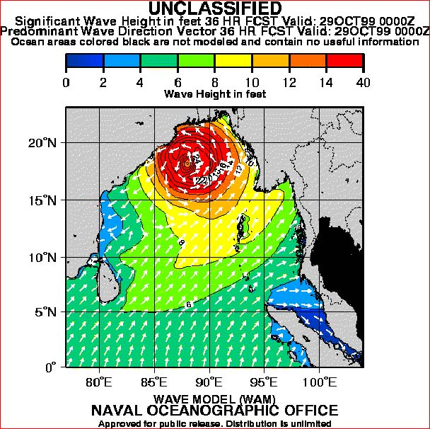
M.S. Swaminathan Foundation in southern India
Village knowledge centres for fishing communities
  Dangers of fishing in ignorance of the weather
  Use of satellite imagery
  Disseminate information to whole community
  Women also know, and can give them other tasks!

Slide 12
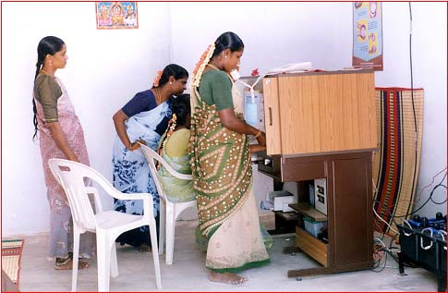
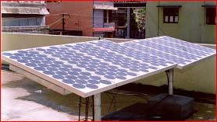
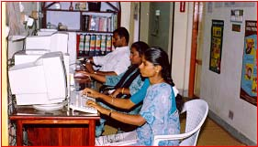
M.S. Swaminathan Foundation in southern India
Village Knowledge Centres
  Particular emphasis on women’s education
  Use of solar power for energy
  Women helping rural women
  Initially from 19997 funded by IDRC
  Now plans to roll out across India

Slide 13
Bangladesh NGOs Network for Radio and Communication
Amateur radio
  Working with Oxfam since 2000
  To promote use of amateur radio
Community Radio
  Training people in the use of community radio since 2001
  Supporting NGOs
  Advocacy

Slide 14
Conclusions
Need for a diversity of solutions
Technologies can indeed overcome many of the physical constraints affecting rural areas
But, need for will of governments to support them
  Is Lipton’s urban bias still alive and well in developing countries?

Slide 15
THANK YOU

