Slide 1
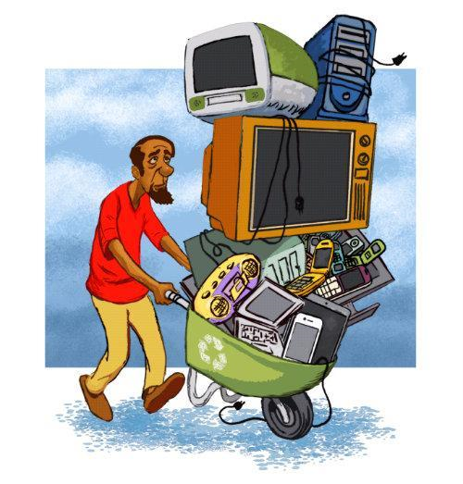
Mr Kishor S Mirgane Assistant Commissioner of State Tax
TOPIC
SEPARATE YOUR
e-WASTE and TECHNOTRASH

Slide 2
“Discarded, surplus, obsolete or broken electrical or electronic devices”
Interchangeable terms-Digital dump,
e-Junk, e-Scrap, WEEE
OR
Technotrash

Slide 3
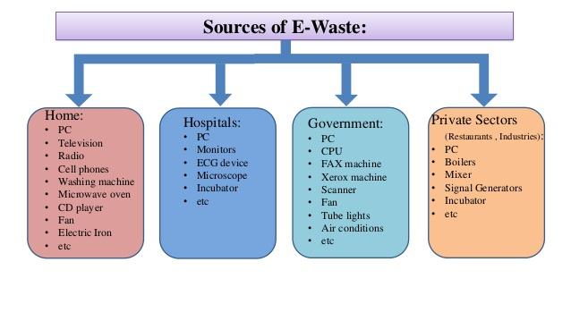

Slide 5
Need to separate e-Waste

Slide 6
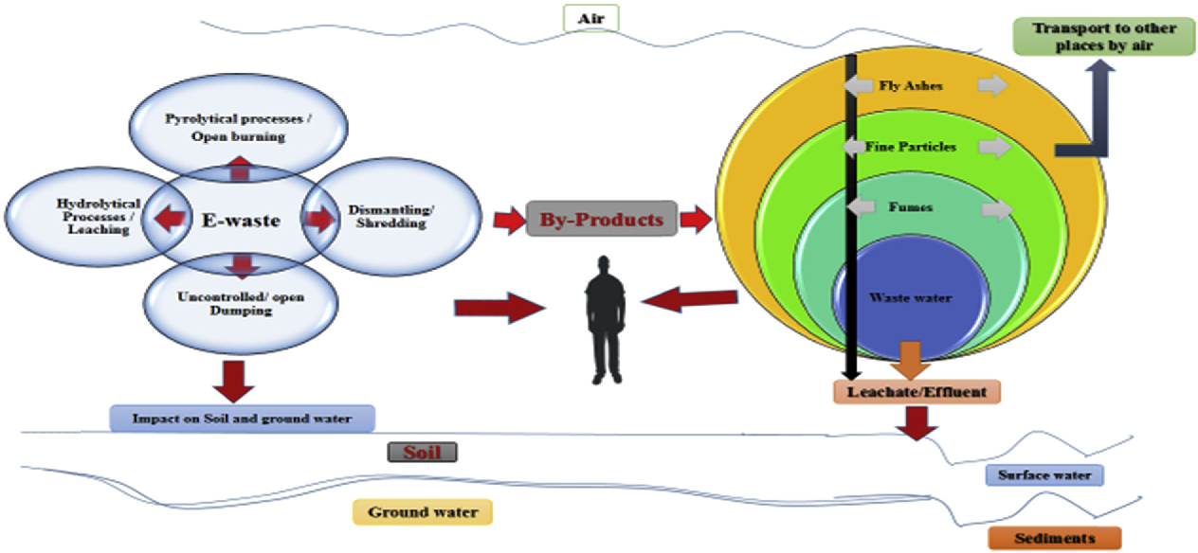
Harmful effects on environment

Slide 7
How to deal with it?

Slide 8
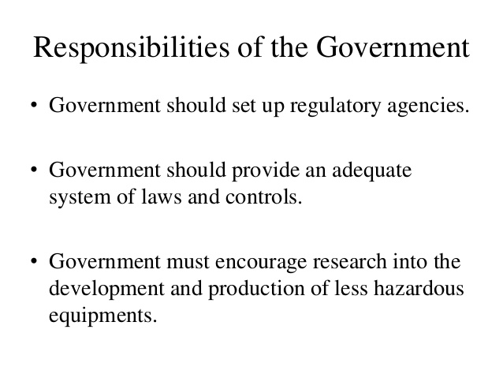

Slide 9
Conclusion
THANK YOU

