Slide 1

ONLINE PASSPORT APPLICATION AND TRACKING
Presented By-
Dhole Megha Narayan.
Class-A 35
Prob. Assistant Commissioner of Sales TAX

Slide 2
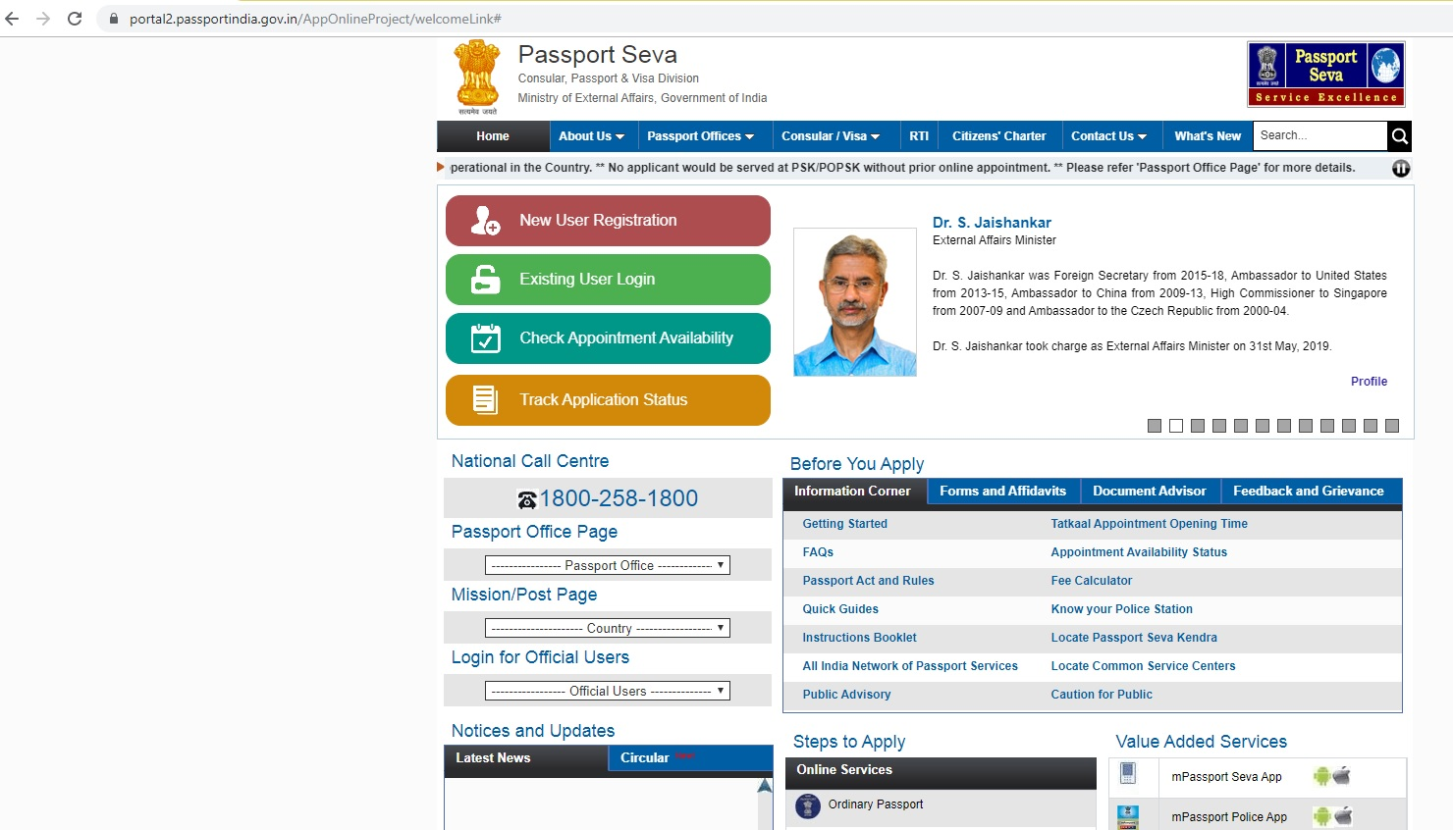
ONLINE APPLICATION FOR PASSPORT
-- APPLY VIA PORTAL
https://portal2.passportindia.gov.in/AppOnlineProject

Slide 3
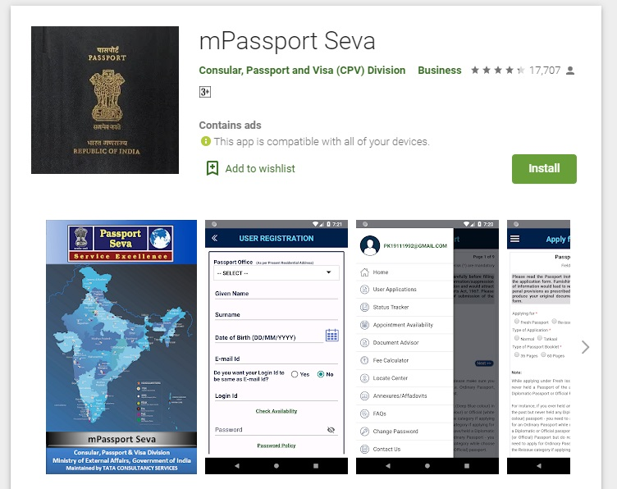
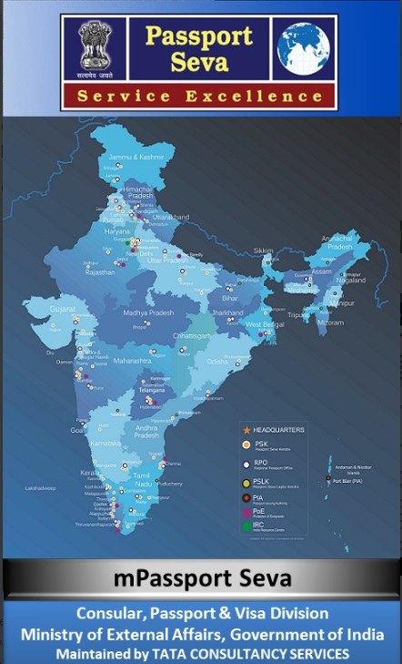
ONLINE APPLICATION VIA Mobile Application
mPASSPORT SEVA

Slide 4
PASSPORT SEVA PROJECT
-- Consular, Passport and Visa (CPV) division of the Ministry of External Affairs (MEA), Government of India.
-- Speedy, Convenient and Transparent process.
-- Public-Private-Partnership mode with Tata Consultancy
Services (TCS).
-- Servicing citizens through 77 Passport Seva Kendras
across India.
-- Passport application status tracking, locating the Passport
Seva Kendra (PSK) .

Slide 5
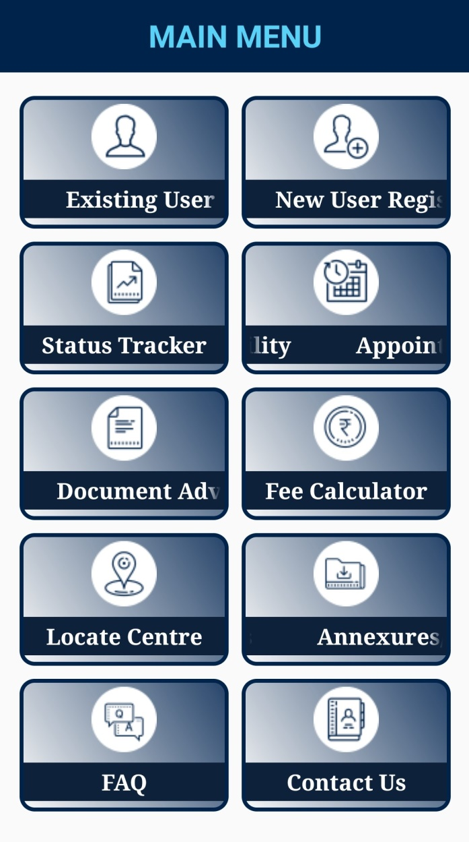
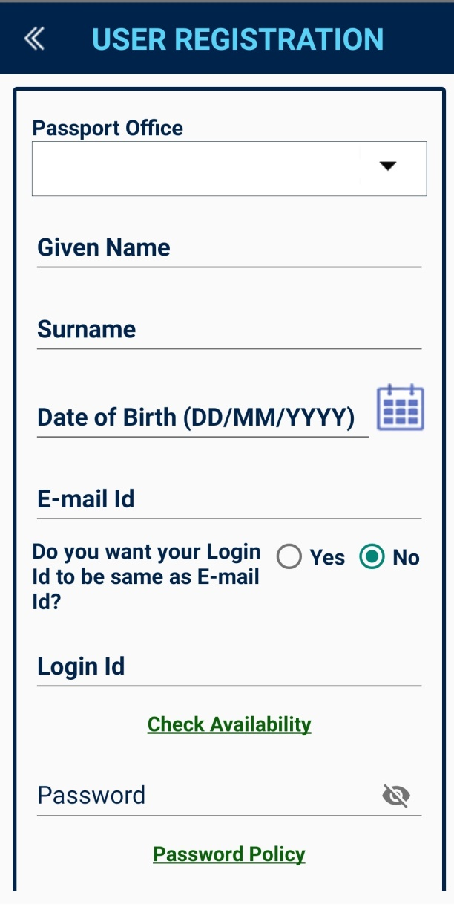
STEPS FOR APPICATION

Slide 6
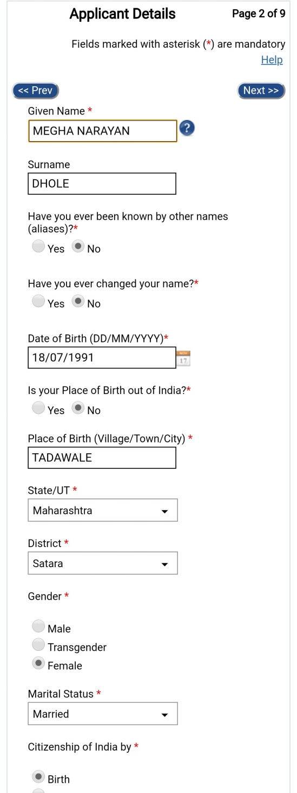
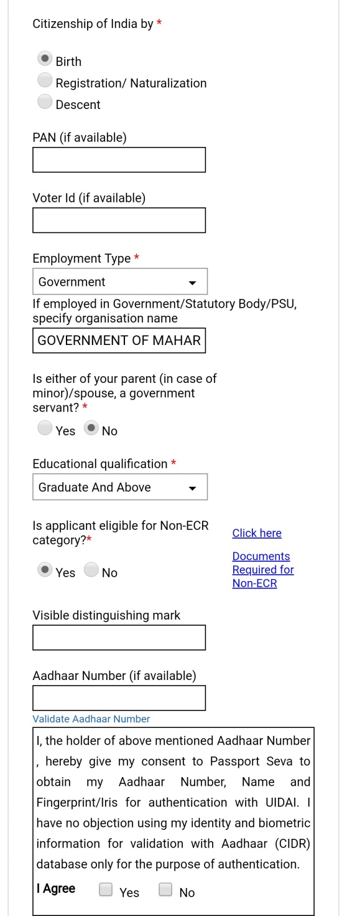

Slide 7
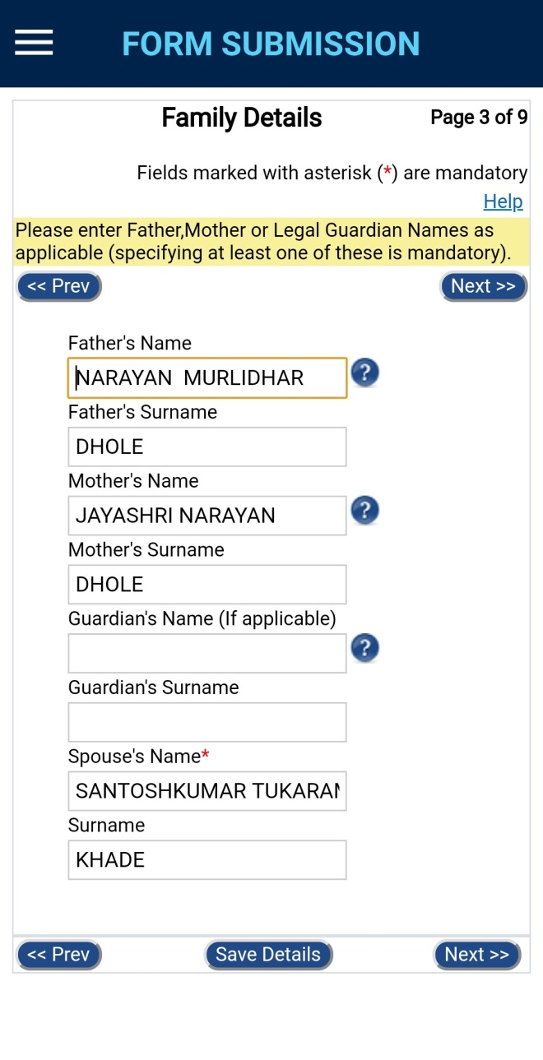
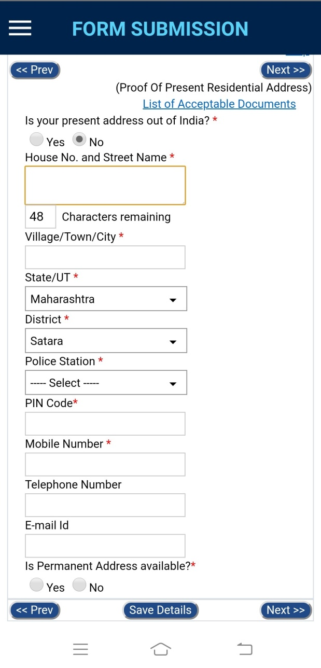

Slide 8
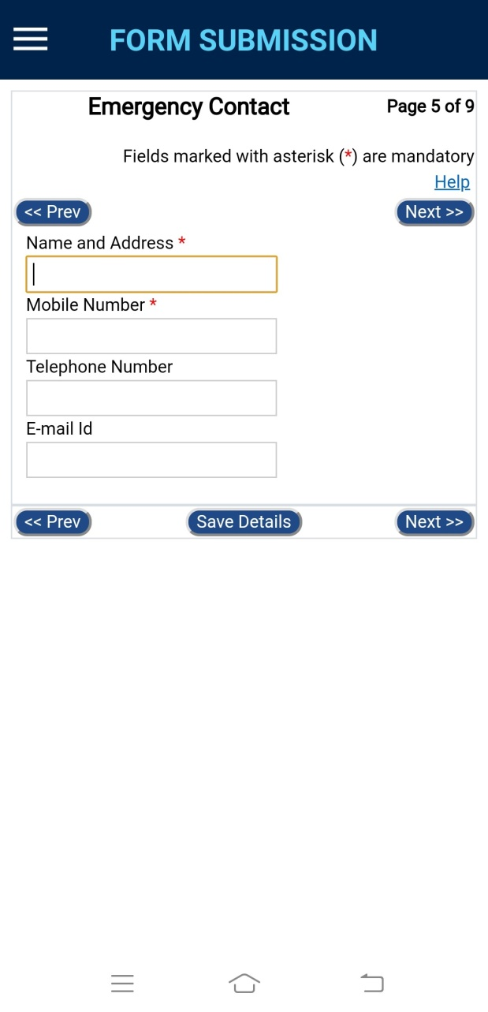
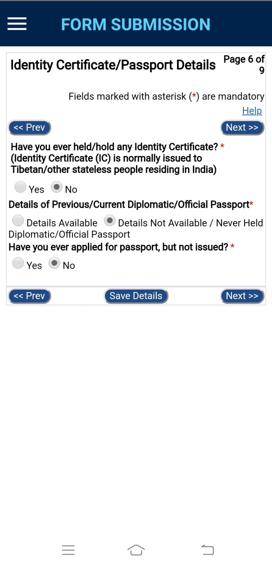

Slide 9
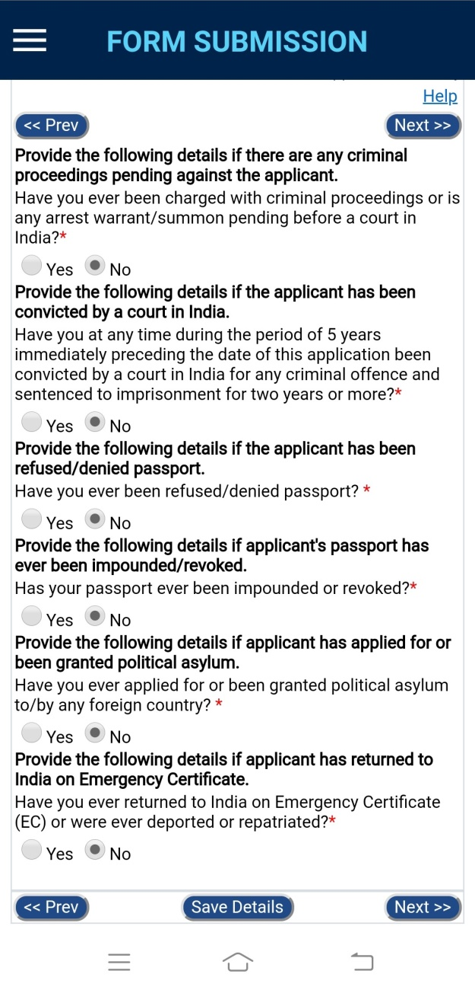
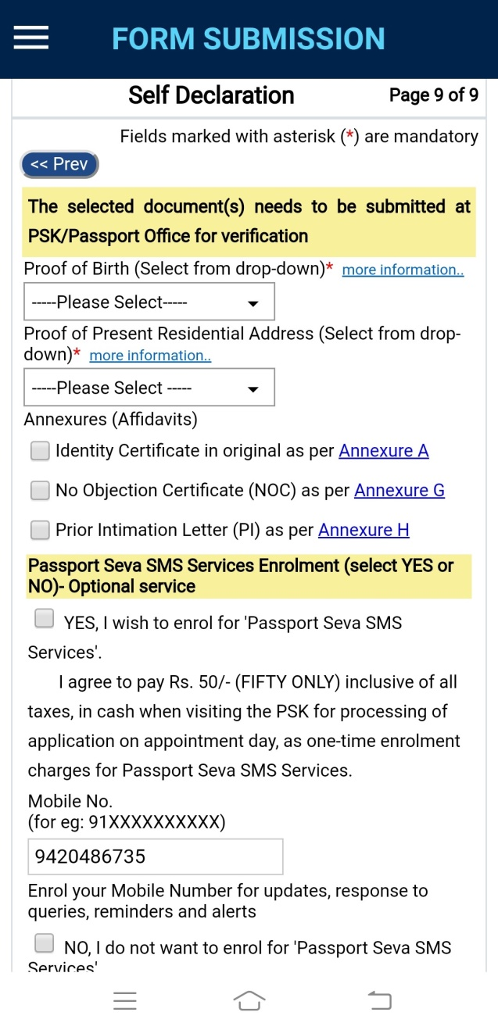

Slide 10
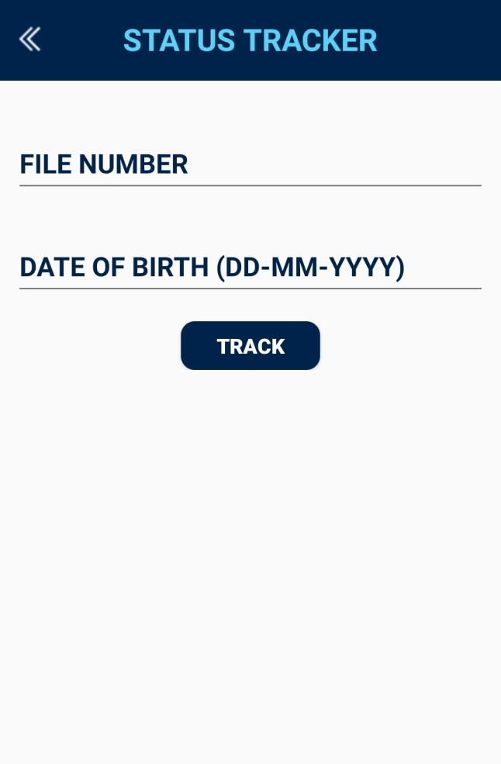
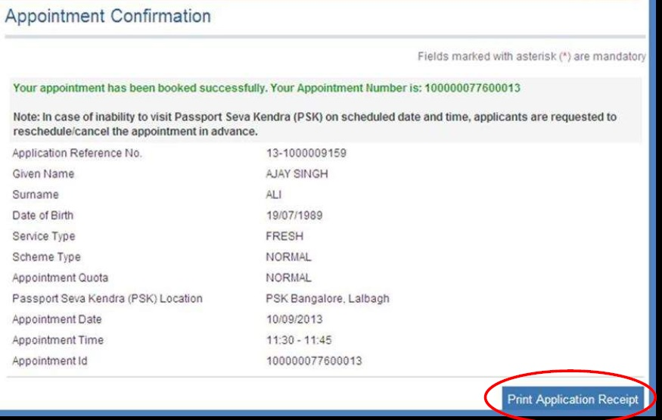

Slide 11
