Slide 1
Secure My Debit/Credit Card Physically
Presented by:-
Kishor B. Marathe
Tahsildar CPTP5

Slide 2
Scope…
Introduction
Need of discussion(Why..)
How you are duped
Prevention techniques
Grievance Redressal

Slide 3
Introduction
Definition -theft and fraud committed using or involving credit card or debit card resulting in financial losses..
Measures to Prevent-
1.Bank side measures
2.User Side measures-Topic of discussion

Slide 4
Why…
Huge Fortune:nearly 5 crore credit cards issued had a transaction worth Rs 6 lakh crore , while 80 crore debit cards registered transactions worth Rs 40 lakh crore in 2018-19.
Global Consumer Fraud Report-India ranked among the top five countries globally that are vulnerable to credit/debit card fraud
National Crime Records Bureau (NCRB)-12,317 cyber crime cases in 2016,
RBI-Over 2000 cases of fraud related to debit/credit cards, involving amount of Rs 1 lakh and above, in 2017-18
News-In October 2018- nearly 32 lakh debit cards across 19 banks, including SBI, HDFC Bank, ICICI Bank and Axis Bank, were compromised and at least 641 customers lost Rs 1.3 crore in fraudulent transaction –NPCI
Even as the RBI and banks are introducing several security features, customers need to take the initiative to prevent frauds.

Slide 5
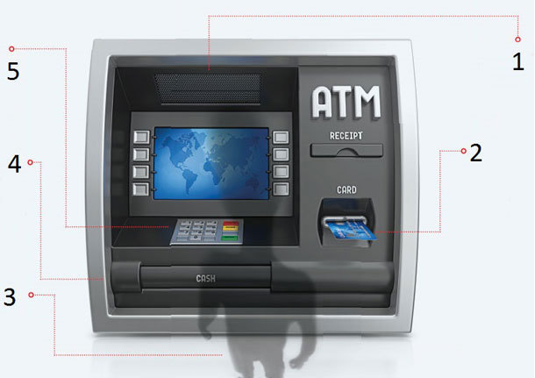
How you are duped…
Traps at the ATM..
1.Hidden Camera
2.Card Skimmer
3.Shoulder surfer
4.False front
5.Fake Keypad
Notes:
1Hidden camera Tiny, pinhole cameras may be placed on the machine or even the roof at strategic positions to capture your PIN. 2. Card skimmer These devices are installed on the card reader slot to either copy the information from the magnetic strip of your card or steal the card itself.
Bulky slot: If the slot feels slightly bulky or misaligned, in all probability an additional card reader slot has been placed on top of the actual one. *Loose slot: If the slot is wobbly or loose, it indicates the presence of a ‘Lebanese loop’, which is a small plastic device with a barb that holds your card back in the machine. You may think the machine has swallowed your card or it has been stuck.
3. Shoulder surfers These are people lurking in the ATM room or outside. They will either peer over your shoulder to read your PIN or offer help if your card is stuck.
4. False front It may be a little difficult to detect as the fake front completely covers the original machine because it is installed on top of it. This allows fraudsters to take your PIN as well as money. 5. Fake keypad This is placed on top of the actual keypad. If the keypad feels spongy to touch or loose, don’t enter your PIN.

Slide 6
Continued…
Techniques…
1.Skimming- attaching a data skimming device in the card reader slot to copy information from the magnetic strip when one swipes the card or installing camera to get pin 2.Card trapping: retains the card when you insert it in the machine and the card is retrieved later
3.Shoulder surfing: bystanders in the room or outside who try to help you if your card gets stuck or peer over your shoulder.
4.Leaving card/PIN: If you write your PIN on the card and forget it in the ATM kiosk or the machine.
5.Pharming: In this technique, fraudsters reroute you to a fake website that seems similar to the original. So even as you conduct transactions and make payment via credit or debit card, the card details can be stolen.
6.Keystroke logging: Here, you unintentionally download a software, which allows the fraudster to trace your key strokes and steal passwords or credit card debit card details.

Slide 7
Continued…
7.Public Wi-Fi-
Public Wi-Fi makes for a good hacking opportunity for thieves to steal your card details.
8.Merchant or point-of-sale theft-
your card is taken by the salesperson for swiping and the information from the magnetic strip is copied to be used later for illegal transactions.
9.Phishing & vishing- While phishing involves identity theft through spam mails which seem to be from a genuine source, vishing is essentially the same through a mobile phone using messages or SMS. These trick you into revealing your password, PIN or account number.
10.SIM swipe fraud- Here the fraudster contacts your mobile operator with fake identity proof and gets a duplicate SIM card.
The operator deactivates your original SIM and the thief generates one-time password (OTP) on the
phone to conduct online transactions.
11.Cards using other documents- This is also an easy form of identity theft, where new cards are made by the fraudster using personal
information that is stolen from application forms or other lost or discarded documents.

Slide 8
Prevention
ATM safeguards-Check machine
Cover keypad- Make sure to cover the keypad with your hand while entering the PIN to escape any cameras attached nearby.
Don’t take help
Use safe sites- Go only to well-known, established sites for e-shopping. Confirm the site’s legitimacy before using it and shop only on those that are Secure Sockets Layer (SSL)-certified. These can be identified through the lock symbol next to the browser’s URL box.
Anti-virus software
No public wifi
Hide CVV
Register for alerts
Log out
Change passwords
Don’t disclose details
Check statements
Merchants & POS- At shops or petrol pumps, make sure that the card is not taken by the salesperson to a remote location where you cannot see it as the card information can be easily copied and stolen. Also, try shopping with retailers that use chip-enabled card readers.

Slide 9
Grievance Redressal…
WHAT TO DO IF CHEATED In case of card identity theft or a fraudulent offline or online transaction, report the loss immediately to the bank or card provider and have the card blocked. For this, make sure that you have the customer care number of your bank handy. Follow it up with a letter or e-mail. It is also advisable to lodge an FIR at the earliest. If the bank does not respond within a week, approach the nodal officer. If there is no response from the bank within 30 days, contact the banking ombudsman appointed by the RBI .

