Slide 1
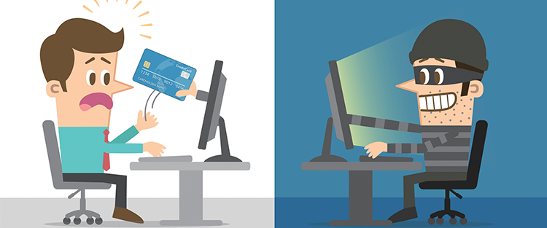
Cyber Security : Identify Fraud
Submitted by
-Nilesh Mahajan
ACST
Class - D Roll NO.-28

Slide 2
Online Fraud
Online fraud and scams operate under many different disguises and go by many names, including consumer cybercrime, internet fraud, online crime, and e-crime.
No matter what it’s called, it causes considerable distress to everyone it affects, and it can even culminate in serious financial problems, as some victims have discovered.
Using false pretenses.
Pretending to be someone or something you’re not.
Creating a counterfeit item or service.

Slide 3
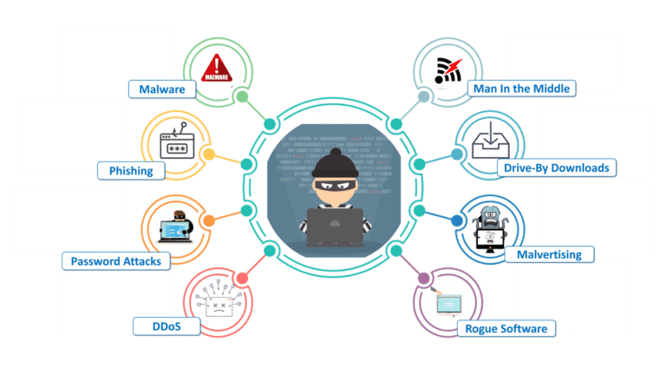
Types Of Online Fraud
Phishing
419 Scam (“Nigerian Scam”)
Identity Theft
Debit & Credit Card Fraud
Online Shopping Fraud
Social Media Fraud
Government Documents Fraud
Check Fraud
Overpayment Scam
Pump-and-Dump

Slide 5
Identifying Security Compromises
Antivirus software detects a problem.
Disk space disappears unexpectedly.
Pop-ups suddenly appear, sometimes selling security software.
Files or transactions appear that should not be there.
The computer slows down to a crawl.
Unusual messages, sounds, or displays on your monitor.
Stolen laptop: 1 stolen every 53 seconds; 97% never recovered.
The mouse pointer moves by itself.
The computer spontaneously shuts down or reboots.
Often unrecognized or ignored problems.

Slide 6
Anti-virus and Anti-spyware Software
Antivirus software detects certain types of malware and can destroy it before any damage is done.
Install and maintain antivirus and antispyware software.
Be sure to keep antivirus software updated.
Many free and commercial options exist.
Contact your Technology Support
Professional for assistance.

Slide 7
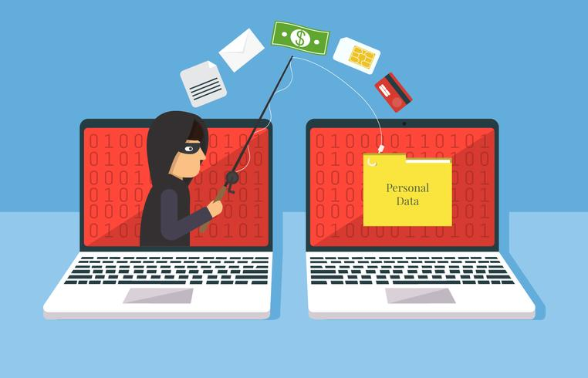
Host-based Firewalls
A firewall acts as a barrier between your computer/private network and the internet. Hackers may use the internet to find, use, and install applications on your computer. A firewall prevents many hacker connections to your computer.
Firewalls filter network packets that enter or leave your computer.

Slide 8
Do’s And Don’t To Avoid Fraud
Protect your personal data.
Keep your passwords secure and change them regularly.
Check your credit report at least annually, if not every 4 months.
Take immediate action if you think your personal information has been compromised.
Be aware of onlookers when using your credit/debit card and entering your PIN number.
Shred personal documents – do not just toss them in the trash.
Password protect all documents your send over the internet.
Monitor your financial accounts for suspicious activity on a regular basis – this includes bank accounts, credit cards and investments.

Slide 9
Provide personal information over the phone or internet unless you initiate the contact – Don’t talk to a stranger.
Toss documents with your personal information in the trash, this includes offers to open a new credit card account.
Share your personal data or leave it unprotected.
Access online banking from shared or public computers.
Click on attachments and links without knowing their true origin.

Slide 10
Thank You

