Slide 1
Manage and maintain strong passwords
By MADHURI TIKHE (Dy. Collector)
Class C

Slide 2
index
Why Password
Elements of strong Password
Password Types
Password Math
HTTP or HTTPS

Slide 3
Why passwords?

Slide 4
Why passwords?
Passwords allow us to feel safe using digital technology to do things that only we should be able to do: signing into our computers and sending email, for example, or encrypting sensitive data.

Slide 5
ELEMENTS OF A STRONG PASSWORD
Make it long
Notes:
Make it long: The longer a password is, the less likely it is that a computer program will be able to guess it in a reasonable amount of time. Some people use passphrases that contain several words, with or without spaces between them. Passphrases are a great idea for services that allow long passwords.
Hence, the recommendation to use passphrases instead of passwords by IT experts just came at the right time to soothe everyone from the hangover of the password disaster phenomenon.

Slide 6
ELEMENTS OF A STRONG PASSWORD
Make it long – Use Passphrases instead of Password
Password – P@ssw0rd
Passphrases - The road to success is always under construction!
Notes:
Make it long: The longer a password is, the less likely it is that a computer program will be able to guess it in a reasonable amount of time. Some people use passphrases that contain several words, with or without spaces between them. Passphrases are a great idea for services that allow long passwords.
Hence, the recommendation to use passphrases instead of passwords by IT experts just came at the right time to soothe everyone from the hangover of the password disaster phenomenon.

Slide 7
ELEMENTS OF A STRONG PASSWORD
Make it long
Make it complex
Notes:
Make it complex: In addition to length, the complexity of a password also helps prevent automatic 'password cracking' software from guessing the right combination of characters. Where possible, you should include upper case letters, lower case letters, numbers and symbols in your password. See the Password math section below for more about this.

Slide 8
ELEMENTS OF A STRONG PASSWORD
Make it long
Make it complex
Don't make it personal
Notes:
Don't make it personal: Your password should not be related to you personally. Don't choose a word or phrase based on information such as your name, date of birth, telephone number, child's name, pet's name, or anything else that a person could learn by doing a little research about you. It is also a good idea to provide fake answers to the "security questions" that some services use to verify your identity if you forget your password. This prevents others from impersonating you by looking up your personal information online. Secure password managers are useful for recording these fake answers.

Slide 9
ELEMENTS OF A STRONG PASSWORD
Make it long
Make it complex
Don't make it personal
Keep it secret
Notes:
Keep it secret: Do not share your password with others unless you absolutely have to. If you must share a password with a friend, family member or colleague, you should first change it to something temporary and share that one, then change it again when they are done using it. Often, there are alternatives to sharing a password, such as creating a separate account for each individual who needs access. Keeping your password secret also means paying attention to who might be reading over your shoulder while you type it in.

Slide 10
ELEMENTS OF A STRONG PASSWORD
Make it long
Make it complex
Don't make it personal
Keep it secret
Make it unique
Notes:
Make it unique: Avoid using the same password for more than one account. Otherwise, anyone who learns that password will gain access to additional services and the information they contain. For similar reasons, it is a bad idea to rotate passwords by swapping them around between different accounts. Uniqueness is particularly important these days, as more and more websites are being compromised and having their password databases exposed online.

Slide 11
ELEMENTS OF A STRONG PASSWORD
Make it long
Make it complex
Don't make it personal
Keep it secret
Make it unique
Keep it fresh
Notes:
Keep it fresh: Change your important passwords occasionally. The longer you keep one password, the more opportunity others have to figure it out.

Slide 12
ELEMENTS OF A STRONG PASSWORD
Make it long
Make it complex
Don't make it personal
Keep it secret
Make it unique
Keep it fresh
Do not use automatic logon functionality
Notes:
Do not use automatic logon functionality: Using automatic logon functionality negates much of the value of using a password. If a malicious user is able to gain physical access to a system that has automatic logon configured, he or she will be able to take control of the system and access potentially sensitive information.

Slide 13
ELEMENTS OF A STRONG PASSWORD
Make it long
Make it complex
Don't make it personal
Keep it secret
Make it unique
Keep it fresh
Do not use automatic logon functionality
Incognito mode

Slide 14
Password types
1 step verification
Multi-factor authentication or two-factor authentication (MFA, 2FA).
Notes:
Methods to add verification for protecting account data, traditionally in addition to a password.
OTP One-time password (sometimes one-time PIN). A single-use code often used in 2FA verification.
A note on using text messages for two factor authentication. If a service supports both text- and app-based two factor authentication codes, you should opt for the latter. SMS text messages are not encrypted, and attackers have successfully intercepted these one-time codes on their way to a target's phone.

Slide 15
PASSWORD MATH

Slide 16
PASSWORD MATH
Many strong passwords include different types of characters such as upper case letters, numbers and symbols. This increases the "search space" of possible combinations that must be tested by brute force attacks that try guess every possible password until they find one that works. You can expand that search space by increasing the length of the password and by using different types of characters.
Notes:
A brute force attack is a trial-and-error method used to obtain information such as a user password or personal identification number (PIN). In a brute force attack, automated software is used to generate a large number of consecutive guesses as to the value of the desired data. Brute force attacks may be used by criminals to crack encrypted data, or by security analysts to test an organization's network security.
A brute force attack is also known as brute force cracking or simply brute force.

Slide 17
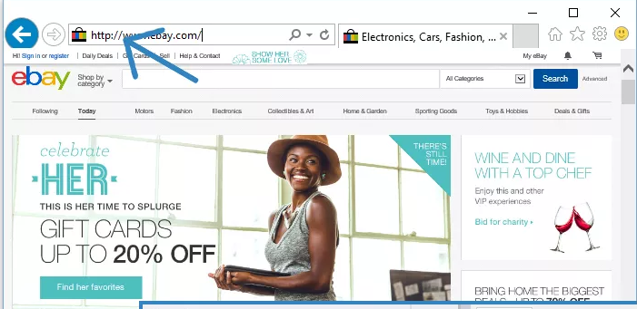
Use https instead of http
Notes:
HTTP stands for Hypertext Transfer Protocol. When you enter http:// in your address bar in front of the domain, it tells the browser to connect over HTTP. HTTP uses TCP (Transmission Control Protocol), generally over port 80, to send and receive data packets over the web. To put it simply it is a protocol that’s used by a client and server which allows you to communicate with other websites. The client sends a request message to an HTTP server (after the TCP handshake) which hosts a website, the server then replies with the response message.
What is HTTPS?
HTTPS is a short abbreviation of Hyper Text Transfer Protocol Secure. It is highly advanced and secure version of HTTP. It uses the port no. 443 for Data Communication. It allows the secure transactions by encrypting the entire communication with SSL. It is a combination of SSL/TLS protocol and HTTP. It provides encrypted and secure identification of a network server.
HTTP also allows you to create a secure encrypted connection between the server and the browser. It offers the bi-directional security of Data. This helps you to protect potentially sensitive information from being stolen.
In HTTPS protocol SSL transactions are negotiated with the help of key-based encryption algorithm. This key is generally either 40 or 128 bits in strength.
SSL – Secure Sockets Layer

Slide 18
Thank you

