Slide 1
PRESENTATION ON SHARE INFORMATION USING SLIDE -SHARE
By Sweeti Yadav Lonare
ACST

Slide 2
What Is Slide-Share ?
Slide-Share is a community for sharing presentations.
Individuals or organizations can upload and share PowerPoint, PDF, or Open Office presentations.
Anyone can find presentations on their topic of interest.
Users can tag presentation, and download or embed them into their own websites or blogs.
Users can also share their documents privately.
Contd….

Slide 3
Slide-Share lets its users to join groups to connect with Slide- Share members who share similar interests.
Business presentations make the most of the content.
Slide-Share also has a facebook application for uploading documents.

Slide 4
Find presentations on any topic
Download SlideShares
use for research, business & more

Slide 5
Get Inspired
by awesome SlideShares
Follow industry experts
and inspirational speakers
Follow what your friends
and colleagues are sharing

Slide 6
How do you share Power-point on Slide-Share ?
Open SlideShare.net in your web browser.
Click “Login” and sign in to Slide-Share.
Click the orange “Upload” button.
Click “Select files to upload.”
Double-click the file you want to upload.
Type the name of your presentation in the “Title” field.
Choose your Privacy settings.

Slide 7
On slideshare we can upload as well as download the Powerpoint Presentation(PPT).
Thus we get the ready access to PPT.
TYPE slideshare.com and then go...

Slide 8
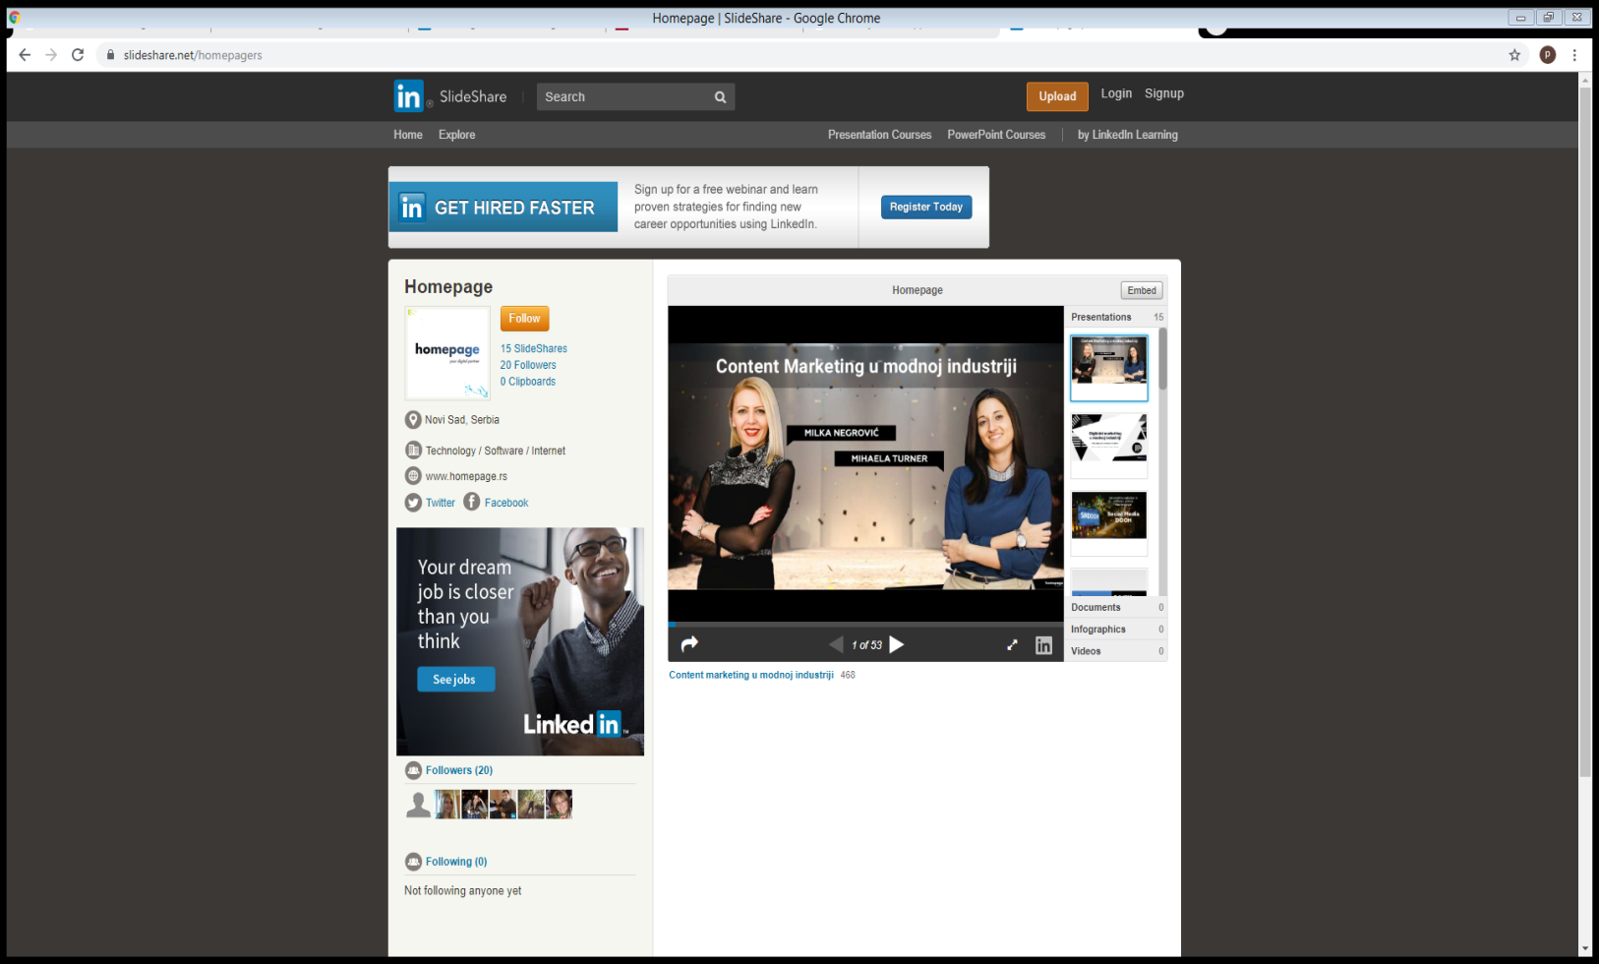
Look of slide-share browser

Slide 9
What to do if you don’t have LinkedIn account
Copy the link
Go to Simply-debrid.com/generate
Paste the copied link
And press generate links button
PDF version of PPT will be generated

Slide 10
By Sweeti Yadav Lonare

