Slide 1
What are Netiquettes?
By
Lingalod Laxman Ramkishan
MFAS
CPTP 5 – D12

Slide 2
Objectives
Introduction to netiquettes
Ten rules of netiquettes
Types of netiquettes
Importance of netiquettes

Slide 3
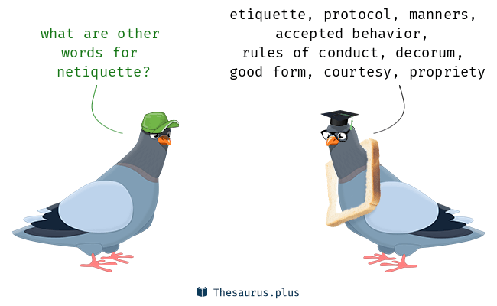
Netiquettes
Netiquette – internet + etiquette
The Do’s and Don’ts of online communication
It is a set of rules for behaving properly online
The practice of netiquettes depends on how Email, chatting or other aspects of the internet actually work or are practiced

Slide 4
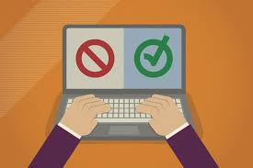
Rules of Netiquettes
Rule No. 1: Respect other people’s privacy
Do not read other people’s mail without their permission
Not respecting other people’s privacy is bad Netiquette
Rule No.2: Adhere to the same standards online that you follow in real life
You need to remember that you can get caught doing things you should not be doing online just like you can in real life
You are still talking to a real person with feelings even though you can’t see them
Rule no. 3: Know where you are in cyberspace
Always take a look around when you enter a new domain when surfing the web
Get a sense of what the discussion group is about before you join it

Slide 5
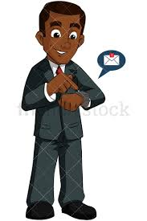
Rules of Netiquettes
Rule no.4: Respect other people’s time and bandwidth
Remember people have other things to do besides read your email. You are not the center of their world.
Keep your post and emails to a minimum by saying what you want to say
Rule No. 5: Make yourself look good online
Remember to always check your spelling and grammar before posting
Always know what you are talking about and make sense saying it
Rule No. 6: Remember the Human
You need to remember that you are talking to a real person when you are online
The internet brings people together who would otherwise never meet

Slide 6
Rules of Netiquettes
Rule no. 7: Share expert knowledge
Share what you know online.
Ask questions online
Post the answers to your questions online because someone may have the same question you do
Rule No. 8: Help keep flame wars under control
Netiquette does not forbid flaming
Netiquette does however forbid people who are flaming to hurt discussion groups by putting the group down
Rule No. 9: Don’t abuse your power
Do not take advantage of other people just because you have more knowledge or power than them
Treat others as you would want them to treat you if the roles were reversed

Slide 7
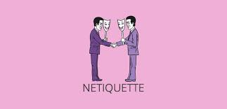
Rules of Netiquettes
Rule no. 10: Be forgiving of other people’s mistakes
Do not point out mistakes to people online.
Remember that you were once the new kid on the block
You still need to have good manners even though you are online and can not see the person face to face

Slide 8
Types of Netiquettes
Netiquette basic
Netiquette of sending
Netiquette of replying
Netiquette of confidentiality

Slide 9
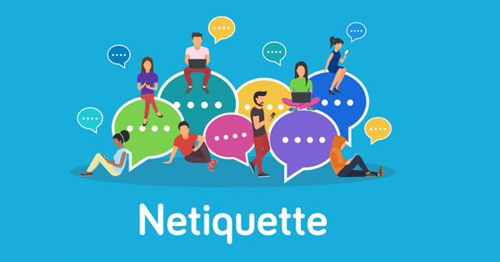
Importance of Netiquettes
Keep it short
Avoid using ALL CAPS
Use your judgement with attachments
Be careful what you say
Pay attention to formatting

Slide 10
Thank You!

