Slide 1
TOPIC
USE OF GOOGLE KEEP FOR ORGANISING A DAY/NOTES/IMPORTANT POINTS
BY
LALITA SHIVAJI BABAR

Slide 2
WHAT IT OFFERS……
Check list
Reminders
Voice notes
Image notes

Slide 3
WHY GOOGLE KEEP……..
A colourful, pinboard-style interface makes for seamless idea-gathering, list-making and note-scanning
Access your notes on all your devices- they will be sync across your phone, tablet, laptop and smart watch
Dictate thoughts and Keep will add both the audio clip and transcription to your note

Slide 4

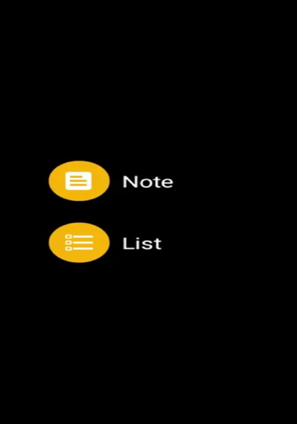
It LOOKS….

Slide 5
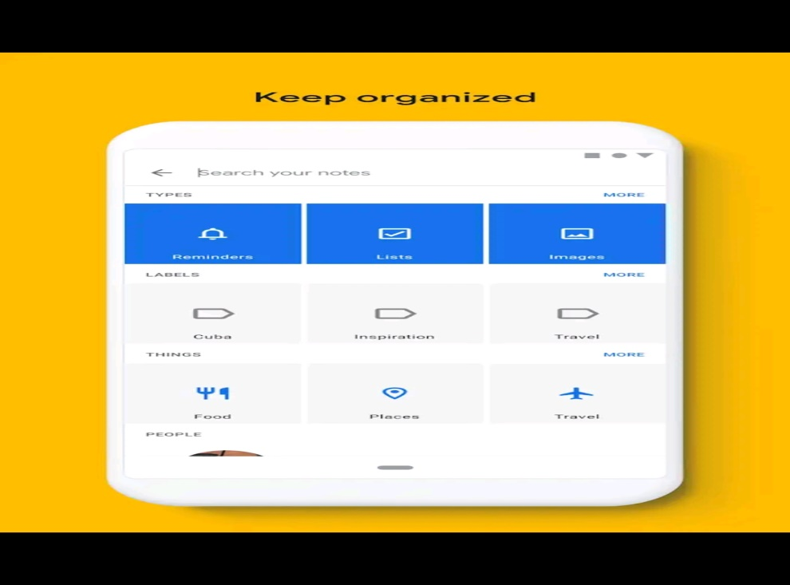

Slide 6
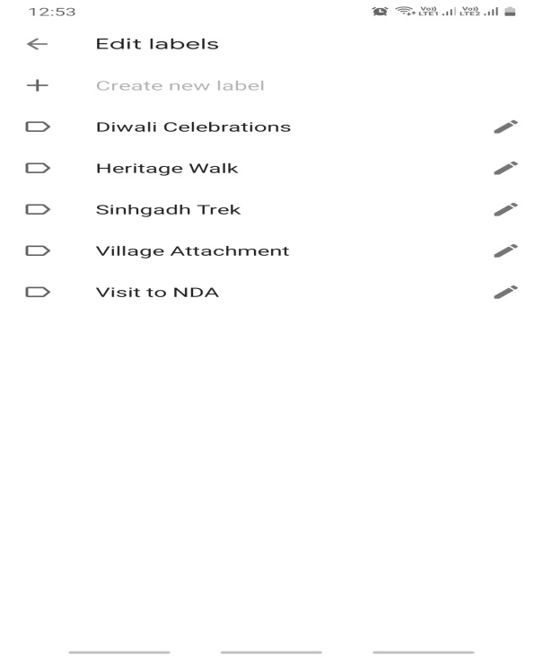
HOW DO YOU ORGANISE….

Slide 7
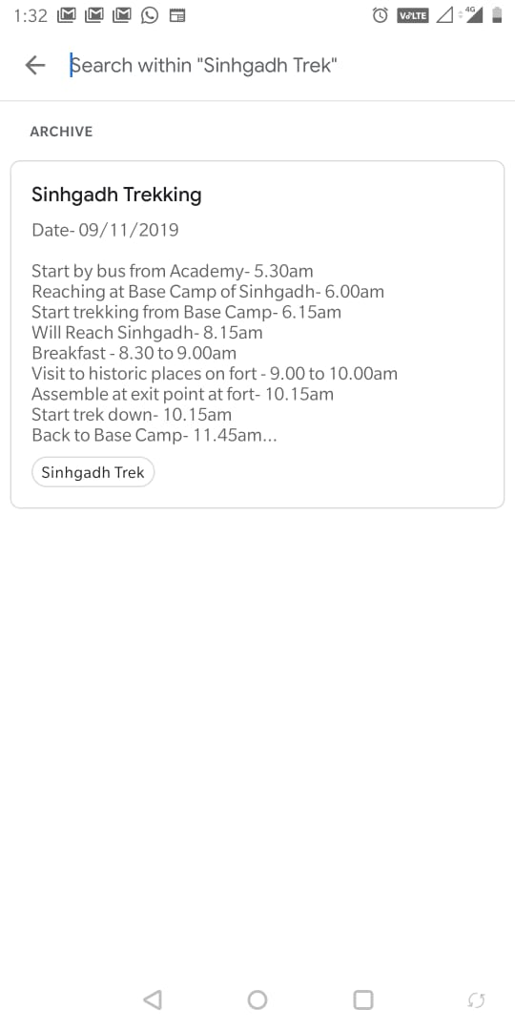
Sinhgadh trek

Slide 8
THANK YOU

