Slide 1
Crime and Criminal Tracking Network and Systems
PREPARED BY:
SUJEETKUMAR ANNA KSHIRSAGAR
DYSP/ACP
CPTP5
CIT ASSIGNMENT

Slide 2
INTRODUCTION
A Central Mission Mode Project under National e-Governance Plan(NeGP) covering all 28 States and 7 Uts.
The project aims at Policing to Next Level - Control of Crime and Criminal(Prevention and Detection) by sharing information all over India(24x7).
Aims at connecting all 20,000 Police Offices in India and 35 SCRB and NCRB.
The project would involve a roll out, all components bundled together, application software (customization), hardware, networking etc.
Fully funded program of the Government of India with a provision of Rs. 2000 Crores in the 11th five year plan.

Slide 3
Stake Holders
Ministery of Home Affairs
NCRB & SCRB
Police Dept in States/UTs
Cititzen and Citizen Groups
External Agencies like Jail, Judiciory, Emigration
Motor vehicles, etc.

Slide 4
OBJECTIVE OF CCTNS
Provide access to information for Investigation, Crime Prevention, Maintenance of Law & Order, Traffic Management etc.
Increase Operational Efficiency of End-User i.e. Police & Citizen.
Create a platform for sharing crime & Criminal information across India.
Improved service delivery to the public/ citizen.

Slide 5
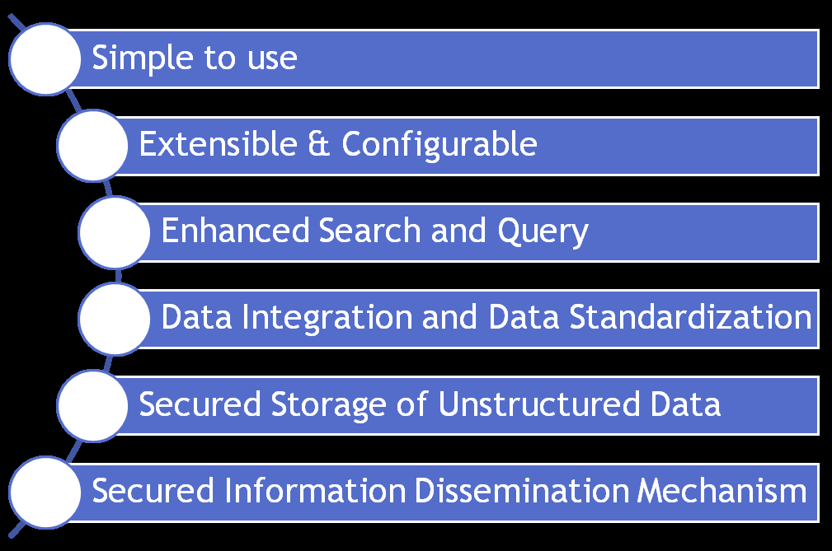
CORE APPLICATION SOFTWARE(CAS) FEATURES

Slide 6
CAS SCREEN SHOT

Slide 7
KEY ISSUES(CHALLENGES)
Reliable and seamless connectivity( Connectivity is the main area of concern for which the success of the project depends)
Data Security Implementation in Phased Manner State Data Centre (SDC) not yet in place.
Lack of knowledge of computer among police personnel Lack of resources(To initiate Budget provisions by State Govt.)
Data Digitization( Data digitization works depends on release of Excel sheet and Data Migration Utility software by MHA to the State).
Customization of CAS- can only start once CAS is released to the state.
Delay in release of CAS will delay the Project.
Change Management

Slide 8
Benefits of CCTNS Project
Multi-lingual support
Sharing of information across Police Stations / Districts / States
Secured storage
Data integration, data standardization
Enhanced search and query
Easy navigation and user friendliness

Slide 9
Benefits to Citizens: (Police to Citizen Services)
Citizens can register/track complaints online
Easy reporting of incidents (Citizen’s Tip)
Provision to download various forms
Multiple channels for interation with Police (Citizen’s Feedback)
Informaiton related to ‘Missing person’, ‘Wanted criminals’, ‘Unidentified dead bodies’ etc. is easily available (Citizen’s Information)
Citizen can avail a multitude of services such apply for Tenenat verification, Event / Performance request etc. once they log into the system

Slide 10
Benefits to Police Personnel: (Police to Police Services)
Simplified record keeping and management, real time report generation
Digitization of legacy data would ensure that past criminal records can be searched
Analysis of real time crime and criminal information
Integration of Forensic Lab, Fingerprint Brureau, PCR , Police Station
Interface with external agencies : Courts, Jails, Transport, Passport etc for timely access and flow of relevant information
Reduce dependency on manual registers / records enabling IOs to focus on investigation
Elimination of duplicate and inconsistent record

Slide 11
Benefits to Government: (Police to Government Services)
Information is avalaible from across India in the same format. This promotes trend analysis as well as helps is monitoring crime rates.
Information sharing helps in establishing a tighter net and nabbing criminals across the country.
Gives government more visibility into crimes occurring at State level and helps bring the entire police force together.

Slide 12
THANK YOU !

