Slide 1
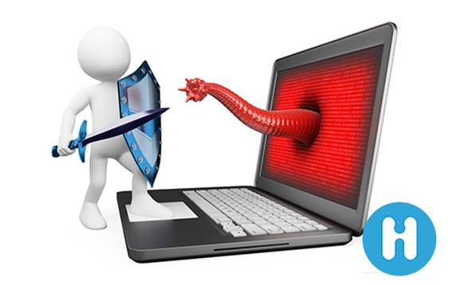
Protect computer from viruses
PRAVEEN I. KOSE
CLASS A
ACST
CPTP 5

Slide 2
CONTENT
What is virus?
How harmful it is for your computer?
Types of virus
Ways to remove it
How Antivirus remove virus
Top 10 Antivirus software
Conclusion

Slide 3
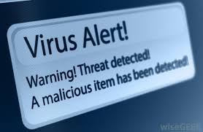
What is virus?
A virus is a malicious program, which replicate itself within files and folders or from one computer to another via any shared service, while windows is running.

Slide 4
How does virus get into your p.c.
A virus can enter your system via number of means:
Through Email attachments
Drive through downloads by installing and running infected programs
Via external devices such as CD/DVDs, USB drives, flash drive etc
Through LAN where one or more computer is infected
By clicking on malicious links

Slide 5
What can virus do?
Can damage files
Can slow system
Can steal information
Can take control

Slide 6
Types of viruses
Boot Sector Viruses
Master Boot Record ( MBR) Virus
Memory Resident Virus
Macro Virus
Polymorphic Virus
Direct Virus

Slide 7
How to avoid getting it on your pc?
Some viruses are extremely difficult to detect and remove, hence it is better to take precaution than to wait for the cure. Here are some tips to follow:
Browse internet safely
Download only from trusted websites
Never click on anything suspicious
Beware of spam mails
Update windows regularly
Implement Firewall
Install a good Antivirus Software

Slide 8
How to remove viruses from pc
Removing a virus manually is a very sophisticated task and doing this may cause more damage to the PC. Therefore, it is advisable to install a good quality Antivirus software
Antivirus software helps in deleting those speed depleting, performance draining, harmful threats and protects your system’s privacy.

Slide 9
Top antivirus software
Kaspersky Antivirus
McAfee Antivirus
Norton Antivirus plus
Trend micro titanium Antivirus plus
Paretologic Antivirus plus
Panda antivirus pro
Directory virus

Slide 10
How does antivirus software work?
Some of the common techniques used by antivirus to detect the presence of virus on a system :
Use SIGNATURE BASED DETECTION techniques to match infected- file signature with the existing database and take the proprietary action if a match is found
Offers REAL TIME PROTECTION by scanning each and every program , files etc, you download or open
Performs HEURISTIC Scan to identify unknown threats

Slide 11
conclusion
Antivirus software will constantly monitor the network and safeguard your computer against vulnerable activity caused by the suspicious program.
The software examines each and every file thoroughly and removes any detected potential threat.
We can choose from the various Antivirus softwares which are available online.

Slide 12
Praveen i. kose

