Slide 1
PRESENTATION ON SEARCHING SYNONYMS ANTONYMS AND THEASURS ON DICTIONARY.COM
Name –Tejashree Balasaheb Kore

Slide 2
USING THE DICTIONARY

Slide 4
The ability to “read” a dictionary entry will help increase your command of the English language and will enable you to be more precise in your speech and writing.

Slide 5
A good dictionary …
Is a very important tool in enhancing word power.
Develops your reading and comprehension skills.
Orients you with origins of words.
Aids in pronunciation and spelling.

Slide 6
Online Dictionaries
YourDictionary
Dictionary.com
Merriam-Webster
Merriam-Webster Visual
OneLook
Milon
Morfix
Milon: English Hebrew Dictionary

Slide 7
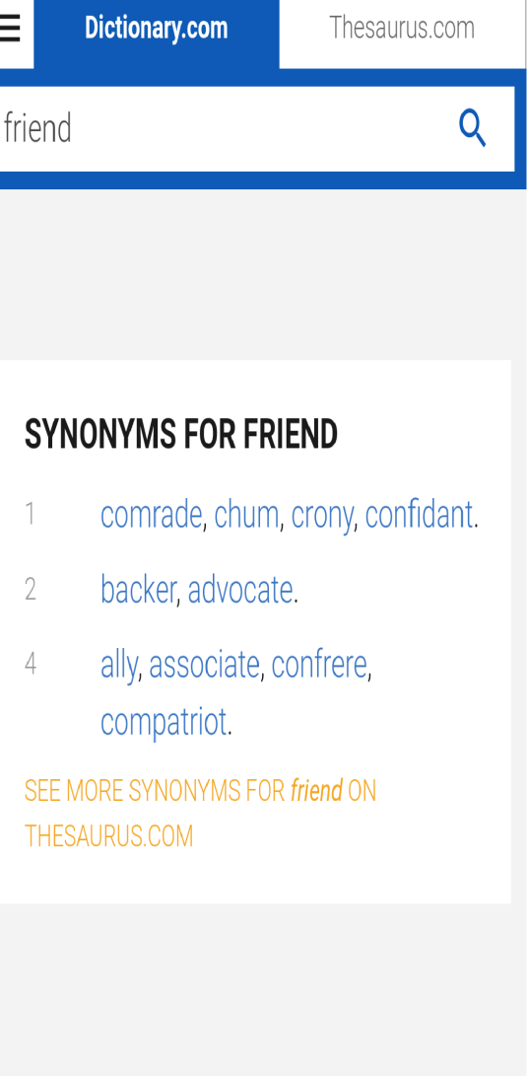
How to find synonyms :

Slide 8
Antonyms at dictionary.com

Slide 9
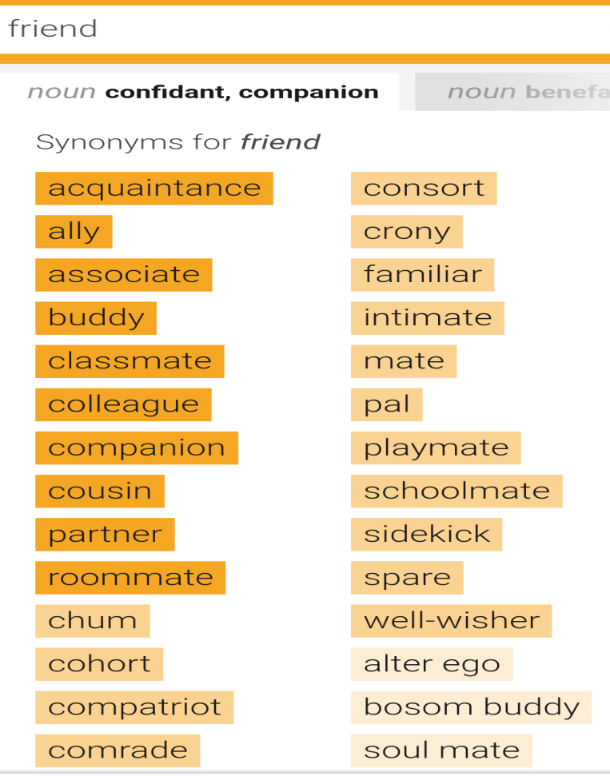
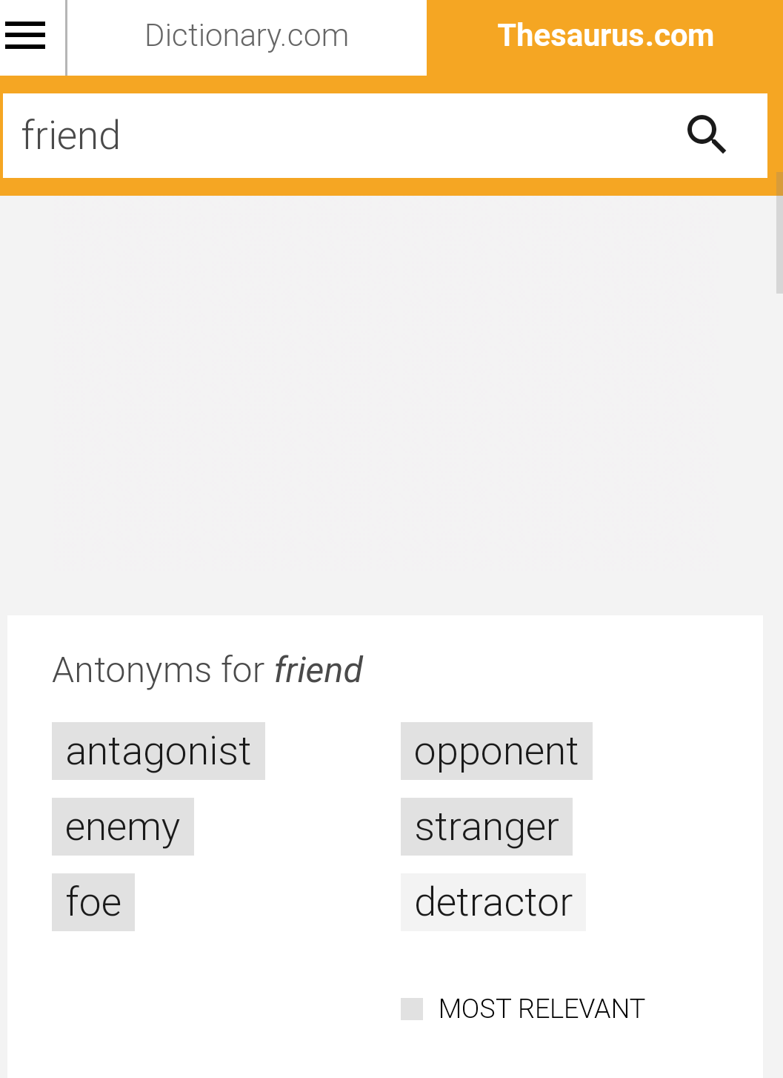
Synonyms and antonyms at thesaurus.com

